Slide 1
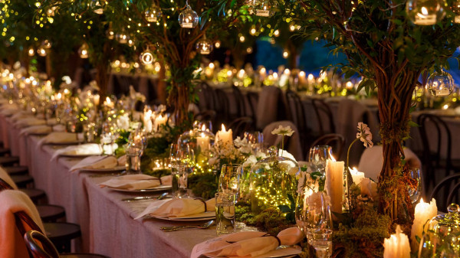
The Parable
of the
Wedding Banquet
Matthew 22:1-14

Slide 2
Matthew 22
1 Jesus spoke to them again in parables, saying: 2 "The kingdom of heaven is like a king who prepared a wedding banquet for his son. 3 He sent his servants to those who had been invited to the banquet to tell them to come, but they refused to come. 4 "Then he sent some more servants and said, 'Tell those who have been invited that I have prepared my dinner: My oxen and fattened cattle have been butchered, and everything is ready. Come to the wedding banquet.' 5 "But they paid no attention and went off--one to his field, another to his business. 6 The rest seized his servants, mistreated them and killed them. 7 The king was enraged. He sent his army and destroyed those murderers and burned their city.

Slide 3
Matthew 22
8 "Then he said to his servants, 'The wedding banquet is ready, but those I invited did not deserve to come. 9 Go to the street corners and invite to the banquet anyone you find.' 10 So the servants went out into the streets and gathered all the people they could find, both good and bad, and the wedding hall was filled with guests. 11 "But when the king came in to see the guests, he noticed a man there who was not wearing wedding clothes. 12 'Friend,' he asked, 'how did you get in here without wedding clothes?' The man was speechless. 13 "Then the king told the attendants, 'Tie him hand and foot, and throw him outside, into the darkness, where there will be weeping and gnashing of teeth.' 14 "For many are invited, but few are chosen."

Slide 5
Matthew 22
1 Jesus spoke to them again in parables, saying: 2 "The kingdom of heaven is like a king who prepared a wedding banquet for his son. 3 He sent his servants to those who had been invited to the banquet to tell them to come, but they refused to come. 4 "Then he sent some more servants and said, 'Tell those who have been invited that I have prepared my dinner: My oxen and fattened cattle have been butchered, and everything is ready. Come to the wedding banquet.' 5 "But they paid no attention and went off--one to his field, another to his business. 6 The rest seized his servants, mistreated them and killed them. 7 The king was enraged. He sent his army and destroyed those murderers and burned their city.

Slide 6
Matthew 22
1 Jesus spoke to them again in parables, saying: 2 "The kingdom of heaven is like a king who prepared a wedding banquet for his son. 3 He sent his servants to those who had been invited to the banquet to tell them to come, but they refused to come. 4 "Then he sent some more servants and said, 'Tell those who have been invited that I have prepared my dinner: My oxen and fattened cattle have been butchered, and everything is ready. Come to the wedding banquet.' 5 "But they paid no attention and went off--one to his field, another to his business. 6 The rest seized his servants, mistreated them and killed them. 7 The king was enraged. He sent his army and destroyed those murderers and burned their city.

Slide 7
Matthew 22
8 "Then he said to his servants, 'The wedding banquet is ready, but those I invited did not deserve to come. 9 Go to the street corners and invite to the banquet anyone you find.' 10 So the servants went out into the streets and gathered all the people they could find, both good and bad, and the wedding hall was filled with guests. 11 "But when the king came in to see the guests, he noticed a man there who was not wearing wedding clothes. 12 'Friend,' he asked, 'how did you get in here without wedding clothes?' The man was speechless. 13 "Then the king told the attendants, 'Tie him hand and foot, and throw him outside, into the darkness, where there will be weeping and gnashing of teeth.' 14 "For many are invited, but few are chosen."

Slide 8
"On the one hand, Christianity is the most exclusive religion imaginable. It insists that belief in Jesus Christ is absolutely necessary for salvation. Jesus is the only way. You must go to Him to get eternal life. On the other hand, Christianity is the most inclusive religion possible because it makes salvation accessible to everyone. Salvation is offered for all people through one Person. Whoever believes in Him will not perish. Anyone who receives or believes in Jesus will live forever with God. There are no racial, social, intellectual, or economic criteria that prevent anyone from joining God’s family. One of the problems with the other religions of the world is that they all smack of elitism… Only Christianity offers salvation to everyone as a free gift."
Philip Ryken, Is Jesus the Only Way?

Slide 9
“There’s plenty good room, plenty good room,
Plenty good room in my Father's kingdom,
There’s plenty good room, plenty good room,
Just choose your seat and sit down.”

Slide 10
Matthew 22
8 "Then he said to his servants, 'The wedding banquet is ready, but those I invited did not deserve to come. 9 Go to the street corners and invite to the banquet anyone you find.' 10 So the servants went out into the streets and gathered all the people they could find, both good and bad, and the wedding hall was filled with guests. 11 "But when the king came in to see the guests, he noticed a man there who was not wearing wedding clothes. 12 'Friend,' he asked, 'how did you get in here without wedding clothes?' The man was speechless. 13 "Then the king told the attendants, 'Tie him hand and foot, and throw him outside, into the darkness, where there will be weeping and gnashing of teeth.' 14 "For many are invited, but few are chosen."

Slide 12
1. What will you do with your invitation?

Slide 13
“Many people visualize a God who sits comfortably on a distant throne, remote, aloof, uninterested, and indifferent to the needs of mortals, until, it may be, they can badger him into taking action on their behalf. Such a view is wholly false. The Bible reveals a God who, long before it even occurs to man to turn to him, while man is still lost in darkness and sunk in sin, takes the initiative, rises from his throne, lays aside his glory, and stoops to seek until he finds him.”
John Stott
Basic Christianity

Slide 14
1. What will you do with your invitation?

Slide 15
2. Will you pass on the invitation, including to “the least of these”?

Slide 16
3. Will you live in joyful anticipation of the Great Banquet?

