Slide 1
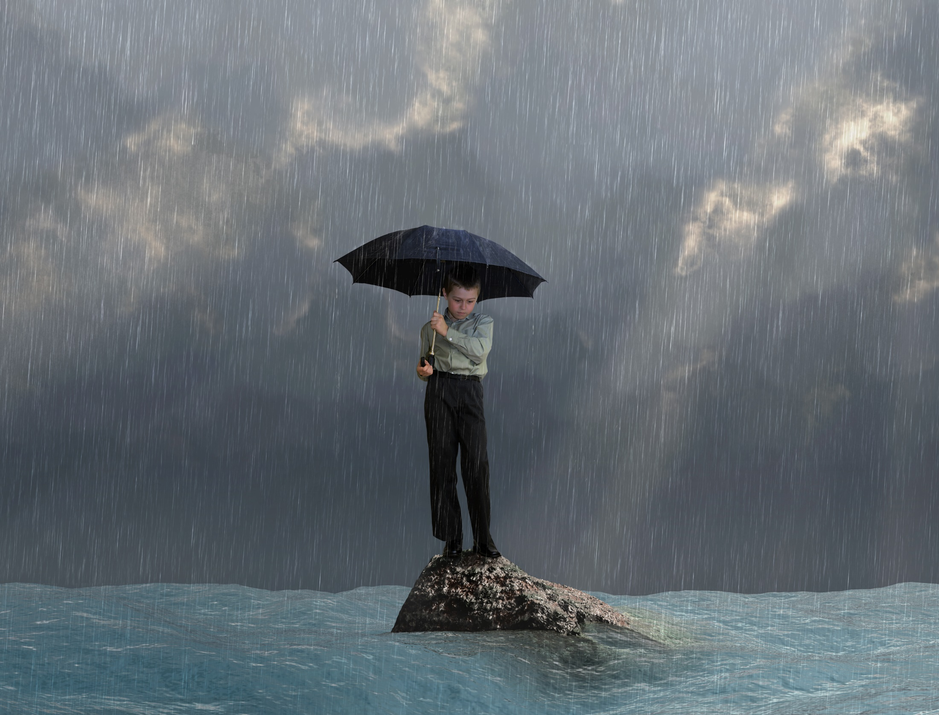
Remaining Faithful and Joyful in Battle

Slide 2
Remaining Faithful and Joyful in Battle
I. We must work to accept and embrace our status as “aliens & strangers.”

Slide 3
Remaining Faithful and Joyful in Battle
I. We must work to accept and embrace our status as “aliens & strangers.”
2 Peter 2:7-8, “…Lot, a righteous man, who was distressed by the filthy lives of lawless men (for that righteous man, living among them day after day, was tormented in his righteous soul by the lawless deeds he saw and heard)…”

Slide 4
Remaining Faithful and Joyful in Battle
II. We must be willing to accept the relentless, prolonged, and often disappointing nature of the struggle to which we have been called.

Slide 5
Remaining Faithful and Joyful in Battle
II. We must be willing to accept the relentless, prolonged, and often disappointing nature of the struggle to which we have been called.
1 Corinthians 15:58, “Therefore, my dear brothers & sisters, stand firm. Let nothing move you. Always give yourselves fully to the work of the Lord, bc you know that your labor in the Lord is not in vain.”

Slide 6
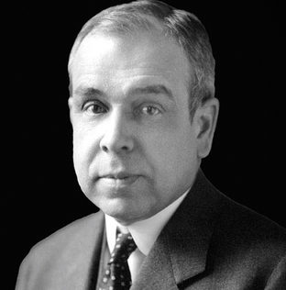
Remaining Faithful and Joyful in Battle
II. We must be willing to accept the relentless, prolonged, and often disappointing nature of the struggle to which we have been called.
“If we are really convinced of the truth of our message, then we can proclaim it before a world of enemies, then the very difficulty of our task, the very scarcity of our allies becomes an inspiration, then we can even rejoice that God did not place us in an easy age, but in a time of doubt and perplexity and battle.”
J. Gresham Machen

Slide 7
Remaining Faithful and Joyful in Battle
III. We must live holy and godly lives.

Slide 8
Remaining Faithful and Joyful in Battle
III. We must live holy and godly lives.
2 Peter 3:10-11a, “But the day of the Lord will come like a thief. The heavens will disappear with a roar; the elements will be destroyed by fire, and the earth and everything in it will be laid bare. Since everything will be destroyed in this way, what kind of people ought you to be?”

Slide 9
Remaining Faithful and Joyful in Battle
III. We must live holy and godly lives.
2 Peter 3:11b-14, “You ought to live holy and godly lives as you look forward to the day of God and speed its coming. That day will bring about the destruction of the heavens by fire, and the elements will melt in the heat. But in keeping with his promise, we are looking forward to a new heaven and a new earth, the home of righteousness. So then, dear friends, since you are looking forward to this, make every effort to be found spotless, blameless and at peace with him.”

Slide 10
Remaining Faithful and Joyful in Battle
III. We must live holy and godly lives.
Psalm 27:4, “One thing I ask from the Lord, this only do I seek: that I may dwell in the house of the Lord all the days of my life, to gaze on the beauty of the Lord and to seek him in his temple.”

Slide 11
Remaining Faithful and Joyful in Battle
III. We must live holy and godly lives.
Psalm 27:4, “One thing I ask from the Lord, this only do I seek: that I may dwell in the house of the Lord all the days of my life, to gaze on the beauty of the Lord and to seek him in his temple.”
Philippians 3:1-11, “I want to know Christ and the power of his resurrection and the fellowship of sharing in his sufferings, becoming like him in his death, and so, somehow, to attain to the resurrection from the dead.”

Slide 12
Remaining Faithful and Joyful in Battle
III. We must live holy and godly lives.
Hebrews 11:13-16, “And they admitted that they were aliens and strangers on earth. People who say such things show that they are looking for a country of their own. If they had been thinking of the country, they had left, they would have had opportunity to return. Instead, they were longing for a better country, – a heavenly one.”

