Slide 1
Sanctification
The Role of Marriage and Family

Slide 2
Sanctification is a gradual and progressive work of the Holy Spirit in our lives, transforming us into the likeness of God.
This can be done through:
Scripture
Prayer
The Church
Confession

Slide 4
Three-element Design of Marriage:
Heterosexual
Monogamous
Permanent

Slide 5
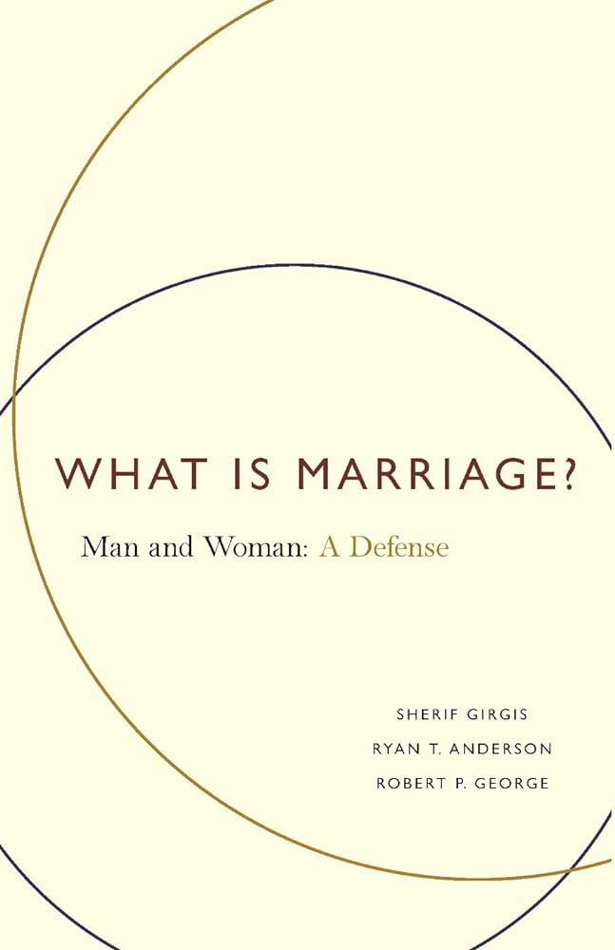

Slide 6
Two definitions of marriage in society:
The Conjugal View
“It is a vision of marriage as a bodily as well as an emotional and spiritual bond, distinguished thus by its comprehensiveness, which is, like all love, effusive: flowing out into the wide sharing of family life and ahead to lifelong fidelity. In marriage, so understood, the world rests its hope and finds ultimate renewal.”
The conjugal view “unites two people in their most basic dimensions, in their minds and bodies; . . . it unites them with respect to procreation, family life, and its broad domestic sharing; . . . it unites them permanently and exclusively.”

Slide 7
Two definitions of marriage in society:
The Conjugal View
The Revisionist View
“[The] revisionist view has informed the marriage policy reforms of the last several decades. It is a vision of marriage as, in essence, a loving emotional bond, one distinguished by its intensity—a bond that needn’t point beyond the partners, in which fidelity is ultimately subject to one’s own desires. In marriage, so understood, partners seek emotional fulfillment, and remain as long as they find it."

Slide 8
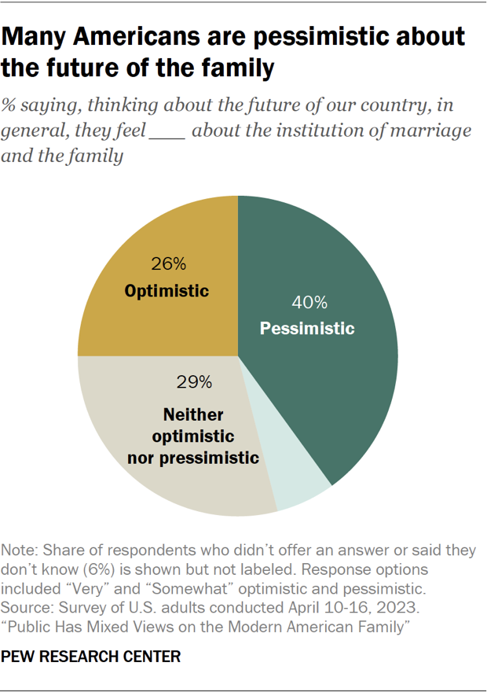

Slide 9
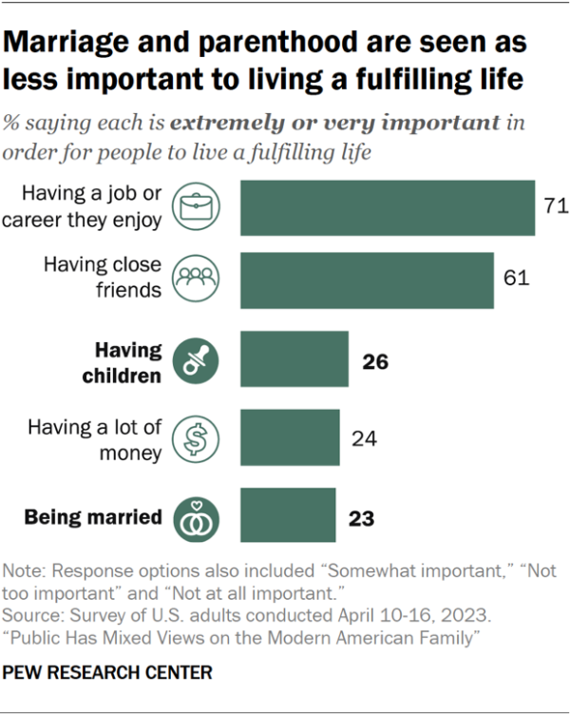

Slide 10
From the Anglican Book of Common Prayer: First, It was ordained for the procreation of children, to be brought up in the fear and nurture of the Lord, and to the praise of his holy Name. Secondly, It was ordained for a remedy against sin, and to avoid fornication; that such persons as have not the gift of continency might marry, and keep themselves undefiled members of Christ's body. Thirdly, It was ordained for the mutual society, help, and comfort, that the one ought to have of the other, both in prosperity and adversity.

Slide 11
Three Purposes of Marriage:
Procreation
Help in Avoiding Sin
Companionship and Partnership

Slide 12
Marriage and family provide an opportunity for us to carry out the Greatest Commandment.
Marriage and family train us in sacrifice and service.
Marriage and family expose our sin and teach us to confess and forgive.
Marriage and family teach us perseverance.
Marriage and family provide opportunities for discipleship and mutual encouragement.
Marriage and family point us to God as the object of our worship and ultimate source of fulfillment.

Slide 13
1 Thessalonians‬ ‭5‬:‭23‬-‭24‬:
May God himself, the God of peace, sanctify you through and through. May your whole spirit, soul and body be kept blameless at the coming of our Lord Jesus Christ. The one who calls you is faithful, and he will do it.

