Slide 1
T ∙ E ∙ S ∙ T
1234567890 1234567890 1234567890 1234567890
Aa Bb Cc Dd Ee Ff Gg Hh Ii Ll Mm Nn Oo Pp Qq Rr Ss Tt
Notes:
Turn on front Projector, then computer and slideshow, then rear projector.

Slide 2
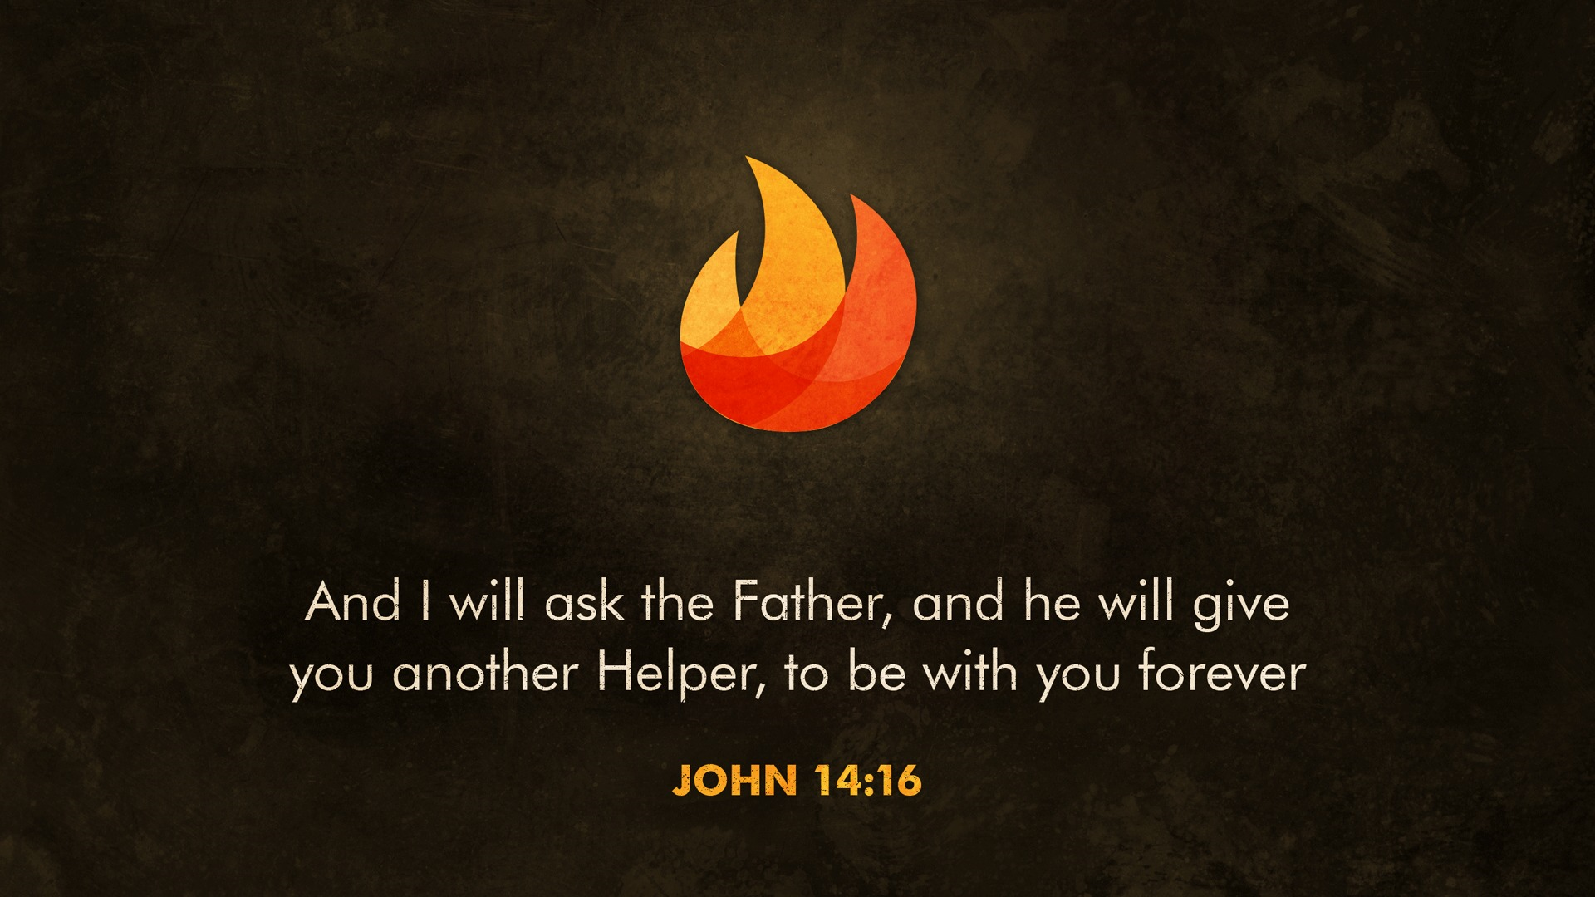

Slide 3

Call to Worship from the Psalter

Slide 4
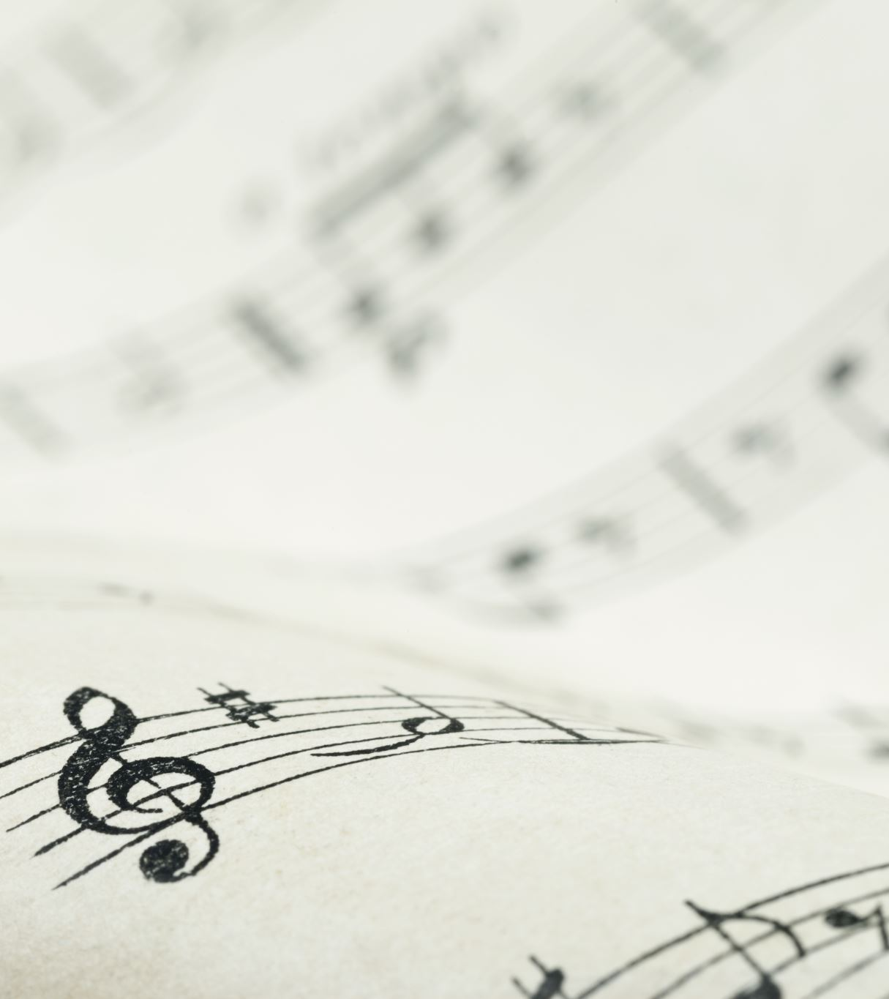
Our God is For Us
City Alight

Slide 5
We won't fear the battle,
we won't fear the night
We will walk the valley with You by our side
You will go before us,
You will lead the way
We have found a refuge, only You can save

Slide 6
Sing with joy now, our God is for us
The Father's love is a strong and mighty fortress
Raise your voice now, no love is greater
Who can stand against us if our God is for us

Slide 7
Even when I stumble, even when I fall
Even when I turn back, still Your love is sure
You will not abandon, You will not forsake
You will cheer me onward with never-ending grace

Slide 8
Sing with joy now, our God is for us
The Father's love is a strong and mighty fortress
Raise your voice now, no love is greater
Who can stand against us if our God is for us

Slide 9
Neither height nor depth can separate us
Hell and death will not defeat us
He who gave His son to free us
Holds us in His love

Slide 10
Neither height nor depth can separate us
Hell and death will not defeat us
He who gave His son to free us
Holds us in His love

Slide 11
Sing with joy now, our God is for us
The Father's love is a strong and mighty fortress
Raise your voice now, no love is greater
Who can stand against us if our God is for us

Slide 12
Sing with joy now, our God is for us
The Father's love is a strong and mighty fortress
Raise your voice now, no love is greater
Who can stand against us if our God is for us

Slide 13
In Christ alone
CCLI License 718717

Slide 14
In Christ alone my hope is found
He is my light, my strength, my song
This cornerstone, this solid ground
Firm through the fiercest drought and storm

Slide 15
What heights of love, what depths of peace
When fears are stilled, when strivings cease
My comforter, my all in all
Here in the love of Christ I stand

Slide 16
In Christ alone, Who took on flesh
Fullness of God in helpless babe
This gift of love and righteousness
Scorned by the ones He came to save

Slide 17
Till on that cross as Jesus died
The wrath of God was satisfied
For every sin on Him was laid
Here in the death of Christ I live

Slide 18
There in the ground His body lay
Light of the world by darkness slain
Then bursting forth in glorious day
Up from the grave He rose again

Slide 19
And as He stands in victory
Sin’s curse has lost its grip on me
For I am His and He is mine
Bought with the precious blood of Christ

Slide 20
No guilt in life, no fear in death
This is the power of Christ in me
From life’s first cry to final breath
Jesus commands my destiny

Slide 21
No power of hell, no scheme of man
Can ever pluck me from His hand
Till He returns or calls me home
Here in the power of Christ I’ll stand

Slide 22
And as He stands in victory
Sin’s curse has lost its grip on me
For I am His and He is mine
Bought with the precious blood of Christ

Slide 23
Christ the Sure & Steady Anchor
Matt Papa
Matt Boswell

Slide 24
Christ the sure and steady anchor in the fury of the storm
When the winds of doubt blow through me
and my sails have all been torn
In the suffering, in the sorrow,
when my sinking hopes are few
I will hold fast to the anchor, it shall never be removed

Slide 25
Christ the sure and steady anchor while the tempest rages on
When temptation claims the battle
and it seems the night has won
Deeper still, then, goes the anchor,
though I justly stand accused
I will hold fast to the anchor, it shall never be removed

Slide 26
Christ the sure and steady anchor
through the floods of unbelief
Hopeless somehow, o my soul now, lift your eyes to Calvary!
This my ballast of assurance, see His love forever proved
I will hold fast to the anchor, it shall never be removed

Slide 27
Christ the sure and steady anchor as we face the wave of death
When these trials give way to glory as we draw our final breath
We will cross that great horizon, clouds behind and life secure
And the calm will be the better, for the storms that we endure

Slide 28
Christ the sure of our salvation,
ever faithful, ever true
We will hold fast to the anchor,
it shall never be removed

Slide 29
The Power of the Cross
Stuart Townend
Keith Getty

Slide 30
Oh to see the dawn
of the darkest day
Christ on the road to Calvary
Tried by sinful men
torn and beaten then
nailed to a cross of wood

Slide 31
Oh to see the pain
written on Your face
bearing the awesome weight of sin
Every bitter thought
every evil deed
crowning Your blood-stained brow

Slide 32
This the power of the cross:
Christ became sin for us
Took the blame, bore the wrath
We stand forgiven at the cross

Slide 33
Now the daylight flees
now the ground beneath
quakes as its Maker bows His head
Curtain torn in two
dead are raised to life
‘Finished!’ the victory cry

Slide 34
This the power of the cross:
Christ became sin for us
Took the blame, bore the wrath
We stand forgiven at the cross

Slide 35
Oh to see my name
written in the wound
for through Your suf‘fring I am free
Death is crushed to death
life is mine to live
won through Your selfless love

Slide 36
This the power of the cross:
Son of God slain for us
What a life, what a cost!
We stand forgiven at the cross

Slide 37
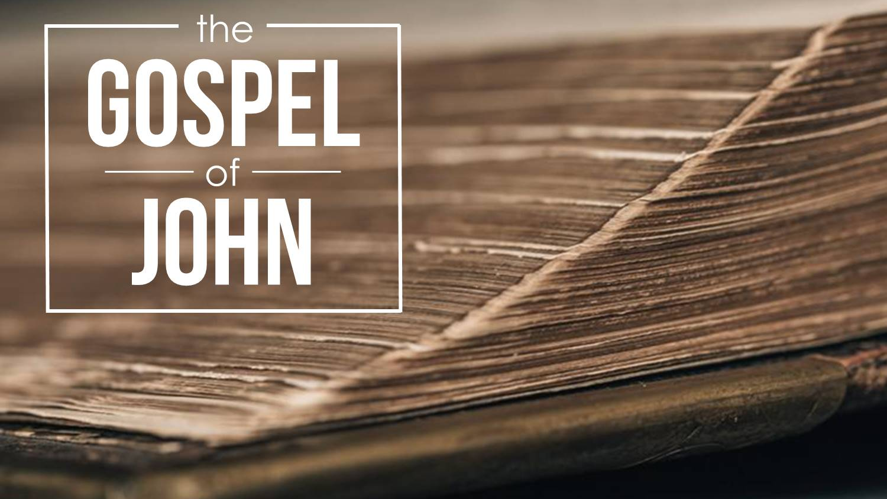

Slide 39
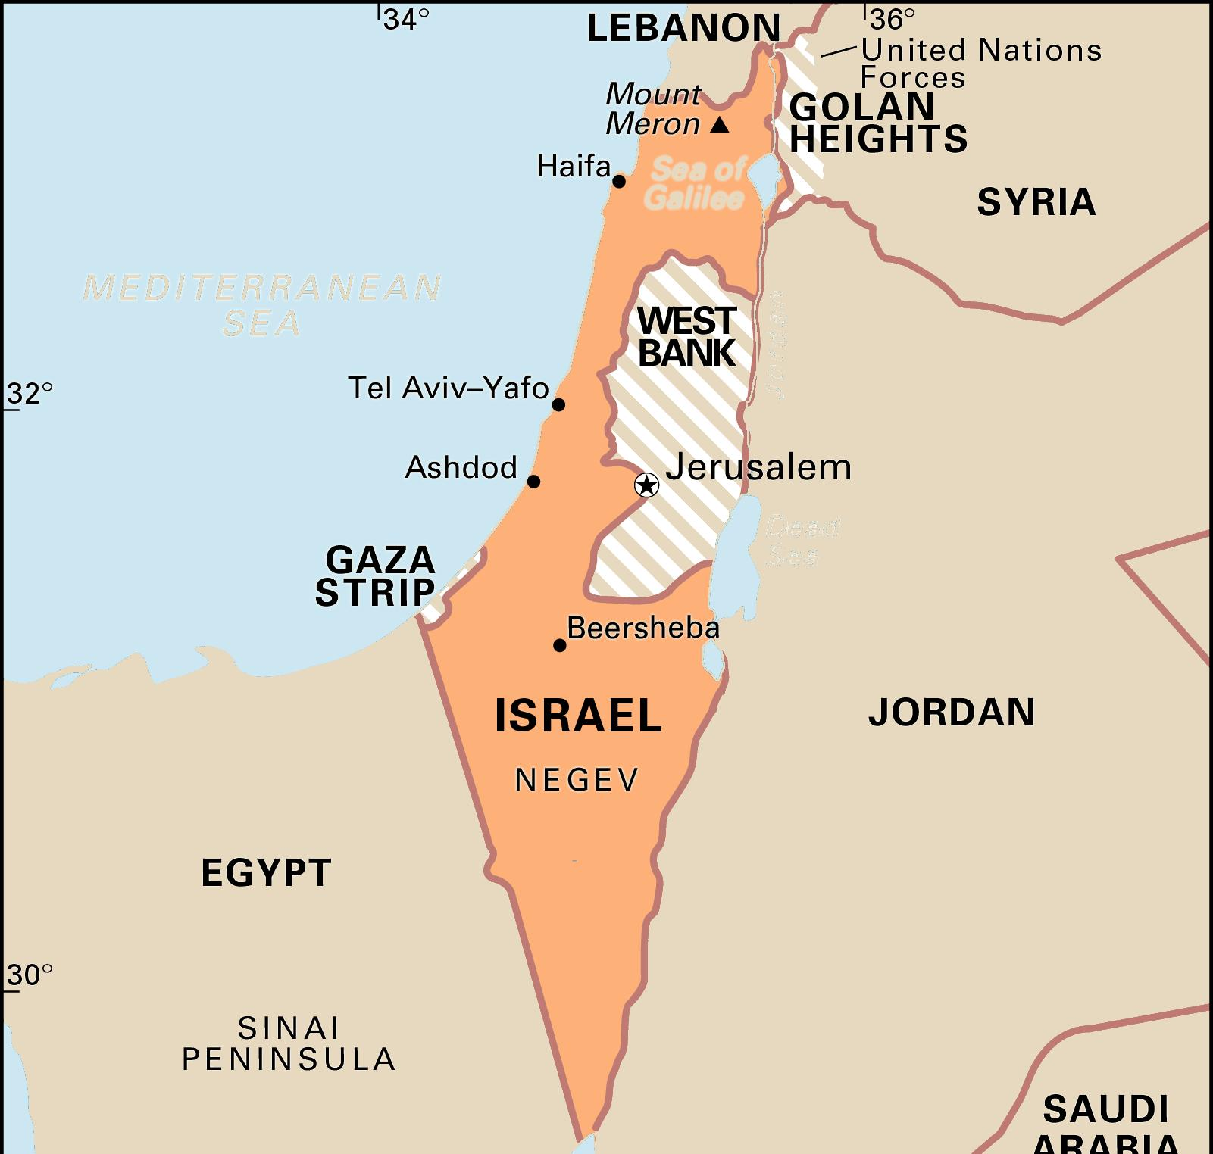

Slide 41
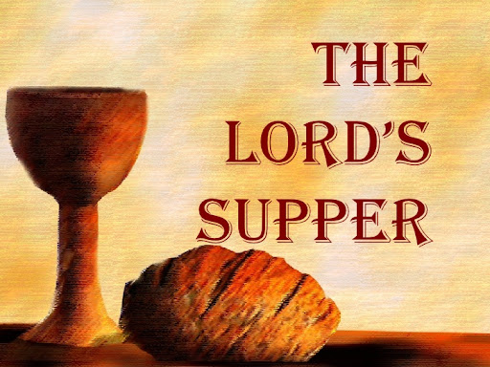

Slide 42
¹⁴For this reason, I kneel before the Father, from whom every family in heaven and on earth derives its name. ¹⁶I pray that out of his glorious riches he may strengthen you with power through his Spirit in your inner being, ¹⁷so that Christ may dwell in your hearts through faith.
And I pray that you, being rooted and established in love, ¹⁸may have power, together with all the Lord’s holy people, to grasp how wide and long and high and deep is the love of Christ, ¹⁹and to know this love that surpasses knowledge — that you may be filled to the measure of all the fullness of God.
²⁰Now to him who is able to do immeasurably more than all we ask or imagine, according to his power that is at work within us, to him be glory in the church and in Christ Jesus throughout all generations, for ever and ever! Amen.

Slide 45
God’s Truthfulness
God’s truthfulness refers to the fact that God represents things as they really are. This is sometimes referred to as his veracity.
Whether speaking of himself or part of his creation, what God says is accurate and completely true.
There are no errors, no lies, no imperfections, no ignorance, no mistakes.

Slide 46
God’s Truthfulness
We know that God has complete knowledge of all things; this we call his omniscience.
And we know that this complete knowledge is accurate and without error.
Furthermore, the Scripture teaches that God cannot lie, for lying is contrary to his very nature.

Slide 47
God’s Truthfulness
Therefore, we can trust what he says is true. Because he is all knowing (and perfect in that knowledge) and because he does not lie, everything he says about anything is absolutely reliable.
God has demonstrated the trustworthiness of his word from the beginning of time. In fact, the Scriptures are a written record of his truthfulness.

Slide 48
God’s Truthfulness
All that God knows and thinks is true and is a correct understanding of the nature of reality.
In fact, since God knows all things infinitely well, we can say that the standard of true knowledge is conformity to God’s knowledge.
If we think the same thing God thinks about anything in the universe, we are thinking truthfully about it.

Slide 49
God’s Truthfulness
God’s words are both true and the final standard of truth. This reliability and truthfulness of his words also applies to his promises. God always does what he promises to do, and we can depend on him to never be unfaithful to his promises.
Realization about God’s veracity should also encourage us in the pursuit of knowledge in all areas of the natural and social sciences.

Slide 50
God’s Truthfulness
All of God’s words about himself and about his creation completely correspond to reality. Whatever the area of our investigation, when we discover more truth about the nature of reality, we discover more of the truth that God already knows.
Indeed, growth in knowledge is part of the process of becoming more like God. ❖

Slide 51
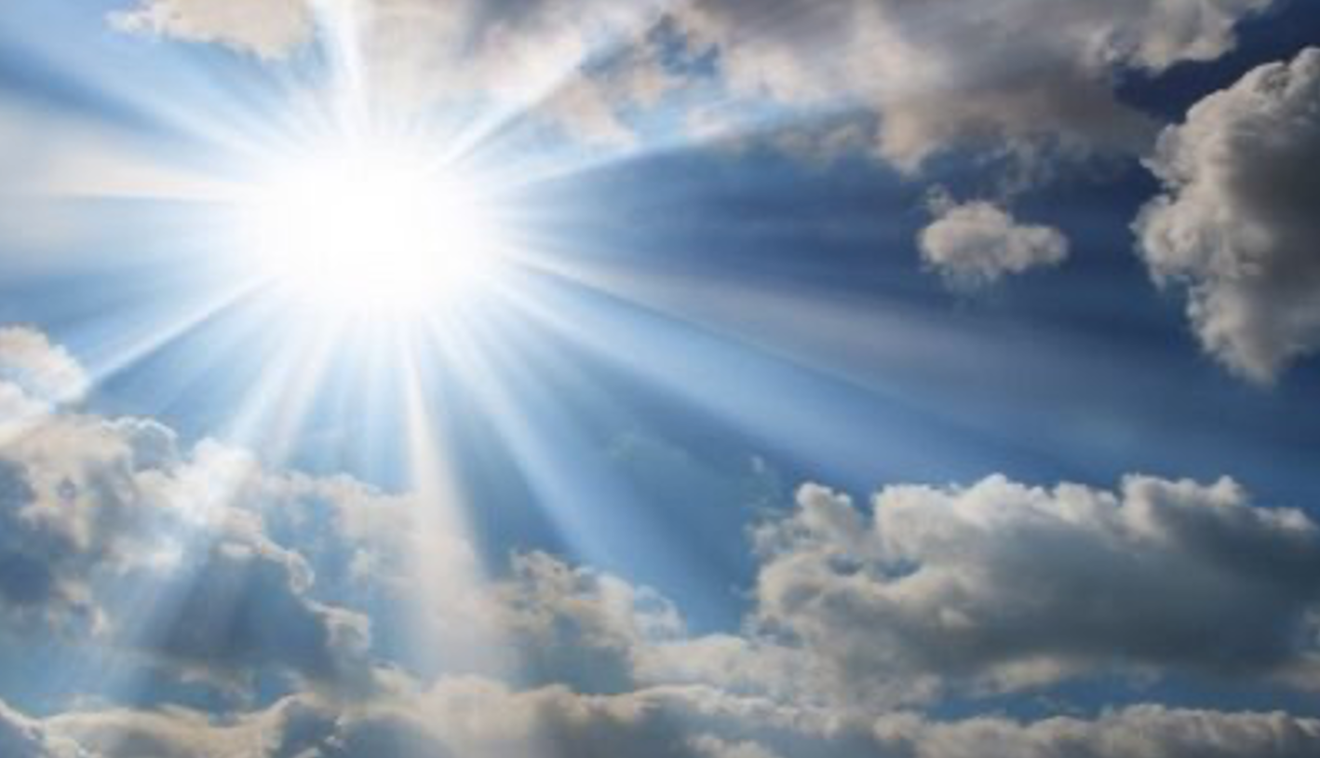
Give Thanks to the Lord
For He is Good
His Love Endures Forever

Slide 53
Sanctification:
Trials, Temptations, & Suffering

Slide 54
Previous sermons in this series:
Introduction
Scripture
Prayer
Church Community
Church Institution
Confession
Marriage & Family
Today

Slide 55
OBJECTIVES regarding trials and temptations
Biblical understanding
Sanctifying effects
Pitfalls to avoid
Our response & actions

Slide 57
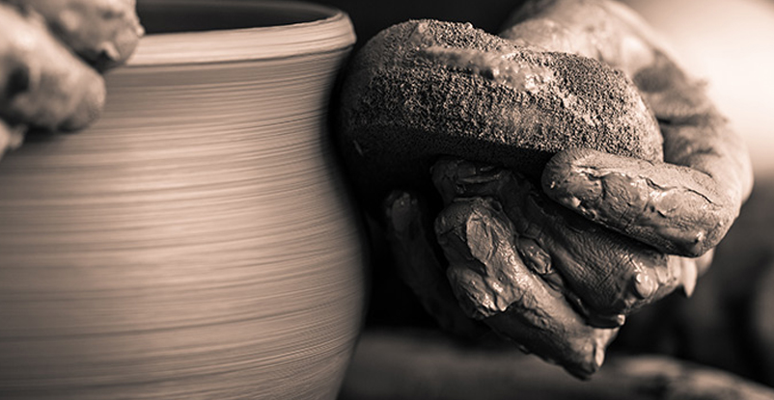

Slide 58
PLAN
Terms
Biblical overview
The means (and pitfalls to avoid)
Our response

Slide 59
Sanctification
The ongoing process of being conformed
to the image of Christ

Slide 60
Trials & Temptations
our source of testing and a means of our sanctification

Slide 61
SOURCES of our trials
Persecution for our faith
Effects of a sinful world
Resisting temptation
Sinful or unwise choices
Self-inflicted harm

Slide 62
SOURCES of our trials
Persecution for our faith
Effects of a sinful world
Resisting temptation
Sinful or unwise choices
Self-inflicted harm

Slide 63
SOURCES of our trials
Persecution for our faith
Effects of a sinful world
Resisting temptation
Sinful or unwise choices
Self-inflicted harm

Slide 64
SOURCES of our trials
Persecution for our faith
Effects of a sinful world
Resisting temptation
Sinful or unwise choices
Self-inflicted harm

Slide 65
SOURCES of our trials
Persecution for our faith
Effects of a sinful world
Resisting temptation
Sinful or unwise choices
Self-inflicted harm

Slide 66
Suffering
the emotional outcome of many trials

Slide 67
SUFFERING
Type: physical or emotional
Duration
Degree

Slide 68
SUFFERING
Type
Duration: brief or lengthy
Degree

Slide 69
SUFFERING
Type
Duration
Degree

Slide 70
CS Lewis
Mere Christianity
When a neurotic who has a pathological horror of cats forces himself to pick up a cat for some good reason, it is quite possible that in God's eyes he has shown more courage than a healthy man may have shown in winning the V.C.
When a man who has been perverted from his youth and taught that cruelty is the right thing does some tiny little kindness, or refrains from some cruelty he might have committed, and thereby, perhaps, risks being sneered at by his companions, he may, in God's eyes, be doing more than you and I would do if we gave up life itself for a friend.

Slide 71
SUFFERING
Type
Duration
Degree: objective and subjective

Slide 72
Why do trials, temptations, suffering exist?

Slide 73
John Polkinghorne
The suffering and evil of the world are not due to weakness, oversight, or callousness on God’s part, but, rather they are the inescapable cost of creation allowed to be other than God.

Slide 74
Why do trials, temptations, suffering exist?

Slide 75
  NIV
  When Jesus saw her weeping, and the Jews who had come along with her also weeping, he was deeply moved in spirit and troubled.
  NLT
  When Jesus saw her weeping and saw the other people wailing with her, a deep anger welled up within him, and he was deeply troubled.
  John 11:33

Slide 76
Biblical Content
the Old Testament

Slide 77
Biblical Content
the New Testament

Slide 78
² Consider it pure joy, my brothers and sisters, whenever you face trials of many kinds, ³ because you know that the testing of your faith produces perseverance. ⁴ Let perseverance finish its work so that you may be mature and complete, not lacking anything. ⁵ If any of you lacks wisdom, you should ask God, who gives generously to all without finding fault, and it will be given to you.
¹² Blessed is the one who perseveres under trial because, having stood the test, that person will receive the crown of life that the Lord has promised to those who love him. ¹³ When tempted, no one should say, “God is tempting me.” For God cannot be tempted by evil, nor does he tempt anyone...
James 1: 2-5, 12-13

Slide 79
² Consider it pure joy, my brothers and sisters, whenever you face trials of many kinds, ³ because you know that the testing of your faith produces perseverance. ⁴ Let perseverance finish its work so that you may be mature and complete, not lacking anything. ⁵ If any of you lacks wisdom, you should ask God, who gives generously to all without finding fault, and it will be given to you.
¹² Blessed is the one who perseveres under trial because, having stood the test, that person will receive the crown of life that the Lord has promised to those who love him. ¹³ When tempted, no one should say, “God is tempting me.” For God cannot be tempted by evil, nor does he tempt anyone...
James 1: 2-5, 12-13

Slide 80
² Consider it pure joy, my brothers and sisters, whenever you face trials of many kinds, ³ because you know that the testing of your faith produces perseverance. ⁴ Let perseverance finish its work so that you may be mature and complete, not lacking anything. ⁵ If any of you lacks wisdom, you should ask God, who gives generously to all without finding fault, and it will be given to you.
¹² Blessed is the one who perseveres under trial because, having stood the test, that person will receive the crown of life that the Lord has promised to those who love him. ¹³ When tempted, no one should say, “God is tempting me.” For God cannot be tempted by evil, nor does he tempt anyone...
James 1: 2-5, 12-13

Slide 81
² Consider it pure joy, my brothers and sisters, whenever you face trials of many kinds, ³ because you know that the testing of your faith produces perseverance. ⁴ Let perseverance finish its work so that you may be mature and complete, not lacking anything. ⁵ If any of you lacks wisdom, you should ask God, who gives generously to all without finding fault, and it will be given to you.
¹² Blessed is the one who perseveres under trial because, having stood the test, that person will receive the crown of life that the Lord has promised to those who love him. ¹³ When tempted, no one should say, “God is tempting me.” For God cannot be tempted by evil, nor does he tempt anyone...
James 1: 2-5, 12-13

Slide 82
³ Not only so, but we also glory in our sufferings, because we know that suffering produces perseverance; ⁴ perseverance, character; and character, hope. ⁵ And hope does not put us to shame, because God’s love has been poured out into our hearts through the Holy Spirit, who has been given to us.
Romans 5:3-5

Slide 83
¹ Therefore, since we are surrounded by such a great cloud of witnesses, let us throw off everything that hinders and the sin that so easily entangles. And let us run with perseverance the race marked out for us, ² fixing our eyes on Jesus, the pioneer and perfecter of faith. For the joy set before him he endured the cross, scorning its shame, and sat down at the right hand of the throne of God. ³ Consider him who endured such opposition from sinners, so that you will not grow weary and lose heart.
Hebrews 12:1-3

Slide 84
¹² Dear friends, do not be surprised at the fiery ordeal that has come on you to test you, as though something strange were happening to you. ¹³ But rejoice inasmuch as you participate in the sufferings of Christ, so that you may be overjoyed when his glory is revealed.
1 Peter 4:12-13

Slide 85
¹⁶ Therefore we do not lose heart. Though outwardly we are wasting away, yet inwardly we are being renewed day by day. ¹⁷ For our light and momentary troubles are achieving for us an eternal glory that far outweighs them all. ¹⁸ So we fix our eyes not on what is seen, but on what is unseen, since what is seen is temporary, but what is unseen is eternal.
2 Corinthians 4:16-18

Slide 86
¹⁰ You, however, know all about my teaching, my way of life, my purpose, faith, patience, love, endurance, ¹¹ persecutions, sufferings—what kinds of things happened to me in Antioch, Iconium and Lystra, the persecutions I endured. Yet the Lord rescued me from all of them. ¹² In fact, everyone who wants to live a godly life in Christ Jesus will be persecuted...
2 Timothy 3:10-12

Slide 87
²⁷ Whatever happens, conduct yourselves in a manner worthy of the gospel of Christ. Then, whether I come and see you or only hear about you in my absence, I will know that you stand firm in the one Spirit, striving together as one for the faith of the gospel ²⁸ without being frightened in any way by those who oppose you. This is a sign to them that they will be destroyed, but that you will be saved—and that by God. ²⁹ For it has been granted to you on behalf of Christ not only to believe in him, but also to suffer for him, ³⁰ since you are going through the same struggle you saw I had, and now hear that I still have.
Philippians 1:27-30

Slide 88
The Means
how trials, temptations, and suffering sanctify us

Slide 89
THE MEANS by which we are sanctified
Develop Christ-like characteristics
Share solidarity with Christ
Accept God's sovereignty
Build trust in God

Slide 90
THE MEANS by which we are sanctified
Develop Christ-like characteristics
Share solidarity with Christ
Accept God's sovereignty
Build trust in God

Slide 91
⁶ In all this you greatly rejoice, though now for a little while you may have had to suffer grief in all kinds of trials. ⁷ These have come so that the proven genuineness of your faith—of greater worth than gold, which perishes even though refined by fire—may result in praise, glory and honor when Jesus Christ is revealed.
1 Peter 1:6-7

Slide 92
THE MEANS by which we are sanctified
Develop Christ-like characteristics
Share solidarity with Christ
Accept God's sovereignty
Build trust in God

Slide 93
THE MEANS by which we are sanctified
Develop Christ-like characteristics
Share solidarity with Christ
Accept God's sovereignty
Build trust in God

Slide 94
¹⁰ I want to know Christ—yes, to know the power of his resurrection and participation in his sufferings, becoming like him in his death, ¹¹ and so, somehow, attaining to the resurrection from the dead.
Philippians 3:10-11

Slide 95
THE MEANS by which we are sanctified
Develop Christ-like characteristics
Share solidarity with Christ
Accept God's sovereignty
Build trust in God

Slide 96
THE MEANS by which we are sanctified
Develop Christ-like characteristics
Share solidarity with Christ
Accept God's sovereignty
Build trust in God

Slide 97
⁷ Endure hardship as discipline; God is treating you as his children. For what children are not disciplined by their father? ⁸ If you are not disciplined—and everyone undergoes discipline—then you are not legitimate, not true sons and daughters at all. ⁹ Moreover, we have all had human fathers who disciplined us and we respected them for it. How much more should we submit to the Father of spirits and live! ¹⁰ They disciplined us for a little while as they thought best; but God disciplines us for our good, in order that we may share in his holiness. ¹¹ No discipline seems pleasant at the time, but painful. Later on, however, it produces a harvest of righteousness and peace for those who have been trained by it.
Hebrews 12:7-11

Slide 98
CS Lewis
The Problem of Pain
The father uses his authority to make the son into the sort of human being he, rightly, and in his superior wisdom, wants him to be.

Slide 99
THE MEANS by which we are sanctified
Develop Christ-like characteristics
Share solidarity with Christ
Accept God's sovereignty
Build trust in God

Slide 100
THE MEANS by which we are sanctified
Develop Christ-like characteristics
Share solidarity with Christ
Accept God's sovereignty
Build trust in God

Slide 101
PROCESSING A TRIAL
Encounter a trial
Resulting in suffering
Powerlessness
Response
Sin
Wisdom
Reject God
Dependence on God
No God or
God is evil
Draw closer to God

Slide 102
Pitfalls
what not to do

Slide 103
Response
what we should do

Slide 104
¹² Dear friends, do not be surprised at the fiery ordeal that has come on you to test you, as though something strange were happening to you. ¹³ But rejoice inasmuch as you participate in the sufferings of Christ, so that you may be overjoyed when his glory is revealed.
1 Peter 4:12-13

Slide 105
Response
what we should do

Slide 106
Conclusion

Slide 107
Develop Christ-like characteristics
Share solidarity with Christ
Accept God's sovereignty
Build trust in God

Slide 110

The hour has already come for you to wake up from your slumber,
because our salvation is nearer now than when we first believed.
The night is nearly over; the day is almost here.
So let us put aside the deeds of darkness
and put on the armor of light.
– Romans 13:11-12 –

Slide 113
DO NOT DELETE THE
FOLLOWING SLIDES

Slide 114

The Birth of Jesus
According to Matthew

Slide 115
Give Thanks to the Lord
For He is Good
His Love Endures Forever

Slide 116
Give Thanks to the Lord
For He is Good
His Love Endures Forever

Slide 117

Give Thanks to the Lord
For He is Good
His Love Endures Forever

Slide 118
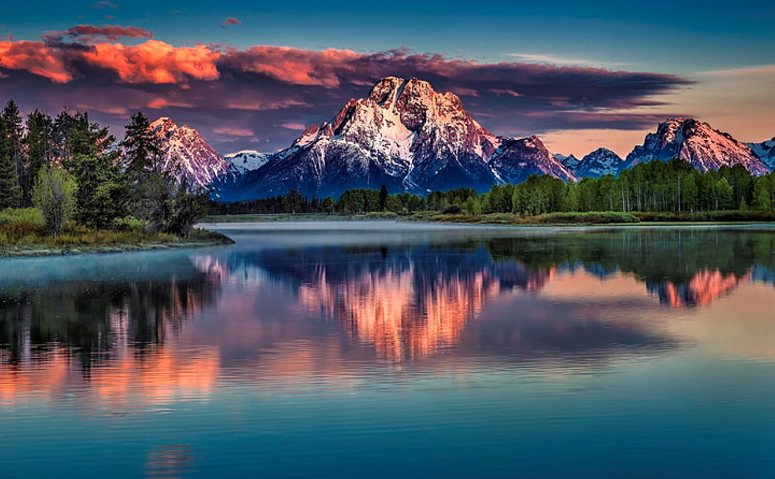
Give Thanks to the Lord
For He is Good
His Love Endures Forever

Slide 119
If we confess our sins,
he is faithful and just and will forgive us our sins
and purify us from all unrighteousness.
1John 1:9

Slide 120
JAMES 3:7-10
For every kind of beast and bird, of reptile and sea creature, can be tamed and has been tamed by mankind, but no human being can tame the tongue. It is a restless evil, full of deadly poison.
With it we bless our Lord and Father, and with it we curse people who are made in the likeness of God. From the same mouth come blessing and cursing. My brothers, these things ought not to be so.

Slide 121
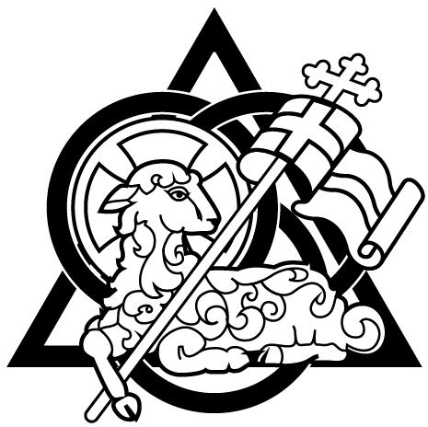

Slide 122
Login Credentials for Church’s WIFI
Network = TEC_Guest
Password = 19931993

Slide 123
Our Father who art in heaven, hallowed be Thy name.
Thy kingdom come, Thy will be done in earth, as it is in heaven.
Give us this day our daily bread.
And forgive us our debts, as we forgive our debtors.
And lead us not into temptation but deliver us from evil.
For Thine is the kingdom, and the power, and the glory, forever. Amen.

Slide 124
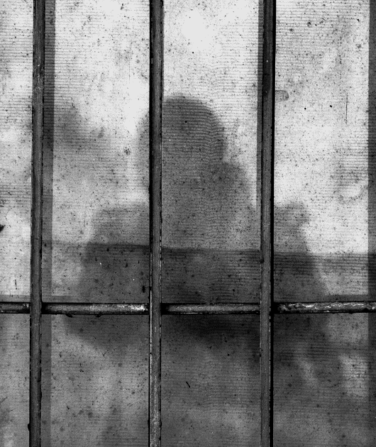
Persecution Report
Remember those in prison, as if you were there yourself. Remember also those being mistreated, as if you felt their pain in your own bodies.
Hebrews 13:3

Slide 125
CHILDREN’S MINISTRY
MATTHEW | 2 and 3 year-olds
MARK | 4 and 5 year-olds plus Kindergarten
LUKE | 1st and 2nd graders
JOHN | 3rd and 4th graders
BRINK | 5th graders until 13 years old

Slide 126
If we confess our sins,
he is faithful and just and will forgive us our sins
and purify us from all unrighteousness.
1John 1:9

Slide 127
JAMES 3:13-16
Who is wise and understanding among you? Let them show it by their good life, by deeds done in the humility that comes from wisdom.
But if you harbor bitter envy and selfish ambition in your hearts, do not boast about it or deny the truth. Such “wisdom” does not come down from heaven but is earthly, unspiritual, demonic.
For where you have envy and selfish ambition, there you find disorder and every evil practice.

Slide 130
Give Thanks to the Lord
For He is Good
His Love Endures Forever

Slide 131
T ∙ E ∙ S ∙ T
1234567890 1234567890 1234567890 1234567890
Aa Bb Cc Dd Ee Ff Gg Hh Ii Ll Mm Nn Oo Pp Qq Rr Ss Tt
Notes:
Turn on front Projector, then computer and slideshow, then rear projector.

Slide 132

“Pride is your greatest enemy, humility is your greatest friend.”
-- John R.W. Stott

Slide 133
"If we turn to the right mayhap our children and our children's children will go that way; but if we turn to the left, generations unborn will curse our names for having been unfaithful to God and to his word."
-- Spurgeon

Slide 134
"All sin tends to be addictive, and the terminal point of addiction is what is called damnation."
-- W. H. Auden

Slide 135
“Paul describes how believers, through their union with Christ’s death and resurrection, are able to shift their physical, intellectual and emotional capacities into God’s service.”
-- Frank Thielman

Slide 136
“Pride is your greatest enemy, humility is your greatest friend.”
-- John R.W. Stott

Slide 137
“Now I begin to be a disciple. . . . Let fire and cross, flocks of beasts, broken bones, dismemberment, come upon me, so long as I attain to Jesus Christ.”
-- Ignatius of Antioch (Letter to the Romans, 5)

Slide 138
“Error, indeed, is never set forth in its naked deformity, lest, being thus exposed, it should at once be detected. But it is craftily decked out in an attractive dress, so as, by its outward form, to make it appear to the inexperienced (as ridiculous as the expression may seem) more true than truth itself.”
-- Irenaeus (Against Heresies 1.2)

Slide 139
"If I profess with the loudest voice and clearest exposition every portion of the truth of God except precisely that little point which the world and the devil are at that moment attacking, I am not confessing Christ however boldly I may be professing Christ.
Where the battle rages, there the loyalty of the soldier is proved, and to be steady on all the battlefield besides, is mere flight and disgrace if he flinches at that point."
-- (Rephrased from Martin Luther)

Slide 140
"Man's greatness lies not in his having the solution to his predicament, but in the fact that he alone in all the universe is aware of his wretched condition."
-- Blaise Pascal

Slide 141
Evangelicals have often made a serious mistake by equating the fact that man is lost and under God's judgment with the idea that man is nothing -- a zero. This is not what the Bible says.
There is something great about man, and we have lost perhaps our greatest opportunity of evangelism in our generation by not insisting that it is the Bible which explains why man is great.
-- Francis A. Schaeffer (He is There & He is not Silent)

Slide 142
Thoughts of peace, thoughts of pity, thoughts of charity, thoughts of God, thoughts of the Son of God - these are pure things, good things and high things.
Therefore, if you would cultivate the Spirit's acquaintance, you must get hold of your thoughts and not allow your mind to be a wilderness in which every kind of unclean beast roams and bird flies.
-- A.W. Tozer

Slide 143
A man can no more diminish God's glory
by refusing to worship Him than a lunatic can put out the sun by scribbling the word 'darkness’ on the walls of his cell.
-- C. S. Lewis, The Problem of Pain

Slide 145
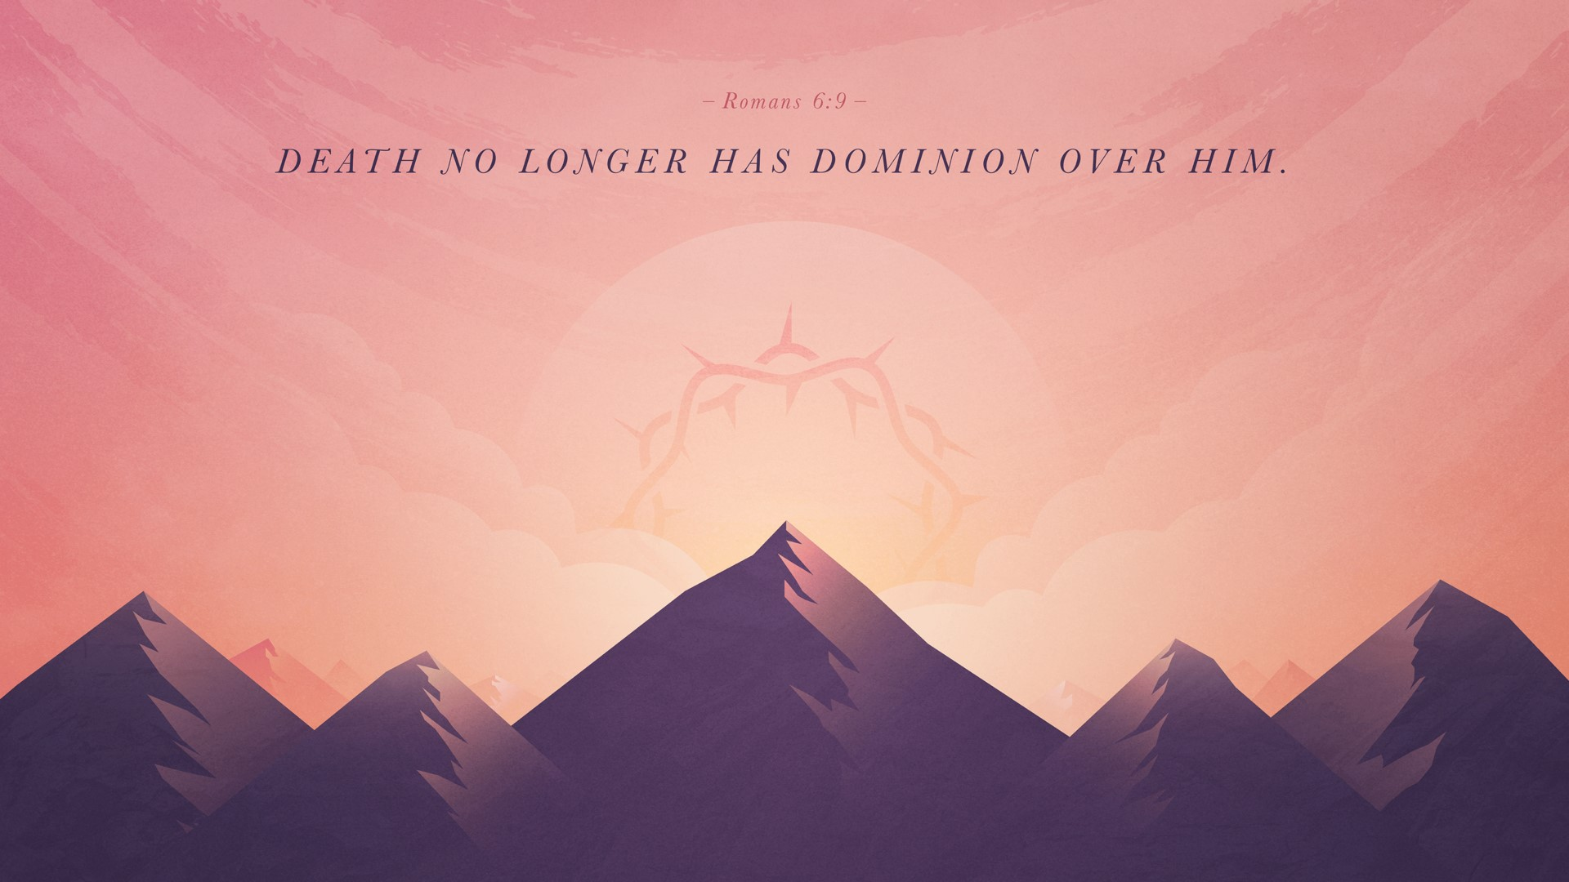

Slide 146
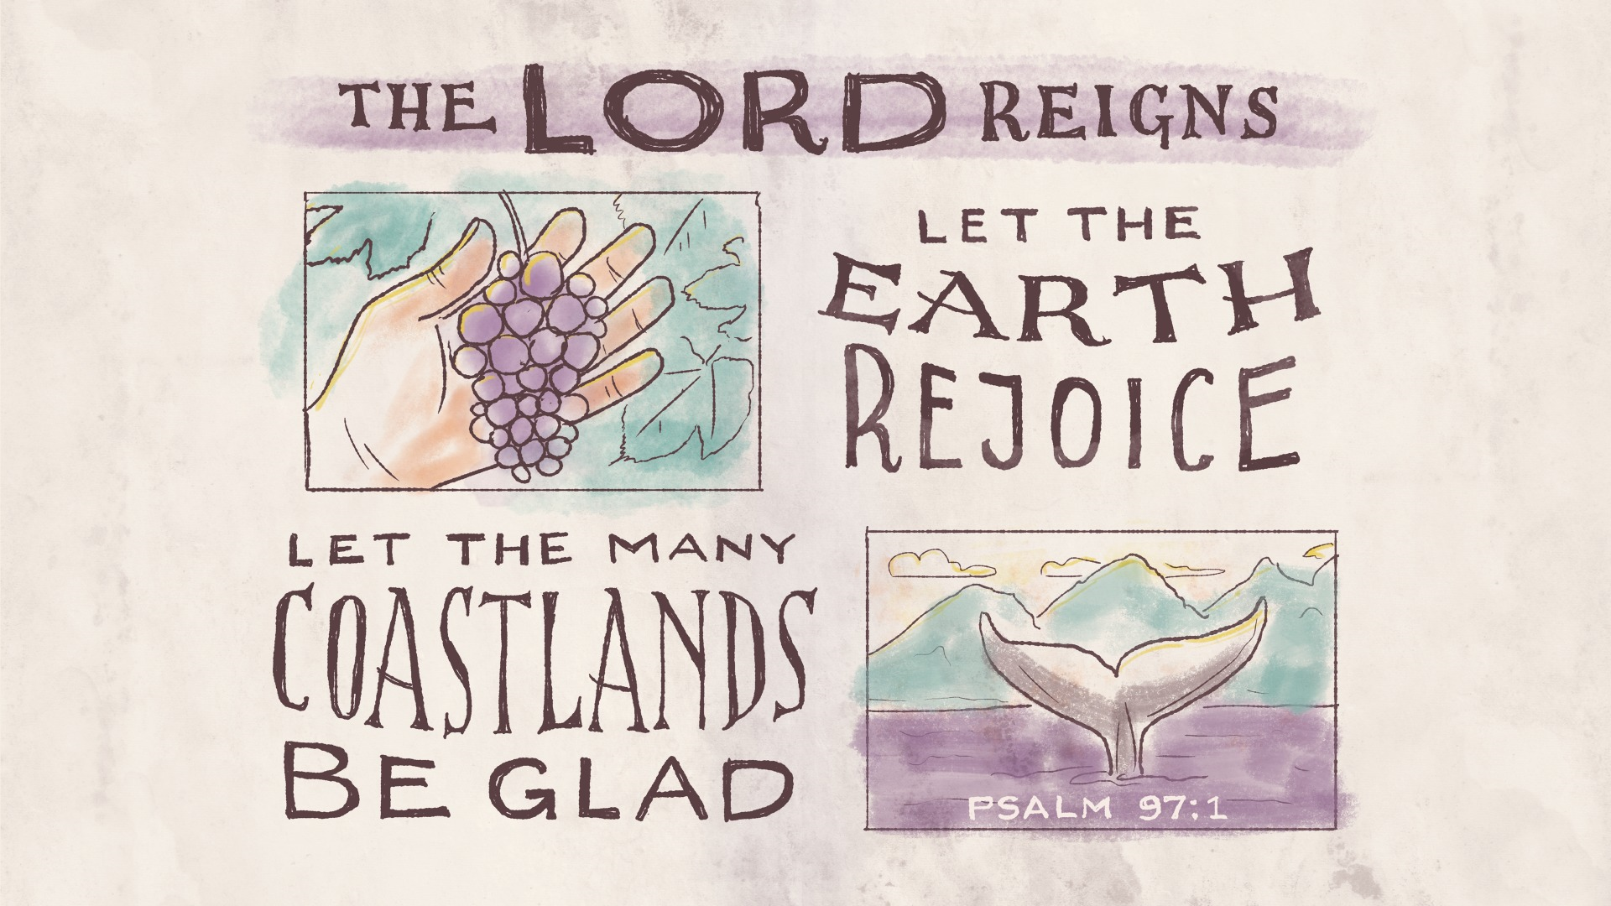

Slide 147
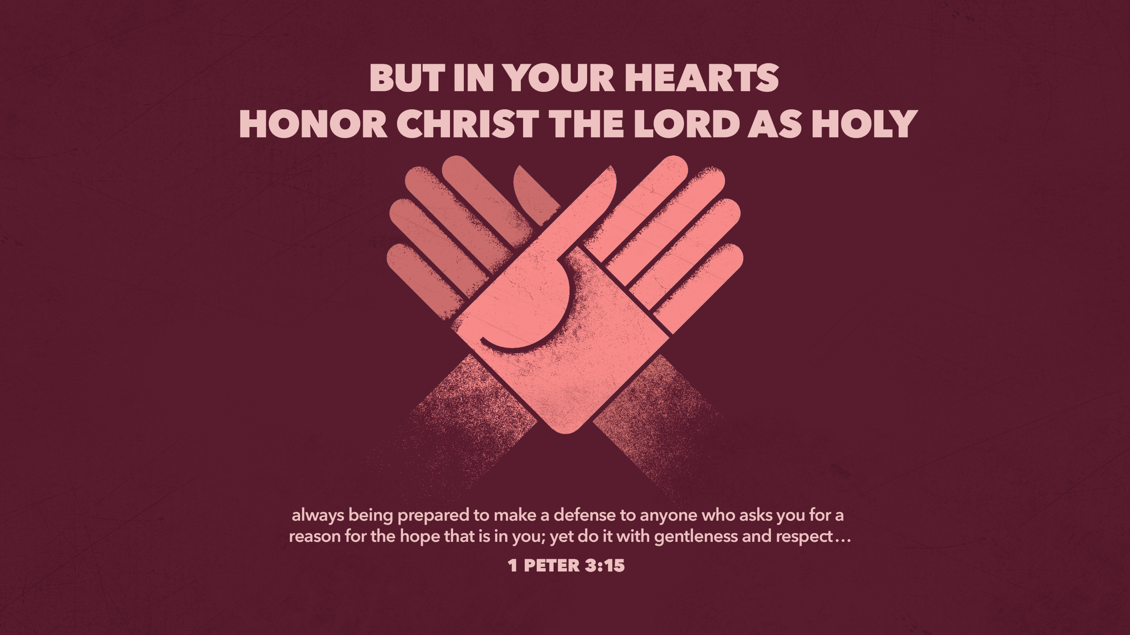

Slide 148
The hour has already come for you to wake up from your slumber,
because our salvation is nearer now than when we first believed.
The night is nearly over; the day is almost here.
So let us put aside the deeds of darkness
and put on the armor of light.
– Romans 13:11-12 –

