Slide 1
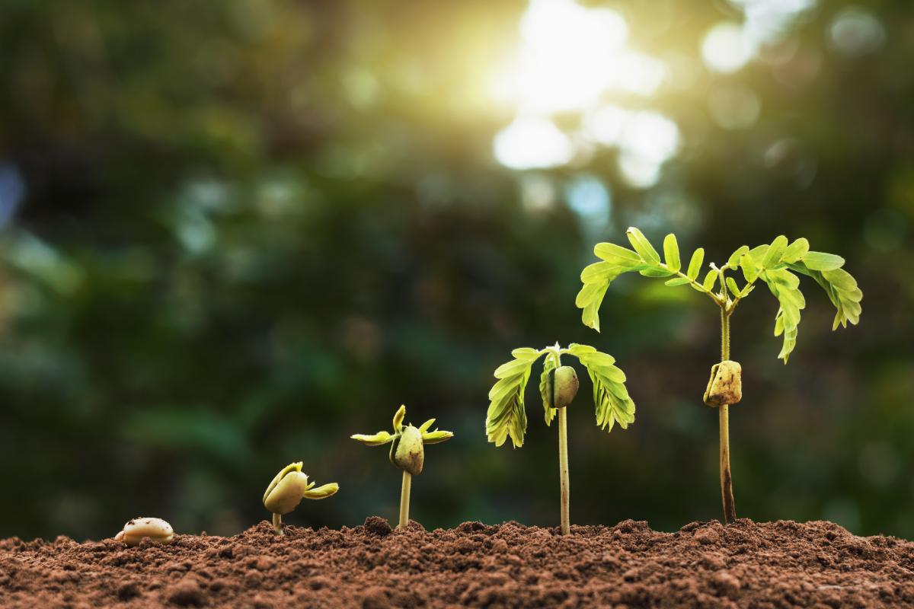
Sanctification: Encouragement for Younger Christians

Slide 8
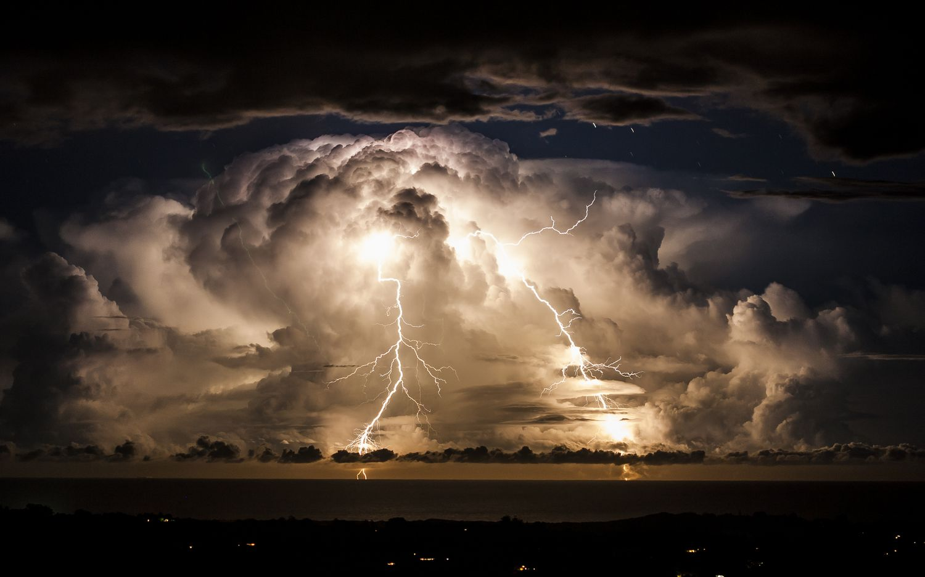

Slide 9
Why did chose this topic?
***I wanted to encourage younger Christians that they will grow in Christ.***

Slide 10
What is Sanctification?
Made like Christ
Saved, but under sin

Slide 11
Who will be sanctified?
Unbelievers?
Bad → Worse → Worst
Believers?
Good → Better → Best

Slide 12
"Okay, Houston ... we've had a problem here."
What about those who fall away?
Reformed theology:
God chose us
Arminian theology:
Therefore, I cannot tell you for certain that you will be sanctified. Only God knows.
He will not “unchoose” us.
→
We have free-will to choose or not to choose God.
We can “unchoose” God.
→

Slide 13
Now what?
We all agree that there are people who appear as Christians but never reach the finish line.
Reformed theology: “They never were true Christians.”
Arminian theology: “They were true Christians who fell away.”

Slide 14
Now what? What about us?
Reformed theology:
I could be found to never have been a true Christian.
I know my heart. (“Prone to wander, Lord I feel it, prone to leave the God I love.”
Arminian theology:
You could fall away.
Enough of this light-hearted banter.
I think that I’m a Christian.
You do too.
Let’s go ahead and say that we will be sanctified. O.K.?

Slide 15
In what areas of my life will I be sanctified?
God has both
incommunicable attributes and
We will never be like God in his incommunicable attributes.
communicable attributes
We will be more like him in his communicable attributes.

Slide 16
How are Christians sanctified?
Sanctification is 100% our responsibility.
This has been emphasized in the current series.
We are sanctified through:
Scripture
Prayer
The Church Community
The Church Institution
Confession
Marriage and Family
Trials, Temptation, & Suffering

Slide 17
How are Christians Sanctified?
Sanctification is 100% our responsibility…
… and 100% God’s work through the Holy Spirit.
Phil 1:6 And I am sure of this, that he who began a good work in you will bring it to completion at the day of Jesus Christ.

Slide 18
How Are Christians Sanctified?
Conviction by the Holy Spirit
1 Timothy 1:15 “It is a trustworthy statement, deserving full acceptance, that Christ Jesus came into the world to save sinners, among whom I am foremost of all.”
Ted Rapone, “I am the greatest of sinners. As you get closer to the light, it shines more into the cracks and crevices.”
I’ll challenge Ted for that title.

Slide 19
How Are Christians Sanctified?
Sanctification is 100% our responsibility…
… and 100% God’s work through the Holy Spirit. Both are involved
Philippians 2:12-13 Therefore, my beloved, as you have always obeyed, so now, not only as in my presence but much more in my absence, work out your own salvation with fear and trembling, ¹³ for it is God who works in you, both to will and to work for his good pleasure.

Slide 20
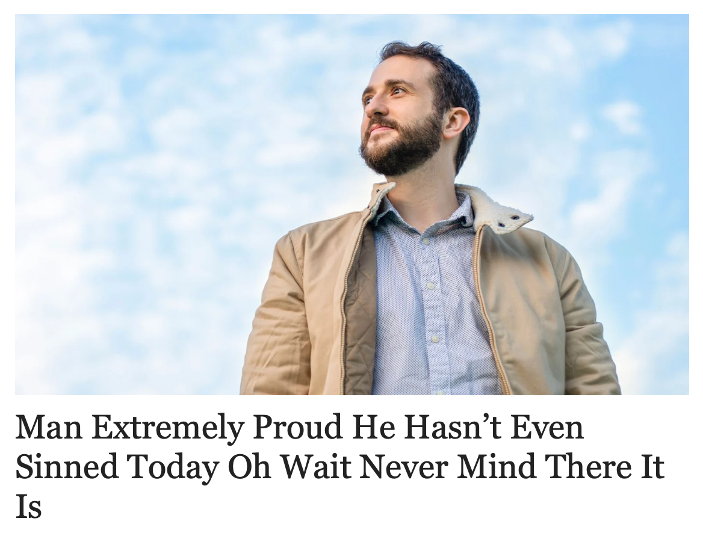
Will I reach complete sanctification in this life?

Slide 21
Will I reach complete sanctification in this life?
Knoxville
The Christian will not be completely sanctified in this life.
“The biggest roadblock to sanctification is the idea that we’ve already arrived our satisfaction that we are happy with where we’re at.” D. Laub
However, the Christian will become significantly more like Jesus.

Slide 22
Stand to Reason
“Waiting biblically means deliberately humbling ourselves before God and being patient for his timing. It also means choosing sanctification, because it’s often in waiting for God’s answer and deliverance that we actually grow in character, grow to be more like Jesus. God is committed to making us the people he wants us to be, and we can choose to be patient for his process of transformation. Waiting on the Lord means not giving up and trusting his good purposes in His time.”
— Melinda Penner (1959 – 2003)

Slide 24
What does sanctification look like?
With apologies to the Beach Boys, “Oh wouldn’t it be nice?”
I’d settle for this one
Level of Sanctification
Spiritual
birth
Physical
death

Slide 25
What does sanctification look like?
Proverbs 17:14
The beginning of strife is like letting out water,
So abandon the quarrel before it breaks out.
F
Level of Sanctification
NP
B
Spiritual
birth
Physical
death

Slide 26
How are Christians sanctified?
The Active Model:
(A.K.A. The Way that it Ought to Work Model)
(A.K.A. The Denny Laub Model)
Acts 20:32 “And now I commend you to God and to the word of his grace, which is able to build you up and to give you the inheritance among all those who are sanctified.”
Changed Life
→
Read Scripture
→
Reflect
→
Conviction
→
Repentance

Slide 27
How are Christians sanctified?
The Passive Model:
(AKA The Slow Learner Model)
(AKA The John Schutt Model)
Lying in bed decades later and you can’t get to sleep and you’re thinking about your life and you’re being convicted by the Holy Spirit
Changed Life
Realization that you’re the chief of sinners 1 Tim 1:15
Do evil
→
→
→
→
Repentance

Slide 28
Survey (Thanks, Stephanie)
Who did I ask?
Why did I ask these questions?
1. How long have you been a Christian?
40 - 64 years

Slide 29
2. During the series on sanctification, the following means were discussed: Scripture, prayer, church community, church institution, confession, marriage and family, and trials. Which one or more of these has helped you to pursue sanctification?
All of them
All except the church institution.
Prayer and family
All of the things covered thus far in the Sanctification Series, I think, have helped motivate me to seek sanctification, but the most effective for me have been prayer and trials.

Slide 30
Which … one or more of these has helped you to pursue sanctification?
I would say all of those listed have helped me pursue sanctification.
I think all of the above have played a part but Scripture, Marriage and Family, and trials would probably stand out as the most.
Church Institution through opening God's Word to understand God and His will better

Slide 31
3. What have you done to pursue sanctification?
Scripture, prayer, church.
Prayed and read the scriptures.
Acknowledging dependence on the Holy Spirit (by first coming to God daily in prayer) has helped me to recognize my limitations and to trust in His provision for conforming me to the image of Christ.
To pursue sanctification, I have spent more time in the Word, in prayer, and in being aware and listening to the Holy Spirit direct me and lovingly admonish me.

Slide 32
3. What have you done to pursue sanctification?
Read and study the Bible and pray for God to change me into the likeness of Christ.
Study, reading scripture and meditation. And consciously committing to changing with the Holy Spirits prompting.
Read, pray, and being mindful of the goal to be more like Christ

Slide 33
4.What has helped you to pursue sanctification?
Desire to please God
Watching my [spouse] live out santification.
Conviction from the Holy Spirit, encouragement from other people around me, previous sermons on sanctification from a variety of Christian teachers (like Alistair Begg, Chip Ingram, Mike Fabarez, etc.) and this sanctification series have helped and are helping me to pursue holiness.

Slide 34
4.What has helped you to pursue sanctification?
The main thing that helps to pursue sanctification, for me, is to remain close to God and His Word and to take time in prayer to God and commune with Him. Spending time with God is where I am shown where and how He wants to use me to glorify Him while I'm here on this earth, with the obvious goal of becoming more Holy as God is Holy.

Slide 35
Reading and studying the Bible, participating in Bible studies, being a part of small groups of Christian fellowship, praying for God's help to face problems and trials. During difficult times I do find myself seeking more after God's will and praying more.
Focusing too much on this world rather than thinking about my real home and what that means.
Not putting prayer and Bible reading first -thinking I'll do it later--right after I finish this- and then moving on to another task. Even today, reading the Bible seems so much easier for me than praying. I seem to get easily distracted. I think a lack of praying is a hindrance to sanctification.

Slide 36
4.What has helped you to pursue sanctification?
The main thing that helps to pursue sanctification, for me, is to remain close to God and His Word and to take time in prayer to God and commune with Him. Spending time with God is where I am shown where and how He wants to use me to glorify Him while I'm here on this earth, with the obvious goal of becoming more Holy as God is Holy.

Slide 37
5. What has hindered you from pursuing sanctification?
Laziness, not in the mood, etc.
My selfishness and pride.
My sinful nature. I can’t shake it.
Things that have hindered my pursuit of sanctification include laziness (lack of discipline) and perhaps, a lack of trust -- a willingness to give up "the good things" for "the best.“
Me
Losing sight of the goal

Slide 38
5. What has hindered you from pursuing sanctification?
I would say the opposite [of what has helped them] has hindered me. When I get lazy in reading the word and I rush through prayer, I know I am still saved, but not moving forward to sanctification as much as I should.
Ted Rapone recently said from the pulpit that the older he gets the more he realizes how sinful he really is, I find this to be true of myself. My own pursuit of sanctification has primarily been an effort to keep the law, at this also I have failed miserably.

Slide 39
6. Is there something that would have helped you avoid pitfalls in pursuing sanctification?
A greater vigor in crucifying the flesh.
I think one pitfall that I can avoid (in preventing the pursuit of sanctification) is spending too much time on the internet -- reading about what's going on in the world. There is obviously a need to stay informed, but all too often, it's easy to get preoccupied with those things and become anxious, instead of focusing on where God wants for my attention to be in my immediate sphere of influence.

Slide 40
6. … helped … avoid pitfalls?
Perhaps if I had heard the term "sanctification" earlier in my life and understood what it meant.
Have an accountability partner.
When I would get up even earlier for Bible study, about the time I opened my Bible I would hear the pitter patter of little feet, instead of becoming angry, I should have reacted with, "Mommy was just getting ready to listen to God. Come join me." We could have cuddled, and I could have read aloud the Bible, and we could have prayed together.

Slide 41
6. … helped … avoid pitfalls?
Things that would have helped me to avoid pitfalls might be as stated above, not getting lazy in reading the Word and spending time in prayer. Also, having an accountability partner might help in avoiding pitfalls.
You can't be conformed to the image of Christ if you don't know what God is like and what He wants you to be like. Dig deeper into His self revelation and apply it to yourself.

Slide 42
7.Is there anything else that you would like to tell the congregation about sanctification?
I think it's a lifelong process. It is not really something you do but a process you participate in, allowing the Holy Spirit to work in you to help you become more Christ like and holy.
Falling down is not the problem. It’s not becoming weary of getting back up. God understands our weaknesses, but requires us to not give up. Just don’t give up.

Slide 43
I have been a Christian for over 40 years. Over this time, I have found many Godly men and women in the church community who have provided excellent examples of the Christian life. Marriage and family of course have provided the opportunity for me to be such an example for my wife and children and to put their needs above my own, at this I have often failed miserably.
Ted Rapone recently said from the pulpit that the older he gets the more he realizes how sinful he really is, I find this to be true of myself. My own pursuit of sanctification has primarily been an effort to keep the law, at this also I have failed miserably.

Slide 44
I have come to see that God has given us the law to show us how sinful we are, and he has given us the gospel to show us his great love. Scripture tells us that "God so loved the world that he gave his one and only Son, that whoever believes in him shall not perish but have eternal life" John 3:16 and "God demonstrates his own love for us in this: While we were still sinners, Christ died for us" Romans 5:8.

Slide 45
When I consider that Jesus, the second person of the trinity, God himself, became a man to be the "Lamb of God who takes away the sin of the world" and that "God made him who had no sin to be sin for us" 2Cor 5:21 I see the only valid response to this great love to be humility, praise and gratitude. I believe that the Holy Spirit uses the knowledge of God's great love for us in Christ to enable us to repent and turn from sin and to love God and our neighbor.

Slide 46
Final Thoughts
“Aslan,” said Lucy. “You're bigger.”
“That is because you are older, little one,” answered he.
“Not because you are?”
“I am not. But every year you grow, you will find me bigger.”
— C.S. Lewis, Prince Caspian

