Slide 1
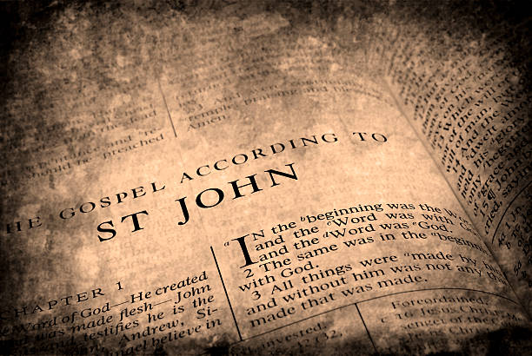

Slide 2
Chiasm / Chiasmus A rhetorical or literary device in which words, grammatical constructions, or concepts are repeated in reverse order, in the same or a modified form.

Slide 3
1-5 ––––––
16-18 ––––––

Slide 4
1-5 ––––––
6-8 ––––––
15 ––––––
16-18 ––––––

Slide 5
1-5 ––––––
6-8 ––––––
9-11 ––––––
14 ––––––
15 ––––––
16-18 ––––––

Slide 6
1-5 ––––––
6-8 ––––––
9-11 ––––––
12-13 ––––––
14 ––––––
15 ––––––
16-18 ––––––

Slide 7
John 1:12-13 Yet to all who did receive him, to those who believed in his name, he gave the right to become children of God— children born not of natural descent, nor of human decision or a husband’s will, but born of God.
John 20:30-31 Jesus performed many other signs in the presence of his disciples, which are not recorded in this book. But these are written that you may believe that Jesus is the Messiah, the Son of God, and that by believing you may have life in his name.

Slide 8
1-5 ––––––
6-8 ––––––
9-11 ––––––
12-13 ––––––
14 ––––––
15 ––––––
16-18 ––––––

Slide 10
¹ In the beginning was the Word, and the Word was with God, and the Word was God.
² He was with God in the beginning.

Slide 11
¹ In the beginning was the Word, and the Word was with God, and the Word was God.
² He was with God in the beginning.

Slide 12
We must choose our words carefully here, of course. How shall we talk about the situation before “in the beginning.” To avoid confusion, I have chosen the word sequence in contrast to the word time as used in the concept of the space-time continuum. It will remind us that something was there before “in the beginning” and that it was more than a static eternal.
-- Francis Schaeffer

Slide 13
¹ In the beginning was the Word, and the Word was with God, and the Word was God.
² He was with God in the beginning.

Slide 14
¹ In the beginning was the Word, and the Word was with God, and the Word was God.
² He was with God in the beginning.

Slide 15
To the Greeks, “logos” was the principle of reason or order ingrained in the universe, the principle which imposes form on the material world and constitutes the rational soul in humans.

Slide 16
¹ In the beginning was the Word, and the Word was with God, and the Word was God.
² He was with God in the beginning.

Slide 17
¹ In the beginning was the Word, and the Word was with God, and the Word was God.
² He was with God in the beginning.

Slide 18
¹ In the beginning was the Word, and the Word was with God, and the Word was God.
² He was with God in the beginning.

Slide 19
New International Version
In the beginning was the Word, and the Word was with God, and the Word was [the] God.

Slide 20
New International Version
In the beginning was the Word, and the Word was with God, and the Word was God.
New World Translation
In the beginning was the Word, and the Word was with God, and the Word was a god.

Slide 21
¹ In the beginning was the Word, and the Word was with God, and the Word was God.
² He was with God in the beginning.

Slide 22
¹ In the beginning was the Word, and the Word was with God, and the Word was God.
² He was with God in the beginning.

Slide 23
¹ In the beginning was the Word, and the Word was with God, and the Word was God.
² He was with God in the beginning.

