Slide 1
Romans
Part XIII
8:1-17

Slide 2
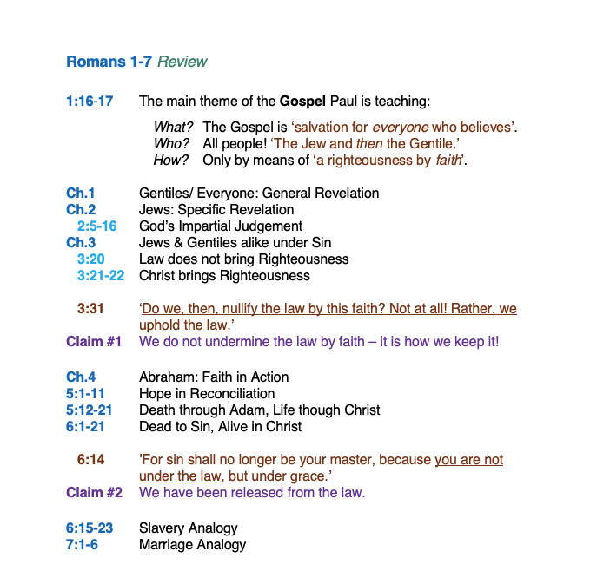
Romans
Review
Ch.1–7

Slide 3
Romans 1:16-17 (NIV)
WHAT
¹⁶ I am not ashamed of the gospel, because it is the power of God for the salvation of everyone who believes: first for the Jew, then for the Gentile.
¹⁷ For in the gospel a righteousness from God is revealed, a righteousness that is by faith from first to last, just as it is written:
"The righteous will live by faith."
WHO
HOW
HOW
HOW

Slide 4
Romans 1-4
²⁰ Therefore, no one will be declared righteous in God’s sight by the works of the law.
Ch.1 Gentiles: General Revelation
Ch.2 Jews: Specific Revelation
2:5-16 God’s Impartial Judgement
Ch.3 Jews & Gentiles alike under sin
3:20 Law does not bring Righteousness
3:21-22 Christ brings Righteousness
²¹ But now apart from the law the righteousness of God has been made known, to which the Law and the Prophets testify. ²² This righteousness from God comes through faith in Jesus Christ to all who believe.
There is no difference between Jew and Gentile, ²³ for all have sinned and fall short of the glory of God.

Slide 5
Romans 1-4
Ch.1 Gentiles: General Revelation
Ch.2 Jews: Specific Revelation
2:5-16 God’s Impartial Judgement
Ch.3 Jews & Gentiles alike under sin
3:20 Law does not bring Righteousness
3:21-22 Christ brings Righteousness
³¹ Do we, then, nullify the law by this faith? Not at all! Rather, we uphold the law.

Slide 6
Claims that need addressed:
#1 We do not undermine the law by faith,
this is how we keep it!

Slide 7
Romans 1-4
Ch.1 Gentiles: General Revelation
Ch.2 Jews: Specific Revelation
2:5-16 God’s Impartial Judgement
Ch.3 Jews & Gentiles alike under sin
3:20 Law does not bring Righteousness
3:21-22 Christ brings Righteousness
Ch.4 Abraham: Faith in Action
²³ The words “it was credited to him” were written not for him alone, ²⁴ but also for us, to whom God will credit righteousness—for us who believe in him who raised Jesus our Lord from the dead.

Slide 8
Romans 5-7
5:1-11 Hope in Reconciliation
5:12-21 Death through Adam, Life though Christ
6:1-14 Dead to Sin, Alive in Christ
¹⁴ For sin shall not be your master, because you are not under the law but grace.

Slide 9
Claims that need answered:
#1 We do not undermine the law by faith,
this is how we keep it!
#2 We have been released from the law.

Slide 10
Romans 5-7
5:1-11 Hope in Reconciliation
5:12-21 Death through Adam, Life though Christ
6:1-14 Dead to Sin, Alive in Christ
6:15-23 Slavery Analogy
7:1-6 Marriage Analogy
⁶ But now, by dying to what once bound us, we have been released from the law so that we serve in the new way of the Spirit, and not in the old way of the written code.

Slide 11
Claims that need answered:
#1 We do not undermine the law by faith,
this is how we keep it!
#2 We have been released from the law.

Slide 12
Romans 5-7
5:1-11 Hope in Reconciliation
5:12-21 Death through Adam, Life though Christ
6:1-14 Dead to Sin, Alive in Christ
6:15-23 Slavery Analogy
7:1-6 Marriage Analogy
7:7-25 The Law & Sin

Slide 13
Romans 7:21-25 (1984 NIV)
²¹ So I find this law at work: When I want to do good, evil is right there with me. ²² For in my inner being I delight in God's law; ²³ but I see another law at work in the members of my body, waging war against the law of my mind and making me a prisoner of the law of sin at work within my members. ²⁴ What a wretched man I am! Who will rescue me from this body of death?

Slide 14
Romans 7:21-25 (1984 NIV)
²¹ So I find this law at work: When I want to do good, evil is right there with me. ²² For in my inner being I delight in God's law; ²³ but I see another law at work in the members of my body, waging war against the law of my mind and making me a prisoner of the law of sin at work within my members. ²⁴ What a wretched man I am! Who will rescue me from this body of death? ²⁵ Thanks be to God--through Jesus Christ our Lord! So then, I myself in my mind am a slave to God's law, but in the sinful nature a slave to the law of sin.

Slide 15
“In any given moment, we may be acting in
the service of heaven or hell.
On any given day, we may have acted in
the service of both.”
- Unknown

Slide 16
Romans 8:1-4 (1984 NIV)
¹ Therefore, there is now no condemnation for those who are in Christ Jesus, ² because through Christ Jesus the law of the Spirit of life set me free from the law of sin and death. ³ For what the law was powerless to do in that it was weakened by the sinful nature, God did by sending his own Son in the likeness of sinful man to be a sin offering. And so he condemned sin in sinful man, ⁴ in order that the righteous requirements of the law might be fully met in us, who do not live according to the sinful nature but according to the Spirit.
⁽¹⁾ Those in Christ are now no longer condemned
⁽²⁾ because they have been freed from sin’s power
⁽³⁾ on the basis of Jesus’ atoning death
⁽⁴⁾ so that they are now able to fulfill the law.

Slide 17
Romans 8:1-4 (1984 NIV)
¹ Therefore, there is now no condemnation for those who are in Christ Jesus, ² because through Christ Jesus the law of the Spirit of life set me free from the law of sin and death. ³ For what the law was powerless to do in that it was weakened by the sinful nature, God did by sending his own Son in the likeness of sinful man to be a sin offering. And so he condemned sin in sinful man, ⁴ in order that the righteous requirements of the law might be fully met in us, who do not live according to the sinful nature but according to the Spirit.

Slide 18
Claims that need answered:
#1 We do not undermine the law by faith,
this is how we keep it!
#2 We have been released from the law.

Slide 19
Romans 8:1-4 (1984 NIV)
¹ Therefore, there is now no condemnation for those who are in Christ Jesus, ² because through Christ Jesus the law of the Spirit of life set me free from the law of sin and death. ³ For what the law was powerless to do in that it was weakened by the sinful nature, God did by sending his own Son in the likeness of sinful man to be a sin offering. And so he condemned sin in sinful man, ⁴ in order that the righteous requirements of the law might be fully met in us, who do not live according to the sinful nature but according to the Spirit.

Slide 20
Claims that need answered:
#1 We do not undermine the law by faith,
this is how we keep it!
#2 We have been released from the law.

Slide 21
Romans 8:1-4 (1984 NIV)
¹ Therefore, there is now no condemnation for those who are in Christ Jesus, ² because through Christ Jesus the law of the Spirit of life set me free from the law of sin and death. ³ For what the law was powerless to do in that it was weakened by the sinful nature, God did by sending his own Son in the likeness of sinful man to be a sin offering. And so he condemned sin in sinful man, ⁴ in order that the righteous requirements of the law might be fully met in us, who do not live according to the sinful nature but according to the Spirit.

Slide 22
’Cleopatra's nose, had it been shorter, the whole face
of the world would have been changed.’
- Blaise Pascal

Slide 23
Romans 8:1-4 (1984 NIV)
¹ Therefore, there is now no condemnation for those who are in Christ Jesus, ² because through Christ Jesus the law of the Spirit of life set me free from the law of sin and death. ³ For what the law was powerless to do in that it was weakened by the sinful nature, God did by sending his own Son in the likeness of sinful man to be a sin offering. And so he condemned sin in sinful man, ⁴ in order that the righteous requirements of the law might be fully met in us, who do not live according to the sinful nature but according to the Spirit.
³ For what the law could not do since it was weakened by the flesh, God did. He condemned sin in the flesh by sending his own Son in the likeness of sinful flesh as a sin offering. [CSB]

Slide 24
Romans 8:1-4 (1984 NIV)
¹ Therefore, there is now no condemnation for those who are in Christ Jesus, ² because through Christ Jesus the law of the Spirit of life set me free from the law of sin and death. ³ For what the law was powerless to do in that it was weakened by the sinful nature, God did by sending his own Son in the likeness of sinful man to be a sin offering. And so he condemned sin in sinful man, ⁴ in order that the righteous requirements of the law might be fully met in us, who do not live according to the sinful nature but according to the Spirit.

Slide 25
Romans 8:5-8 (1984 NIV)
⁵ Those who live according to the sinful nature have their minds set on what that nature desires; but those who live in accordance with the Spirit have their minds set on what the Spirit desires. ⁶ The mind of sinful man is death, but the mind controlled by the Spirit is life and peace; ⁷ the sinful mind is hostile to God. It does not submit to God's law, nor can it do so. ⁸ Those controlled by the sinful nature cannot please God.

Slide 26
Romans 8:9-11 (1984 NIV)
⁹ You, however, are controlled not by the sinful nature but by the Spirit, if the Spirit of God lives in you. And if anyone does not have the Spirit of Christ, he does not belong to Christ. ¹⁰ But if Christ is in you, your body is dead because of sin, yet your spirit is alive because of righteousness. ¹¹ And if the Spirit of him who raised Jesus from the dead is living in you, he who raised Christ from the dead will also give life to your mortal bodies through his Spirit, who lives in you.

Slide 27
Romans 8:12-17 (1984 NIV)
¹² Therefore, brothers, we have an obligation – but it is not to the sinful nature, to live according to it. ¹³ For if you live according to the sinful nature, you will die; but if by the Spirit you put to death the misdeeds of the body, you will live, ¹⁴ because those who are led by the Spirit of God are sons of God. ¹⁵ For you did not receive a spirit that makes you a slave again to fear, but you received the Spirit of sonship. And by him we cry, "Abba, Father." ¹⁶ The Spirit himself testifies with our spirit that we are God's children. ¹⁷ Now if we are children, then we are heirs – heirs of God and co-heirs with Christ, if indeed we share in his sufferings in order that we may also share in his glory.

Slide 28
Romans 8:12-17 (1984 NIV)
‘So you are no longer a slave, but God’s child;
and since you are his child, God has made you
also an heir.’ Galatians 4:7
¹² Therefore, brothers, we have an obligation – but it is not to the sinful nature, to live according to it. ¹³ For if you live according to the sinful nature, you will die; but if by the Spirit you put to death the misdeeds of the body, you will live, ¹⁴ because those who are led by the Spirit of God are sons of God. ¹⁵ For you did not receive a spirit that makes you a slave again to fear, but you received the Spirit of sonship. And by him we cry, "Abba, Father." ¹⁶ The Spirit himself testifies with our spirit that we are God's children. ¹⁷ Now if we are children, then we are heirs – heirs of God and co-heirs with Christ, if indeed we share in his sufferings in order that we may also share in his glory.

Slide 29
Romans
Part XIII
8:1-17

