Slide 1
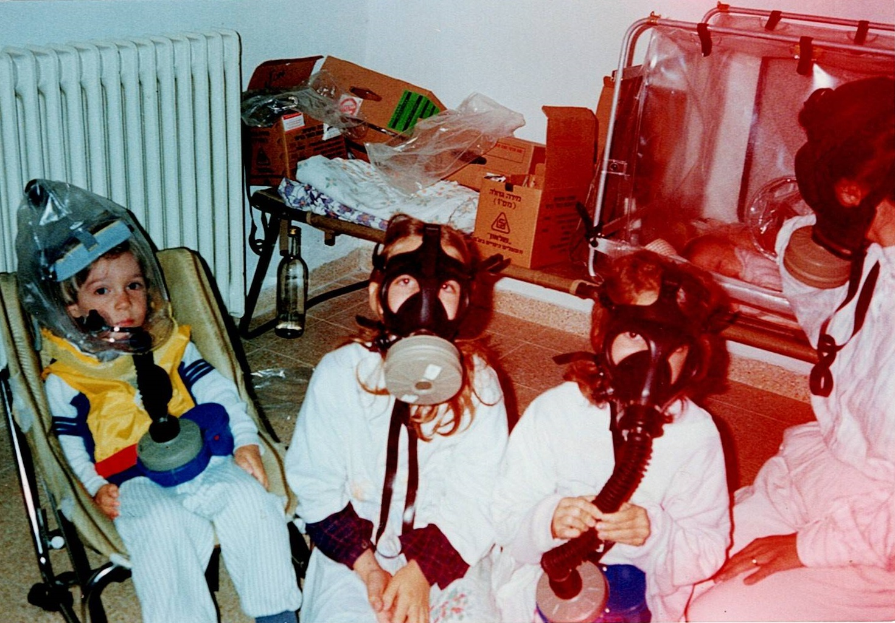

Slide 5
Psalm 8

Slide 6
When I consider your heavens, the work of your fingers, the moon, and the stars which you have set in place

Slide 7
What is mankind that you are mindful of them? Human beings that you care for them?

Slide 8
You have made them a little lower than the angels and crowned them with glory and honor

Slide 9
You made them rulers over the works of your hands. You put everything under their feet.

Slide 17
Genesis 1:28

Slide 18
God blessed them and said to them, “Be fruitful and increase in number; fill the earth and subdue it. Rule over the fish in the sea and the birds in the sky and over every living creature that moves on the ground.

Slide 20
Exodus 19:5-6

Slide 21
Although the whole earth is mine, you will be for me a kingdom of priests and a holy nation

Slide 23
2 Cor. 3:18

Slide 24
And we all, who with unveiled faces contemplate the Lord’s glory, are being transformed into his image with ever-increasing glory, which comes from the Lord, who is the Spirit.

Slide 26
Romans 5:17

Slide 27
If, by the trespass of the one man, death reigned through that one man, how much more will those who receive God’s abundant provision of grace and of the gift of righteousness reign in life through the one man, Jesus Christ!

Slide 29
1 John 4:13

Slide 30
This is how we know that we live in him and he in us: He has given us of his Spirit

Slide 31
Romans 14:17

Slide 32
The kingdom of God is not a matter of eating and drinking but of righteousness and peace and joy in the Holy Spirit

Slide 33
Philippians 3:20

Slide 34
But our citizenship is in heaven. And we eagerly await a Savior from there, the Lord Jesus Christ

