Slide 2
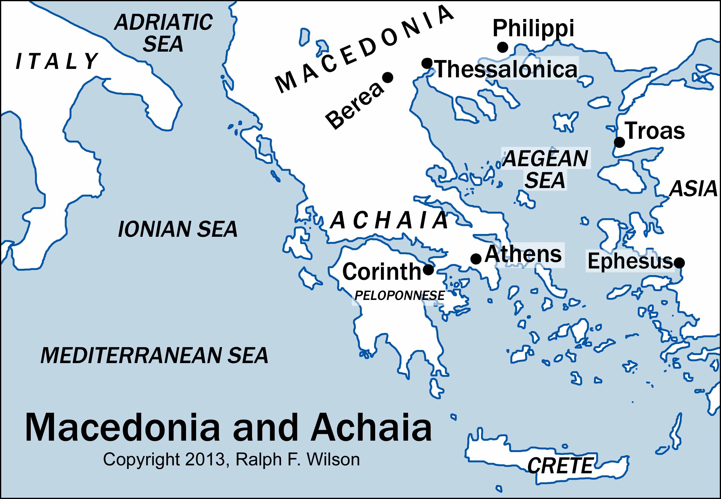

Slide 7
OUTLINE
1. Your faith has greatly encouraged both us and others. (1:1-10)
2. Our time with you speaks for itself. (2:1-13)
3. The persecution you suffer is not unique to you. (2:14-16)
4. Absence has made our hearts grow fonder. (2:17-3:5)
5. Because of the good report about you, we can finally move forward. (3:6-8)
6. This is how we pray for you. (3:9-13)
7. Don’t forget our instructions regarding purity, love, and hard work. (4:1-12)
8. Regarding those among you who have died. (4:13-18)
9. We must keep awake for His sudden return. (5:1-11)
10. Final instructions. (5:12-28)

Slide 8
1:10 And they speak of how you are looking forward to the coming of God’s Son from heaven—Jesus, whom God raised from the dead.
2:19 After all, what gives us hope and joy, and what will be our proud reward and crown as we stand before our Lord Jesus when he returns? It is you!
3:13 May he, as a result, make your hearts strong, blameless, and holy as you stand before God our Father when our Lord Jesus comes again with all his holy people.
4:17 Then, together with them, we who are still alive and remain on the earth will be caught up in the clouds to meet the Lord in the air. Then we will be with the Lord forever.
5:23 Now may the God of peace make you holy in every way, and may your whole spirit and soul and body be kept blameless until our Lord Jesus Christ comes again.

Slide 9
Acts 17:4
Some of the Jews who listened were persuaded and joined Paul and Silas, along with many God-fearing Greek men and quite a few prominent women.
1 Thessalonians 1:9
. . . for they keep talking about . . . how you turned away from idols to serve the living and true God.

Slide 10
The Typical Christian at Thessalonica
• Gentile
• Previously, a pagan (worshiper of idols)
• Spoke common Greek as his first language
• Illiterate
• Worked manual labor, possibly as a slave
• No experience with the Jewish Synagogue
• Had now embraced a lifestyle radically different than his environment
• Not reluctant to share the faith
• Suffered harassment from family and society
• Knew someone who had been severely persecuted for the Faith

Slide 12
1 Thessalonians 1:1
This letter is from Paul, Silas, and Timothy.
We are writing to the church in Thessalonica, to you who belong to God the Father and the Lord Jesus Christ.
May God give you grace and peace.

