Slide 3
1 Thessalonians 1:1
This letter is from Paul, Silas, and Timothy.
We are writing to the church in Thessalonica, to you who belong to God the Father and the Lord Jesus Christ.
May God give you grace and peace.

Slide 4
1 Thessalonians 1:1
This letter is from Paul, Silas, and Timothy.
We are writing to the church in Thessalonica, to you who belong to God the Father and the Lord Jesus Christ.
May God [our Father and the Lord Jesus Christ] give you grace and peace.

Slide 5
1 Thessalonians 1:1
This letter is from Paul, Silas, and Timothy.
We are writing to the church in Thessalonica, to you who belong to God the Father and the Lord Jesus Christ.
May God give you grace and peace.

Slide 6
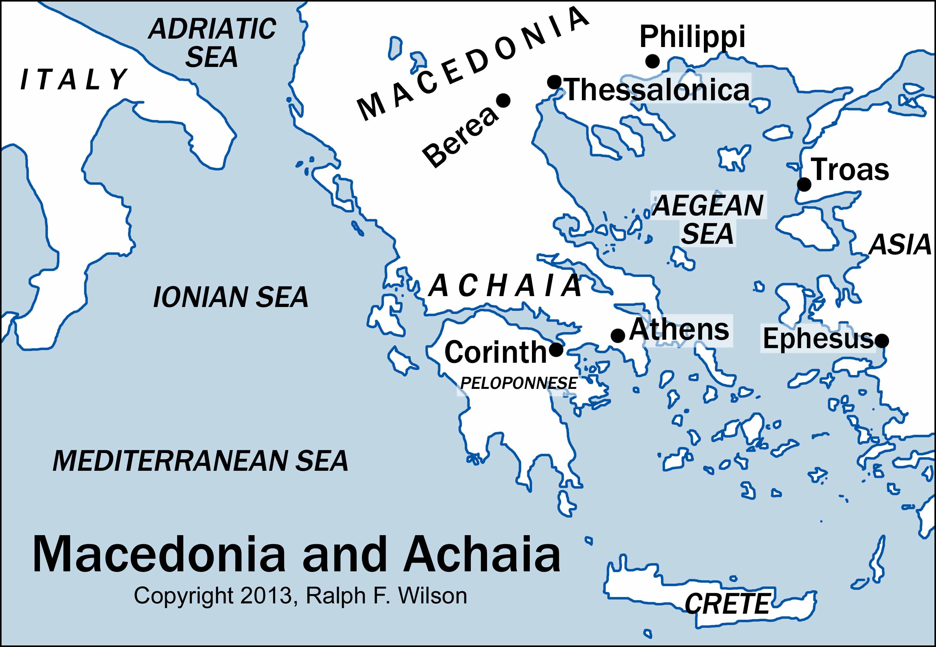

Slide 8
1 Thessalonians 1:1
This letter is from Paul, Silas, and Timothy.
We are writing to the church in Thessalonica, to you who belong to God the Father and the Lord Jesus Christ.
May God give you grace and peace.

Slide 9
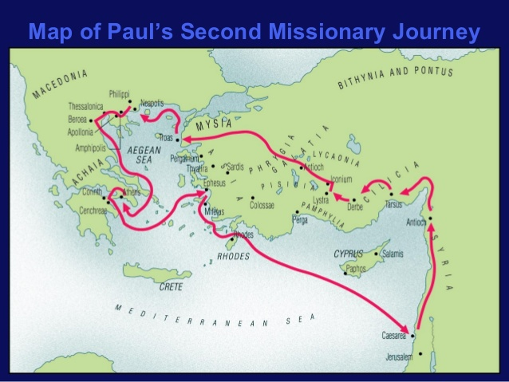

Slide 10
Antioch

Slide 11
Region of Syria and Cilicia

Slide 12
Lystra

Slide 13
Region of Phrygia and Galatia

Slide 14
Troas

Slide 15
Philippi

Slide 16
Thessalonica

Slide 17
Berea

Slide 18
Athens

Slide 19
Corinth

Slide 20
Corinth

Slide 21
Ephesus

Slide 22
Caesarea

Slide 23
Jerusalem
Antioch

Slide 25
Additional matters Paul wants to address:
1. Defending his team’s integrity
2. Expect to be persecuted
3. Abstain from sexual immorality
4. What to expect when Christ returns

