Slide 1
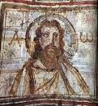
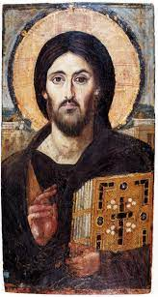
Prayer: Part 2
How to Pray
How not to Pray
Reverence

Slide 2
Avoiding Pitfalls to Praying
Make a Plan
Avoid Mental Drift
Use Prayer Models
Create a System
Journaling
Accountability
No Simple Answers

Slide 3
Ways not to Pray:
Marathon Myth
Persistence Myth
Numbers Myth
Faith in Faith
Formula Myth

Slide 4
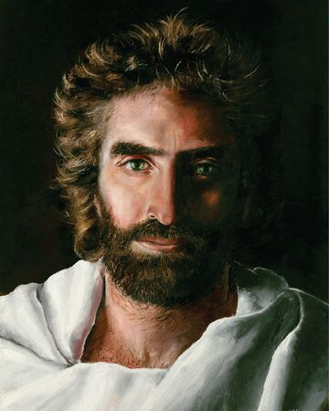
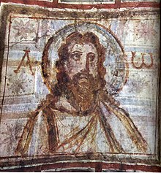
Reverence
Honor and respect that is deeply felt and outwardly demonstrated. Because of God’s awesome power and majesty, He is deserving of the highest level of reverence.

