Slide 1
THE BACKSTORY
THE THESSALONIAN BELIEVERS
CALLED TO LIVE HOLY LIVES
THE RETURN OF JESUS
FINAL WORDS
GRAB BAG

Slide 2
THE BACKSTORY
The account of how the church in Thessalonica was started is found in _____________.

Slide 3
The church in Thessalonica was planted during which of Paul’s missionary journeys? __________

Slide 4
Who were Paul’s coworkers during this missionary journey?

Slide 5
Who was Silas?

Slide 6
Timothy joined Paul and Silas at __________.

Slide 7
The 2nd missionary journey was originally planned out by Paul and ________________.

Slide 8
Where was Paul when he wrote this letter?

Slide 9
True or False?
According to Acts 17, the original converts of the church in Thessalonica included some Jews, a large number of God-fearing Greeks, and quite a few prominent women.

Slide 10
What is the tone and content of the letter?

Slide 11
Where is Thessalonica?

Slide 12
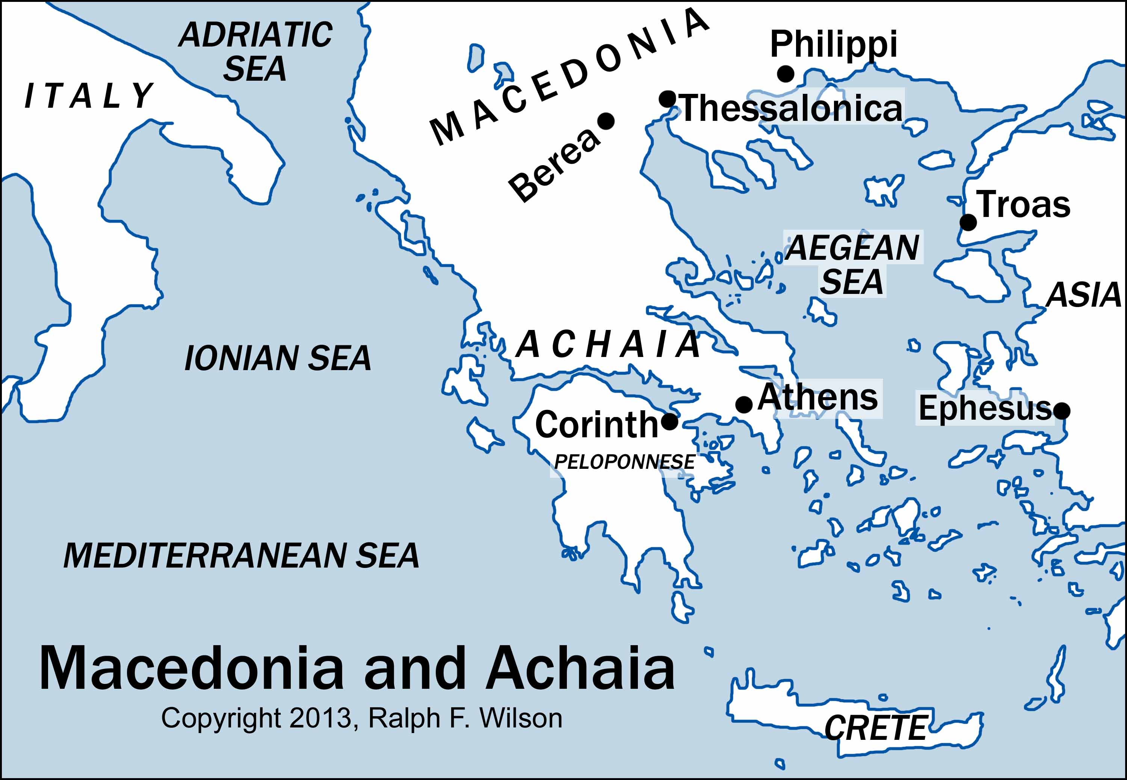

Slide 13
True or False?
1 Thessalonians may have been Paul’s first epistle, having been written within 20 years of Christ’s death/resurrection.

Slide 14
Why did Paul and Silas leave Thessalonica so abruptly?

Slide 15
How were hostile Jews able to stir up riots in the city, over Paul and the Gospel?

Slide 16
Why didn’t Paul return to Thessalonica after he left?

Slide 17
In chapter 2, Paul mentions how Satan had prevented him from returning to Thessalonica to follow up with the new believers there. Paul does not mention how Satan stopped him, but based on what we know, what might we infer?

Slide 18
Who was Jason?

Slide 19
In the letter, we learn that Paul was very eager to return to Thessalonica. Why did he want to go so badly?

Slide 20
True or False?
Because Paul couldn’t go to Thessalonica himself, he sent Timothy as soon as there was an opportunity to do so. Timothy brought back a report. The letter we know of as 1Thessalonians is Paul’s response to Timothy’s report.

Slide 21
THE THESSALONIAN BELIEVERS
How are the Thessalonian believers described in chapter 1?

Slide 22
How are the Thessalonian believers described in chapter 1?

Slide 23
True or False?
Though Paul loves them dearly, he is clearly disappointed that they failed to provide for him and his team. When they were with them, Paul, Silas, and Timothy had to find employment so as to support themselves, which cut into their time of actual ministry.

Slide 24
True or False?
In Acts 17, the new converts at Thessalonica were pleading with Paul and his team to not leave the city. But they did anyway. As a result, the Thessalonians thought they were cowards and questioned the claims of the Gospel they preached.

Slide 25
True or False?
Paul never mentions in his letter that the Thessalonian believers actually faced persecution. However, it is a pretty safe assumption that they did.

Slide 26
In chapter 3, Paul commends them for remaining strong in the faith, saying _____________________________ .

Slide 27
CALLED TO LIVE HOLY LIVES
Is this verse found in 1 Thessalonians?
“We pleaded with you, encouraged you, and urged you to live your lives in a way that God would consider worthy. For he called you to share in his kingdom and glory.”

Slide 28
Is this verse found in 1 Thessalonians?
“May the Lord make your love for one another and for all people grow and overflow, just as our love for you overflows.”

Slide 29
Is this verse found in 1 Thessalonians?
“May he, as a result, make your hearts strong, blameless, and holy as you stand before God our Father when our Lord Jesus comes again with all his holy people.”

Slide 30
Is this verse found in 1 Thessalonians?
“God’s will for you is to be holy, so stay away from all sexual sin.”

Slide 31
Is this verse found in 1 Thessalonians?
“God has called us to live holy lives, not impure lives.”

Slide 32
Is this verse found in 1 Thessalonians?
“May the God of peace make you holy in every way.”

Slide 33
Is this verse found in 1 Thessalonians?
“But the Lord is faithful, and he will strengthen and protect you from the evil one. We have confidence in the Lord that you are doing and will continue to do the things we command. May the Lord direct your hearts into God’s love and Christ’s perseverance.”

Slide 34
Paul begins chapter 4 with, “Finally, dear brothers and sisters, we urge in the name of the Lord Jesus to live in a way that pleases God.”
After this, he lists a number of ways to please God. What isn’t on his list?

Slide 35
In chapter 4, Paul makes a very bold statement regarding the admonishment to avoid sexual sin, “Anyone who refuses to live by these rules is not disobeying ___________ teaching but is rejecting __________.

Slide 36
THE RETURN OF JESUS
It appears that the Thessalonians were grieving the deaths of Christian loved ones. Paul does not want them to grieve like those who have no hope. What is going on?

Slide 37
How does Paul describe the return of Jesus in chapter 4?

Slide 38
What point is Paul making when he says that Jesus will come like a thief in the night?

Slide 39
Did Jesus ever use the expression, “Thief in the night” to describe his return?

Slide 40
What might we imply from Paul’s words, “When people are saying ‘Everything is peaceful and secure,’ then disaster will come”?

Slide 41
True or False?
In chapter 5, Paul uses sleepiness and drunkenness as figures of speech to contrast one’s readiness regarding Christ’s return.

Slide 42
True or False?
Each of the 5 chapters in this letter ends with a reference to the second coming of Jesus.

Slide 43
Did Paul expect Jesus to return during the lifetime of the Thessalonian readers? If so, then how can this letter be inspired by God since that didn’t happen?

Slide 44
LAST WORDS
Paul exhorts the Thessalonians to never stop praying. And yet, this is a charge that even Paul himself couldn’t keep. He stopped praying when he slept, talked to other people, and even when he took time to write this letter.
Why would he tell them to do something that is virtually impossible to do?

Slide 45
True or False?
The practice of giving prophesies resulted in so many abuses that Paul finally told them to stop doing it.

Slide 46
The remedy for abusing the practice of giving prophesies was not to forbid them, but to test them. How did Paul tell us to do that?

Slide 47
Paul prays, “. . . may your whole spirit and soul and body be kept blameless until our Lord Jesus comes again.”
Some have used this verse to insist that humans are made up of 3 distinct parts. What might be our best response to such a claim?

Slide 48
1 Thess 3:13
May he, as a result, make your hearts strong, blameless, and holy as you stand before God our Father when our Lord Jesus comes again with all his holy people.
1 Thess 5:23
Now may the God of peace make you holy in every way, and may your whole spirit and soul and body be kept blameless until our Lord Jesus Christ comes again.

Slide 49
Greet all the brothers and sisters with a sacred kiss. How should we think about this?

Slide 50
What is the difference between being thankful in all circumstances and being thankful for all circumstances?

Slide 51
Paul exhorts his readers to “Stay away from every kind of evil.” What is he referring to?

Slide 52
GRAB BAG
The New Living Translation is one that strives to __________.

Slide 53
Describe the nature and content of this letter.

Slide 54
What was Paul’s mood toward his readers when he wrote this letter?

Slide 55
Did Paul ever return to Thessalonica as he had prayed for?

