Slide 1
Mark 10:17-22

Slide 4
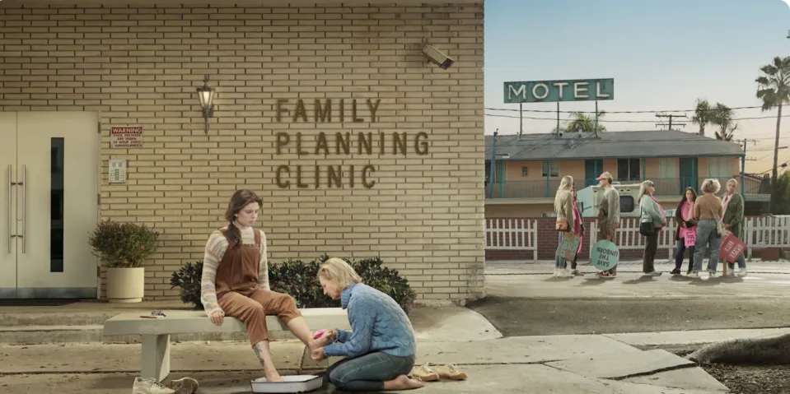

Slide 7
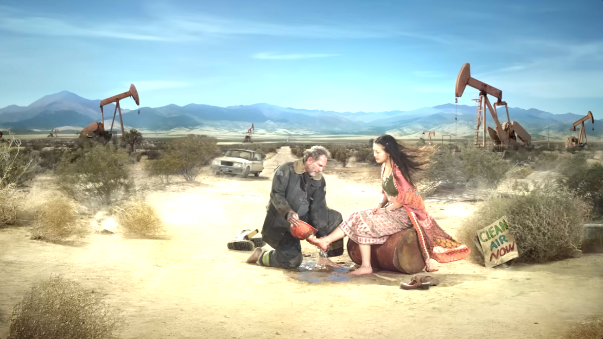

Slide 8
