Slide 1
Romans
Part
8:29-30
XV

Slide 2
Romans 8:28
²⁸ And we know that in all things God works for the good of those who love him, who have been called according to his purpose.

Slide 3
Romans 8:28 (2011 NIV)
²⁸ And we know that in all things God works for the good of those who love him, who have been called according to his purpose.
Romans 8:28 (ESV)
²⁸ And we know that for those who love God all things work together for good, for those who are called according to his purpose.

Slide 4
Romans 8:29-30
²⁸ And we know that in all things God works for the good of those who love him, who have been called according to his purpose.
²⁹ For those God foreknew he also predestined to be conformed to the image of his Son, that he might be the firstborn among many brothers and sisters. ³⁰ And those he predestined, he also called; those he called, he also justified; those he justified, he also glorified.
Plain reading
Reformed view
Arminian view

Slide 5
Romans 8:29-30
I am sure of this, that he who started a good work in you will carry it on to completion until the day of
Christ Jesus.
Philippians 1:6
²⁸ And we know that in all things God works for the good of those who love him, who have been called according to his purpose.
²⁹ For those God foreknew he also predestined to be conformed to the image of his Son, that he might be the firstborn among many brothers and sisters. ³⁰ And those he predestined, he also called; those he called, he also justified; those he justified, he also glorified.

Slide 6
C O M P U L S O R Y
1. We’re not going to
settle this today.
2. Let’s play nice.

Slide 7
Romans 8:29-30
²⁹ For those God foreknew he also predestined to be conformed to the image of his Son, that he might be the firstborn among many brothers and sisters. ³⁰ And those he predestined, he also called; those he called, he also justified; those he justified, he also glorified.

Slide 9
Romans 8:29-30
²⁹ For those God foreknew he also predestined to be conformed to the image of his Son, that he might be the firstborn among many brothers and sisters. ³⁰ And those he predestined, he also called; those he called, he also justified; those he justified, he also glorified.

Slide 10
Romans Summary (John AT Robinson)
1:1 Foreordination; “set apart”
1:6 Effectual Calling
“And you also are among those Gentiles who are called to belong to Jesus Christ“
1:16-Ch.4 Justification
Ch.5-Ch.8 Glorification

Slide 12
TOTAL
DEPRAVITY
CONDITIONAL
DEPRAVITY
UNLIMITED
ATONEMENT
RESISTABLE
GRACE
CONDITIONAL
SECURITY

Slide 13
Romans 8:29-30
²⁹ For those God foreknew he also predestined to be conformed to the image of his Son, that he might be the firstborn among many brothers and sisters. ³⁰ And those he predestined, he also called; those he called, he also justified; those he justified, he also glorified.

Slide 14
NT foreknow (proginōskō)
English Greek
uneasy
OT know (ginōskō)
easy
Hebrew
OT know (Yâda‘)

Slide 15
Romans (John AT Robinson)
1:1 Foreordination; “set apart”
1:6 Effectual Calling
“And you also are among those Gentiles who are called to belong to Jesus Christ“
1:16-Ch.4 Justification
Ch.5-Ch.8 Glorification

Slide 16
Romans (John AT Robinson)
1:1 Foreordination; “set apart”
1:6 Effectual Calling
“And you also are among those Gentiles who are called to belong to Jesus Christ“
1:16-Ch.4 Justification
Ch.5-Ch.8 Glorification

Slide 17
Romans 8:29-30
²⁹ For those God foreknew he also predestined to be conformed to the image of his Son, that he might be the firstborn among many brothers and sisters. ³⁰ And those he predestined, he also called; those he called, he also justified; those he justified, he also glorified.

Slide 18
Romans (John AT Robinson)
1:1 Foreordination; “set apart”
1:6 Effectual Calling
“And you also are among those Gentiles who are called to belong to Jesus Christ“
1:16-Ch.4 Justification
Ch.5-Ch.8 Glorification

Slide 19
Romans (John AT Robinson)
1:1 Foreordination; “set apart”
1:6 Effectual Calling
“And you also are among those Gentiles who are called to belong to Jesus Christ“
1:16-Ch.4 Justification
Ch.5-Ch.8 Glorification

Slide 20
Romans 8:29-30
²⁹ For those God foreknew he also predestined to be conformed to the image of his Son, that he might be the firstborn among many brothers and sisters. ³⁰ And those he predestined, he also called; those he called, he also justified; those he justified, he also glorified.

Slide 21
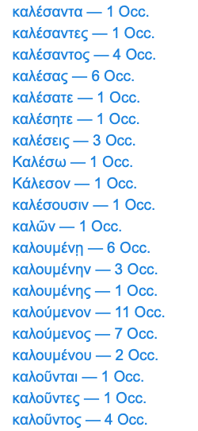
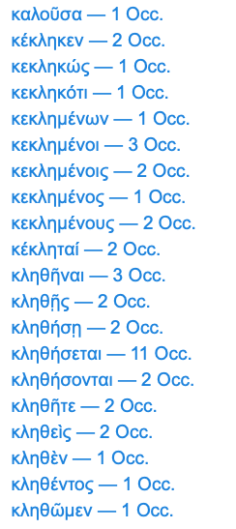
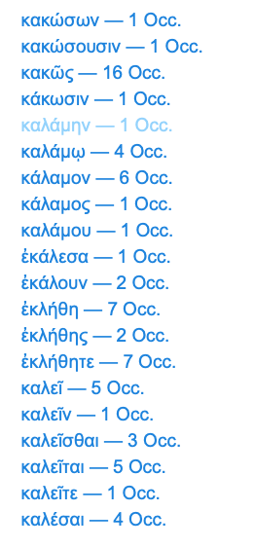
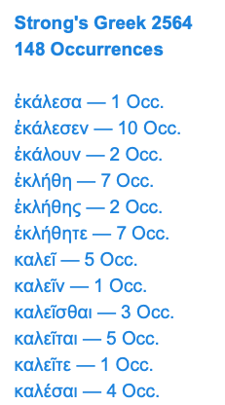
‘Call’

Slide 22
“Does God predestine individuals
TO faith ,
or does God predestine those who
HAVE faith?”

Slide 23
Romans (John AT Robinson)
1:1 Foreordination; “set apart”
1:6 Effectual Calling
“And you also are among those Gentiles who are called to belong to Jesus Christ“
1:16-Ch.4 Justification
Ch.5-Ch.8 Glorification
?

Slide 24
Are we called to exercise faith to be born again?
…or must we be born again to exercise faith?

