Slide 1
Romans
Part XVI

Slide 2
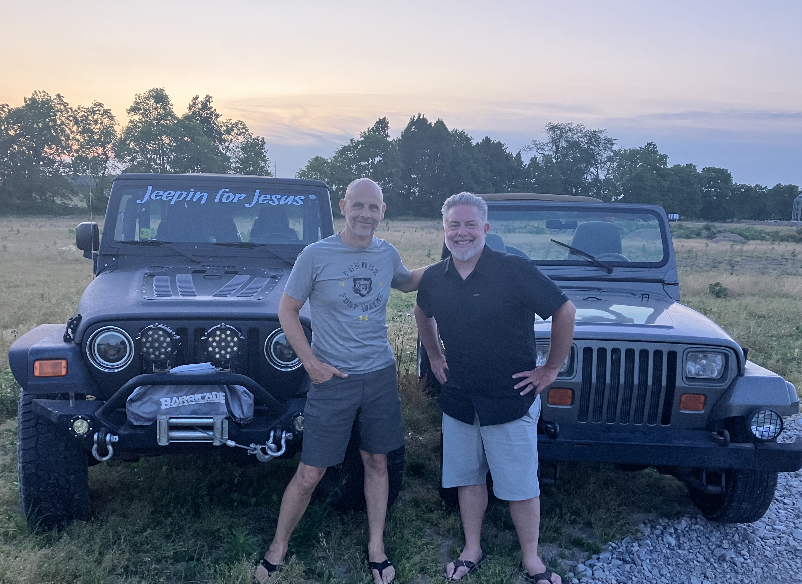
Jeepin’ for Jesus

Slide 3
Romans
(sort of)
Part XVI
Faith: God’s Call & Total Depravity

Slide 4
Romans 8:29-30
²⁹ For those God foreknew he also predestined to be conformed to the image of his Son, that he might be the firstborn among many brothers and sisters. ³⁰ And those he predestined, he also called; those he called, he also justified; those he justified, he also glorified.

Slide 5
Does God predestine individuals
TO faith ,
or does God predestine those who
HAVE faith?

Slide 6
Are we called to exercise faith to be born again?
…or must we be born again to exercise faith?
❶ Passages from Calvinist perspective
❷ Passages from Arminian perspective
❸ Total Depravity

Slide 7
Colossians 2:12
“…having been buried with him in baptism,
in which you were also raised with him
through faith in the powerful working of
God, who raised him from the dead.”

Slide 8
John 10:24-27
²⁴ The Jews who were there gathered around him,
saying, “How long will you keep us in suspense? If you
are the Messiah, tell us plainly.” ²⁵ Jesus answered, “I
did tell you, but you do not believe. The works I do in
my Father’s name testify about me, ²⁶ but you do not
believe because you are not my sheep. ²⁷ My sheep
listen to my voice; I know them, and they follow me.

Slide 9
“You’re going to get teased a lot because
you’re a freshman.”
“You’re a freshman because you’re in the
9th grade.”

Slide 10
John 10:24-27
²⁴ The Jews who were there gathered around him,
saying, “How long will you keep us in suspense? If you
are the Messiah, tell us plainly.” ²⁵ Jesus answered, “I
did tell you, but you do not believe. The works I do in
my Father’s name testify about me, ²⁶ but you do not
believe because you are not my sheep. ²⁷ My sheep
listen to my voice; I know them, and they follow me.

Slide 11
Ephesians 2:8-9
For it is by grace you have been saved,
through faith – and this is not from
yourselves; it is the gift of God – not by
works, so that no one may boast.

Slide 12
Ephesians 2:8-9
For it is by grace you have been saved,
through faith – and this is not from
yourselves; it is the gift of God – not by
works, so that no one may boast.

Slide 13
Ephesians 2:8-9
For it is by grace you have been saved,
through faith – and this is not from
yourselves; it is the gift of God – not by
works, so that no one may boast.

Slide 14
“I want to live in that house, with Deanna –
but it’s not mine.”

Slide 15
Ephesians 2:8-9
For it is by grace you have been saved,
through faith – and this (salvation by
grace) is not from yourselves; it is the gift
of God – not by works, so that no one may
boast.

Slide 16
John 1:12
¹¹ He came to his own, and his own people did
not receive him. ¹² To all who did receive him,
who believed in his name, he gave the right to
become children of God. ¹³ Who were born, not
of blood nor of the will of the flesh nor of the will
of man, but of God.

Slide 17
John 1:12-13
¹¹ He came to his own, and his own people did
not receive him. ¹² To all who did receive him,
who believed in his name, he gave the right to
become children of God. ¹³ Who were born, not
of blood nor of the will of the flesh nor of the will
of man, but of God.

Slide 18
John 1:11-13
¹¹ He came to his own, and his own people did
not receive him. ¹² To all who did receive him,
who believed in his name, he gave the right to
become children of God. ¹³ Who were born, not
of blood nor of the will of the flesh nor of the will
of man, but of God.

Slide 19
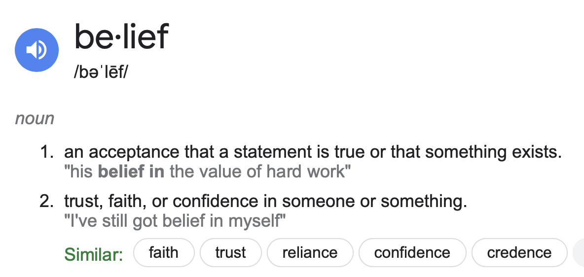

Slide 20
Romans 10:8-10
⁸ But what does it say? “The word is near you; it is in your mouth and in your heart,” that is, the message concerning faith that we proclaim: ⁹ If you declare with your mouth, “Jesus is Lord,” and believe in your heart that God raised him from the dead, you will be saved. ¹⁰ For it is with your heart that you believe and are justified, and it is with your mouth that you profess your faith and are saved.

Slide 21
Romans 4:21-24
²¹ Being fully persuaded that God had power to do what he had promised. ²² This is why “it was credited to him as righteousness.” ²³ The words “it was credited to him” were written not for him alone, ²⁴ but also for us, to whom God will credit righteousness—for us who believe in him who raised Jesus our Lord from the dead.

Slide 22
John 20:24-31
²⁴ Now Thomas, one of the twelve, called the
Twin, was not with then when Jesus came…

Slide 23
Mark 16:14-16
¹⁴ Afterward he appeared to the eleven themselves as
they were reclining at table, and he rebuked them for
their unbelief and hardness of heart, because they
had not believed those who saw him after he had
risen. ¹⁵ And he said “Go into all the world and
proclaim the gospel to the whole creation. ¹⁶ Whoever
believes and is baptized will be saved, but whoever
does not believe will be condemned.

Slide 24
John 9:35-41
³⁵ Jesus heard that they had cast him out…

Slide 25
Acts 16:25-40
Psalm 95:7-9
Hosea 4:6
Isaiah 45:22

Slide 26
Acts 17:26-27
²⁶ From one man he made all the nations, that they should inhabit the whole earth; and he marked out their appointed times in history and the boundaries of their lands. ²⁷ God did this so that they would seek him and perhaps reach out for him and find him, though he is not far from any one of us.

Slide 27
Hebrews 11:6
1 Timothy 2:3-6
2 Peter 3:9
John 12:31
1 John 2:2
John 3:16-18
Romans 10:11-13

Slide 28
Are we called to exercise faith to be born again?
…or must we be born again to exercise faith?
❶ Passages from Calvinist perspective
❷ Passages from Arminian perspective
❸ Total Depravity

Slide 29
Ephesians 2:1-5
¹ As for you, you were dead in your transgressions and sins, ² in which you used to live when you followed the ways of this world and of the ruler of the kingdom of the air, the spirit who is now at work in those who are disobedient.
³ All of us also lived among them at one time, gratifying the cravings of our flesh and following its desires and thoughts. Like the rest, we were by nature deserving of wrath. ⁴ But because of his great love for us, God, who is rich in mercy, ⁵ made us alive with Christ even when we were dead in transgressions — it is by grace you have been saved.

Slide 30
Spiritually Blind
John 14:17
1 John 2:11
2 Corinthians 4:3-4
Separated from Christ
Colossians 1:21-22

Slide 31
Ephesians 2:12-13
¹² Remember that at that time you were separate from Christ, excluded from citizenship in Israel and foreigners to the covenants of the promise, without hope and without God in the world. ¹³ But now in Christ Jesus you, who once were far away, have been brought near by the blood of Christ.

Slide 32
Romans
Part XVI
Faith: God’s Call & Total Depravity

Slide 33
“…yet the old Arminian standards said the same.
True, they affirm that God has given grace to every
man, but they do not dispute the fact that apart
from that grace, there was no ability in man to do
that which was good in his own salvation.”
- Charles Spurgeon

