Slide 1
“I lift my eyes up to the hills. From where does my help come from? My help comes from the Lord, who made heaven and earth. He will not let your foot be moved; he who keeps you will not slumber. Behold, he who keeps Israel will neither slumber nor sleep.
The Lord is your keeper; the Lord is your shade on your right hand. The sun shall not strike you by day, nor the moon by night. The Lord will keep you from all evil; he will keep your life. The Lord will keep your going out and your coming in from this time forth and forever more.”

Slide 2
“Our help is in the name of the Lord, who made heaven and earth.”

Slide 3
“Those who trust in the Lord are like Mount Zion, which cannot be moved, but abides forever. As the mountains surround Jerusalem, so the Lord surrounds his people, from this time forth and forevermore.”

Slide 4
“Unless the Lord builds the house, those who build it labor in vain. Unless the Lord watches over the city, the watchman stays awake in vain.”

Slide 5
“If you, O Lord, should mark iniquities, O Lord, who could stand? But with you there is forgiveness, that you may be feared. . . . I wait for the Lord, my soul waits, and in his word I hope.”

Slide 6
“Behold, how good and pleasant it is when brothers dwell together in unity.”

Slide 8
Psalm 120 – Unknown
Psalm 121 – Unknown
Psalm 122 – King David
Psalm 123 – Unknown
Psalm 124 – King David
Psalm 125 – Unknown
Psalm 126 – Unknown
Psalm 127 – King Solomon
Psalm 128 – Unknown
Psalm 129 – Unknown
Psalm 130 – Unknown
Psalm 131 – King David
Psalm 132 – Unknown
Psalm 133 – King David
Psalm 134 - Unknown

Slide 9
A Song of Ascents

Slide 10
A Song of Ascents
שִׁיר הַמַּֽעֲלוֹת
Hama’Aloth
SHIR

Slide 11
שִׁיר
(Shir) Hymn or Song

Slide 12
מַּֽעֲלוֹת
(ma’aloth) Goings Up/Ascents

Slide 13
Ascents
Steps or gradations within the psalm
“Going up” out of exile in Babylon
Songs for climbing up steps in the temple
Songs during pilgrimage up to Jerusalem

Slide 14
Ascents
Steps or gradations within the psalm

Slide 15
Ascents
Steps or gradations within the psalm
“Going up” out of exile in Babylon

Slide 16
Ezra 7:9 (ESV)
“For on the first day of the first month he began to go up from Babylonia, and on the first day of the fifth month he came to Jerusalem, for the good hand of his God was on him.”

Slide 17
Ascents
Steps or gradations within the psalm
“Going up” out of exile in Babylon
Songs for climbing up steps in the temple

Slide 18
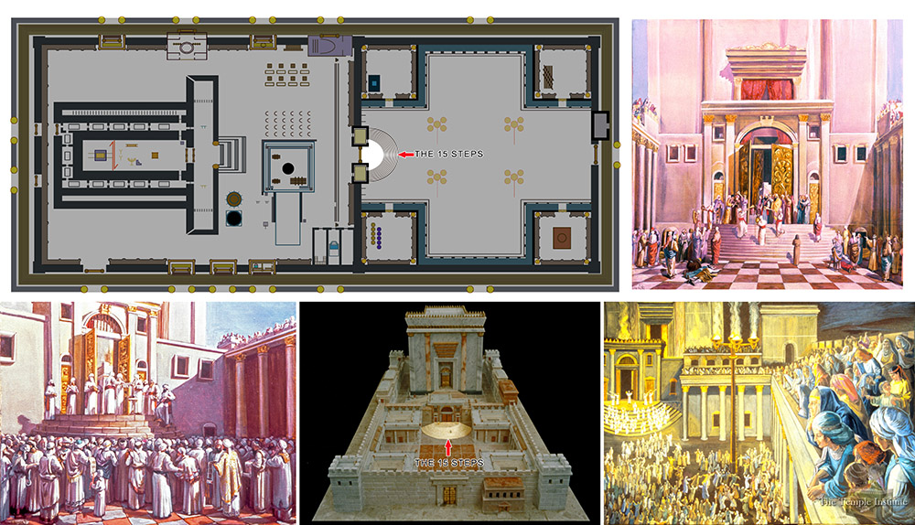

Slide 19
Sukkah 5:4
“Levites with harps, lyres, cymbals and trumpets and countless other musical instruments were there upon the 15 steps leading down from the Azara to the Court of the Women, corresponding to the 15 Songs of Ascent; they stood upon these steps with their instruments of music and sang their songs.”

Slide 20
Ascents
Steps or gradations within the psalm
“Going up” out of exile in Babylon
Songs for ascending steps in the temple
Songs during pilgrimage up to Jerusalem

Slide 21
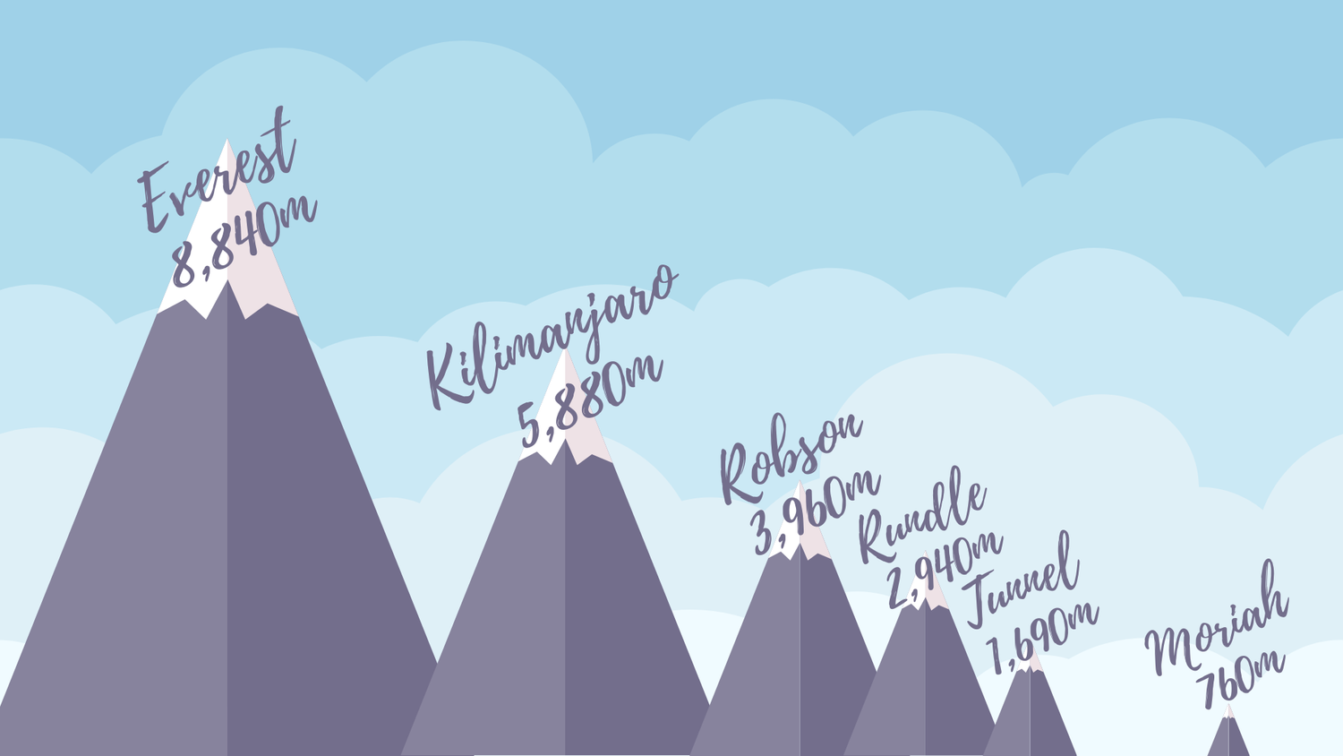

Slide 22
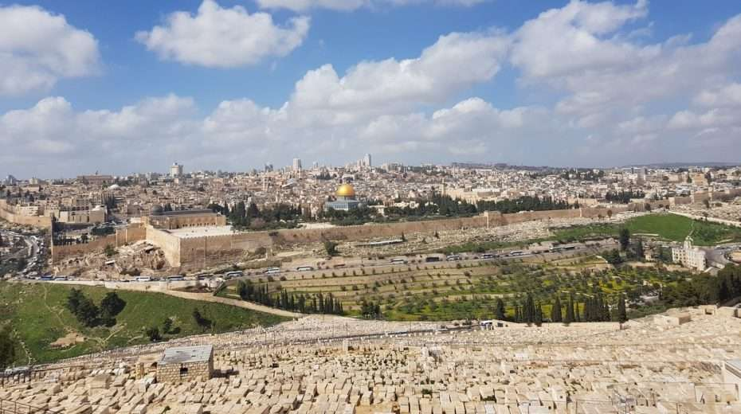

Slide 24
Songs of Ascents #1
psalm 120

Slide 25
Songs of Ascents #2
psalm 121

Slide 26
Songs of Ascents #3
psalm 122

Slide 27
Songs of Ascents #4
psalm 123

Slide 28
Songs of Ascents #5
psalm 124

Slide 29
Songs of Ascents #6
psalm 125

Slide 30
Songs of Ascents #7
psalm 126

Slide 31
Songs of Ascents #8
psalm 127

Slide 32
Songs of Ascents #9
psalm 128

Slide 33
Songs of Ascents #10
psalm 129

Slide 34
Songs of Ascents #11
psalm 130

Slide 35
Songs of Ascents #12
psalm 131

Slide 36
Songs of Ascents #13
psalm 132

Slide 37
Songs of Ascents #14
psalm 133

Slide 38
Songs of Ascents #15
psalm 134

