Slide 2
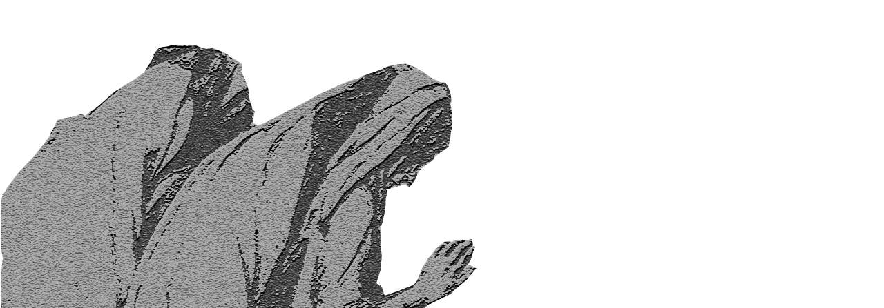

Slide 3
“But the midwives feared God and did not do as the king of Egypt commanded them, but let the male children live.”
- Ex 1:17

Slide 4
“But the midwives feared God and did not do as the king of Egypt commanded them, but let the male children live.”
- Ex 1:17

Slide 6
PSALM 130
¹ Out of the depths I cry to you, O Lord!
² O Lord, hear my voice!
Let your ears be attentive
to the voice of my pleas for mercy!

Slide 7
PSALM 130
¹ Out of the depths I cry to you, O Lord!
² O Lord, hear my voice!
Let your ears be attentive
to the voice of my pleas for mercy!
³ If you, O Lord, should mark iniquities,
O Lord, who could stand?

Slide 8
PSALM 130
¹ Out of the depths I cry to you, O Lord!
² O Lord, hear my voice!
Let your ears be attentive
to the voice of my pleas for mercy!
³ If you, O Lord, should mark iniquities,
O Lord, who could stand?
⁴ But with you there is forgiveness,

Slide 9
PSALM 130
¹ Out of the depths I cry to you, O Lord!
² O Lord, hear my voice!
Let your ears be attentive
to the voice of my pleas for mercy!
³ If you, O Lord, should mark iniquities,
O Lord, who could stand?
⁴ But with you there is forgiveness,
that you may be feared.

Slide 14
SERVILE

Slide 16
ISAIAH 11
1 There shall come forth a shoot from the stump of Jesse,
and a branch from his roots shall bear fruit.
2 And the Spirit of the Lord shall rest upon him,
the Spirit of wisdom and understanding,
the Spirit of counsel and might,
the Spirit of knowledge and the fear of the Lord.
3 And his delight shall be in the fear of the Lord. …

Slide 18
“My Father, if it is possible, may this cup be taken from me. Yet not as I will, but as you will.”
- Mt 26:39

Slide 20
“For this reason the Father loves me, because I lay down my life that I may take it up again.”
- Jn 10:17

Slide 21
SERVILE

Slide 22
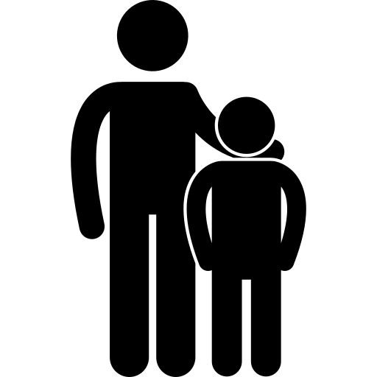
SERVILE
FILIAL

Slide 24
PSALM 130
¹ Out of the depths I cry to you, O Lord!
² O Lord, hear my voice!
Let your ears be attentive
to the voice of my pleas for mercy!
³ If you, O Lord, should mark iniquities,
O Lord, who could stand?
⁴ But with you there is forgiveness,
that you may be feared.

Slide 25
⁵ I wait for the Lord, my soul waits,
and in his word I hope;
⁶ my soul waits for the Lord
more than watchmen for the morning,
more than watchmen for the morning.
⁷ O Israel, hope in the Lord!
For with the Lord there is steadfast love,
and with him is plentiful redemption.
⁸ And he will redeem Israel
from all his iniquities.

Slide 27
“³² And what more shall I say? For time would fail me to tell of Gideon, Barak, Samson, Jephthah, of David and Samuel and the prophets— ³³ who through faith conquered kingdoms, enforced justice, obtained promises, stopped the mouths of lions, ³⁴ quenched the power of fire, escaped the edge of the sword, were made strong out of weakness, became mighty in war, put foreign armies to flight.

Slide 28
³⁵ Women received back their dead by resurrection. Some were tortured, refusing to accept release, so that they might rise again to a better life. ³⁶ Others suffered mocking and flogging, and even chains and imprisonment.

Slide 29
³⁷ They were stoned, they were sawn in two, they were killed with the sword. They went about in skins of sheep and goats, destitute, afflicted, mistreated—³⁸ of whom the world was not worthy—wandering about in deserts and mountains, and in dens and caves of the earth.”
- Heb 11:32-38

Slide 31
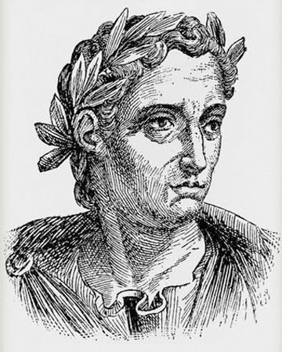

Slide 32
“Whatever the nature of their admission, I am convinced that their stubbornness and unshakable obstinacy ought not to go unpunished.”
- Pliny the Younger

Slide 33
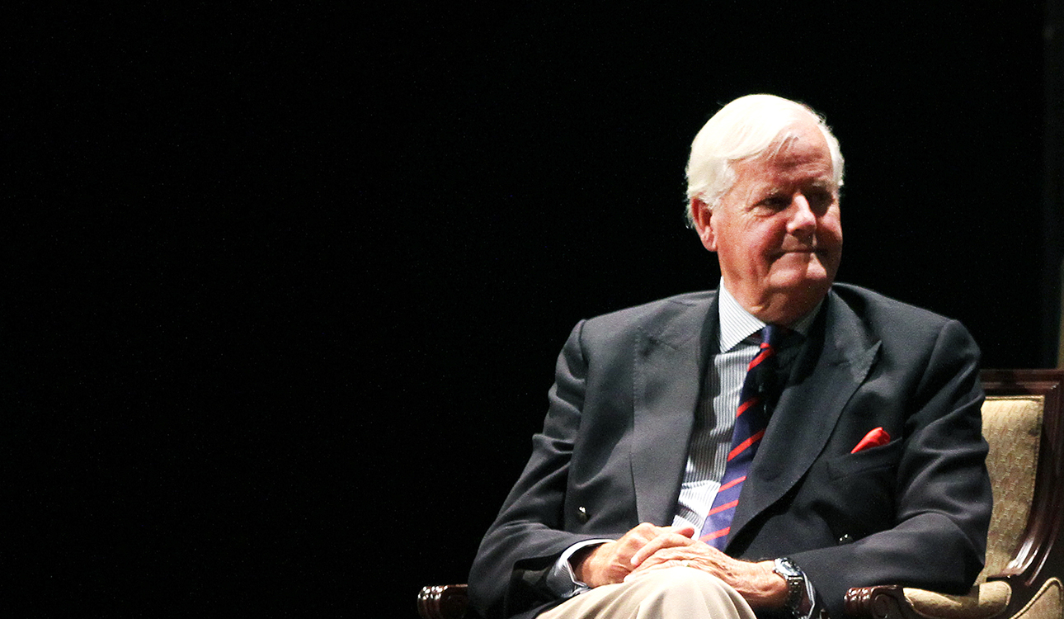

Slide 34
“Would we be convicted today for being stubborn, tenacious, unbending and obstinate?”
- Os Guinness, Impossible People

Slide 35
“… Christians with hearts that can melt with compassion, but with faces like flint and backbones of steel who are unmanipulable, unbribable, undeterrable and unclubbable, without ever losing the gentleness, the mercy, the grace and compassion of our Lord.”
- Os Guinness, Impossible People

Slide 39
