Slide 1
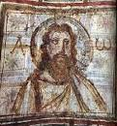
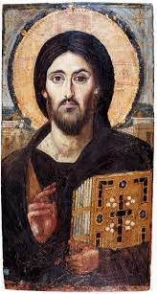
Prayer III

Slide 2
2 Thessalonians 1: 1-12
Prays that God would make the Thessalonians worthy of His calling.
Prays that by His power God may bring to fruition your every desire for goodness and your every deed prompted by faith.
Prays all this so that Jesus may be glorified in them and them in Him.

Slide 3
1 Thessalonians 3:9-13
Thanks God they are remaining faithful to the Lord.
Prays that he’ll get to see them soon.
Prays that their love will increase and overflow.
Prays that their hearts would be strengthened so they will be blameless and holy for when Christ comes back.

Slide 4
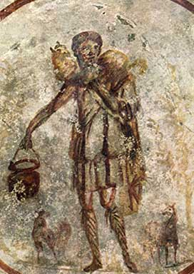
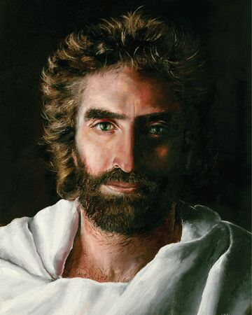
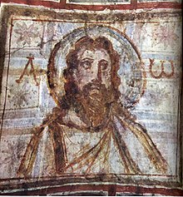
Colossians 1:9-14
Prays that they will be filled with the knowledge of God’s will so they live lives worthy of the Lord, that they will continue to grow and bear fruit, that they will be strengthened with power through God, that they’ll be patient, endure and be thankful.

Slide 5
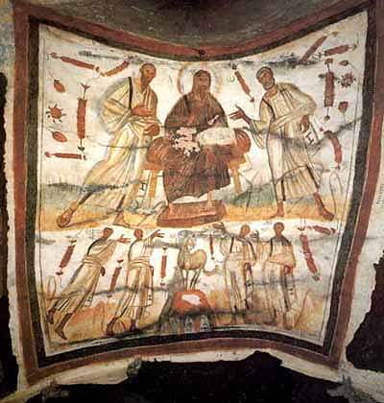
Ways to Please God
Bear fruit in every good work
Grow in the knowledge of God
Display great endurance and patience
Pray and joyfully give thanks to the Father

Slide 6
Philippians 1:9-11
Prays for growth in love and knowledge and insight so that they will be able to discern what is best and may be pure and blameless for the day of Christ.

Slide 7
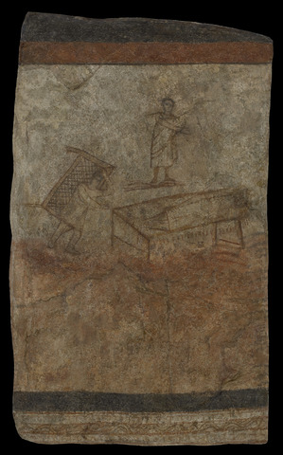
Philippians 1:9-11
⁹ And this is my prayer: that your love may abound more and more in knowledge and depth of insight, ¹⁰ so that you may be able to discern what is best and may be pure and blameless for the day of Christ, ¹¹ filled with the fruit of righteousness that comes through Jesus Christ—to the glory and praise of God.

Slide 8
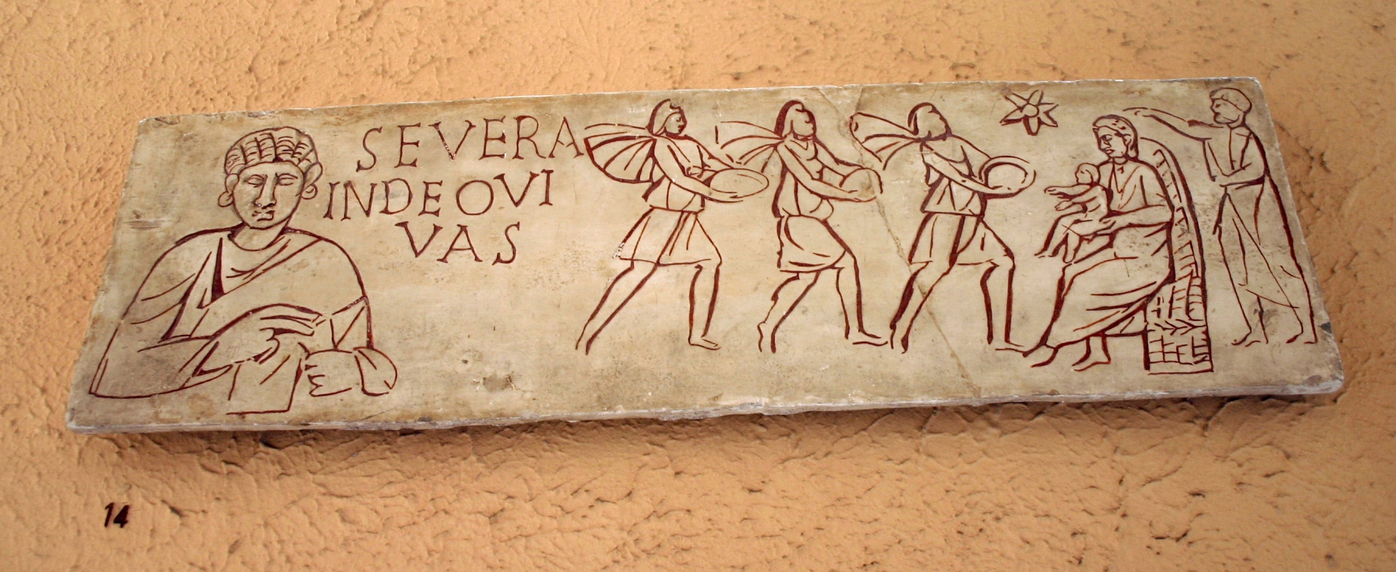
Paul’s Prayers
Prays they be worthy.
Prays for spiritual growth.
Prays that Christ be glorified.
Prays for love to increase.
Prays they be holy and blameless.
Prays they be filled with knowledge of God.
Prays they be patient, enduring, and thankful.

