Slide 3
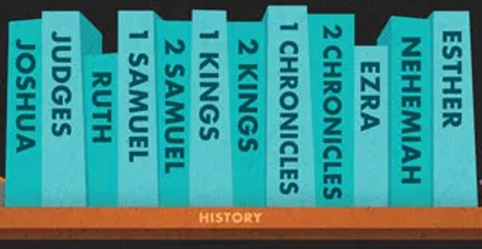
Purposeful stories retelling historical events

Slide 4
1 2 3 4 5 6 7
| | | | | | | |

Slide 5
1 2 3 4 5 6 7
| | | | | | | |
1. Beginnings
2. Patriarchs
3. Sojourn / Conquest / Settlement
4. United Monarchy
5. Divided Monarchy
6. Exile
7. Return from Exile / Post-exilic Judaism

Slide 6
1 2 3 4 5 6 7
| | | | | | | |
1. Beginnings Genesis 1-10
(First Part of Genesis)
? – 2000 B.C.

Slide 7
1 2 3 4 5 6 7
| | | | | | | |
2. Patriarchs
Genesis 11 to Exodus 14
(Most of Genesis and first part of Exodus)
2000 – 1500 B.C.

Slide 8
1 2 3 4 5 6 7
| | | | | | | |
3. Sojourn / Conquest / Settlement
Exodus 15-40, Leviticus, Numbers, Deuteronomy, Joshua, Judges, Ruth
(Most of Exodus to the end of Ruth)
1500 – 1050 B.C.

Slide 9
1 2 3 4 5 6 7
| | | | | | | |
4. United Monarchy
1st and 2nd Samuel, 1st Kings 1-11, 1st Chronicles, 2nd Chronicles 1-9
(1st and 2nd Samuel, first part of 1st Kings)
1050 – 950 B.C.

Slide 10
1 2 3 4 5 6 7
| | | | | | | |
5. Divided Monarchy
1st Kings 12-25, 2nd Kings 1-16, 2 Chronicles 10-36
(Second half of 1st Kings to first half of 2nd Kings)
950 – 700 B.C.

Slide 11
1 2 3 4 5 6 7
| | | | | | | |
6. Exile
2nd Kings 17–25 (Last half of 2nd Kings)
(Last half of 2nd Kings)
700 – 550 B.C.

Slide 12
1 2 3 4 5 6 7
| | | | | | | |
7. Return from Exile / Post-exilic Judaism
Ezra, Nehemiah, Esther
550 – 400 B.C.

Slide 14
1 2 3 4 5 6 7
| | | | | | | |
The Prophets

