Slide 2
JOSHUA
The Book of Joshua

Slide 3
Sermon Outline
Fun Facts to not Forget
Interpretive Issues to Investigate
Theological Things to Think about
JOSHUA

Slide 4
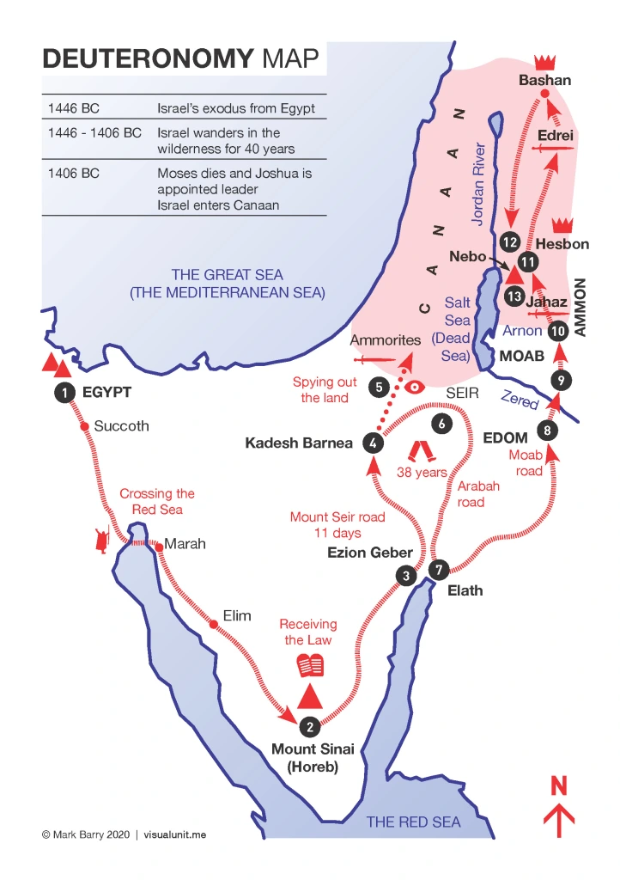

Slide 5
Fun Facts to not Forget
Joshua: Taking Possession of the Promised Land (Chapters 1-24)
JOSHUA

Slide 6
Fun Facts to not Forget
Subduing the Land (Chapters 1-12)
Inhabiting the Land (Chapters 13-24)
JOSHUA

Slide 7
Fun Facts to not Forget
Subduing the Land (Chapters 1-12)
Preparation for Conquest (Chapters 1-5)
The Battles of Conquest (Chapters 6-12)
Inhabiting the Land (Chapters 13-24)
Dividing the Land (Chapters 13-22)
Joshua’s Benediction (Chapters 23-24)
JOSHUA

Slide 8
Subduing the Land (Chapters 1-12)
Preparation for Conquest (Chapters 1-5)
Instructions (Chapter 1)
Two Spies (Chapter 2)
Crossing the Jordan (Chapters 3-4)
Circumcision (Chapter 5)
Passover (Chapter 5)
The Commander of the Lord’s Army (Chapter 5)
JOSHUA

Slide 9
Subduing the Land (Chapters 1-12)
The Battles of Conquest (Chapters 6-12)
Four Military Campaigns
Jericho (Chapter 6)
The problem with Achan (Chapter 7)
Ai (Chapter 8)
The problem with Gibeon (Chapter 9)
Southern coalition (Chapter 10)
Northern coalition (Chapter 11)
Summary (Chapter 12)
JOSHUA

Slide 10
II. Inhabiting the Land (Chapters 13-24)
Not all at once
Not a complete displacement
Conditional possession
JOSHUA

Slide 11
Interpretive Issues to Investigate
What the Bible says is true.
What the Bible says might not be what we have assumed.
Did the Israelites commit genocide at God’s command?
JOSHUA

Slide 12
“devoted to destruction”
6:17 [Jericho] and all that is within it shall be devoted to the LORD for destruction…
6:21 Then they devoted all in [Jericho] to destruction, both men and women, young and old, oxen, sheep, and donkeys, with the edge of the sword.
8:2 And you shall do to Ai and its king as you did to Jericho and its king.
8:26 Joshua did not draw back his hand…until he had devoted all the inhabitants of Ai to destruction.
10:28 He devoted to destruction every person in [Makkedah]; he left none remaining.
10:30 And he struck [Libnah] with the edge of the sword, and every person in it; he left none remaining in it.
10:32 And he captured [Lachish] … and struck it with the edge of the sword, and every person in it, as he had done to Libnah.
10:33 And Joshua struck [Horam king of Gezer] and his people, until he left none remaining.
10:35 And he devoted every person in [Eglon] to destruction that day, as he had done to Lachish.
10:37 He left none remaining, as he had done to Eglon, and devoted [Hebron] to destruction and every person in it.
10:39 And they struck them with the edge of the sword and devoted to destruction every person in [Debir]; he left none remaining.
10:40 So Joshua struck the whole land, the hill country and the Negeb and the lowland and the slopes, and all their kings. He left none remaining, but devoted to destruction all that breathed, just as the LORD God of Israel commanded.
11:11 And they struck with the sword all who were in [Hazor], devoting them to destruction; there was none left that breathed.
11:12 And all the cities of those kings, and all their kings, Joshua captured, and struck them with the edge of the sword, devoting them to destruction, just as Moses the servant of the LORD had commanded.
11:21 Joshua devoted [the Anakim] to destruction with their cities.
JOSHUA

Slide 13
“devoted to destruction”?
10:33 Joshua struck [Horam king of Gezer] and his people, until he left none remaining.
10:37 He left none remaining…and devoted [Hebron] to destruction and every person in it.
10:39 They struck them with the edge of the sword and devoted to destruction every person in [Debir]; he left none remaining.
10:40 Joshua struck the whole land…and all their kings. He left none remaining, but devoted to destruction all that breathed.
16:10 [The Ephraimites] did not drive out the Canaanites who lived in Gezer.
14:12 “Now give me [Hebron]...and I shall drive them out.”
15:15 [Caleb] went up from [Hebron] against the inhabitants of Debir.
15:63 …the Jebusites, the inhabitants of Jerusalem, the people of Judah could not drive out.
JOSHUA

Slide 14
Did God command genocide?
Yes, but he was wrong to do so.
God is capricious, immoral, and untrustworthy.
It was a different God (Marcionism).
God has “grown” since then.
Yes, but only as a test.
Yes, and Israel was right to obey.
No, the human authors only thought/claimed that he did.
No, what God commanded was not genocide.
JOSHUA

Slide 15
Did God command genocide?
Yes, but he was wrong to do so.
God is capricious, immoral, and untrustworthy.
It was a different God (Marcionism).
God has “grown” since then.
Yes, but only as a test.
Yes, and Israel was right to obey.
No, the human authors only thought/claimed that he did.
No, what God commanded was not genocide.
JOSHUA

Slide 16
Did God command genocide?
Yes, but he was wrong to do so.
God is capricious, immoral, and untrustworthy.
It was a different God (Marcionism).
God has “grown” since then.
Yes, but only as a test.
Yes, and Israel was right to obey.
No, the human authors only thought/claimed that he did.
No, what God commanded was not genocide.
JOSHUA

Slide 17
Did God command genocide?
Yes, but he was wrong to do so.
God is capricious, immoral, and untrustworthy.
It was a different God (Marcionism).
God has “grown” since then.
Yes, but only as a test.
Yes, and Israel was right to obey.
No, the human authors only thought/claimed that he did.
No, what God commanded was not genocide.
JOSHUA

Slide 18
Did God command genocide?
Yes, but he was wrong to do so.
God is capricious, immoral, and untrustworthy.
It was a different God (Marcionism).
God has “grown” since then.
Yes, but only as a test.
Yes, and Israel was right to obey.
No, the human authors only thought/claimed that he did.
No, what God commanded was not genocide.
JOSHUA

Slide 19
Did God command genocide?
Yes, but he was wrong to do so.
God is capricious, immoral, and untrustworthy.
It was a different God (Marcionism).
God has “grown” since then.
Yes, but only as a test.
Yes, and Israel was right to obey.
No, the human authors only thought/claimed that he did.
No, what God commanded was not genocide.
JOSHUA

Slide 20
Did God command genocide?
Yes, but he was wrong to do so.
God is capricious, immoral, and untrustworthy.
It was a different God (Marcionism).
God has “grown” since then.
Yes, but only as a test.
Yes, and Israel was right to obey.
No, the human authors only thought/claimed that he did.
No, what God commanded was not genocide.
JOSHUA

Slide 21
Did God command genocide?
Yes, but he was wrong to do so.
God is capricious, immoral, and untrustworthy.
It was a different God (Marcionism).
God has “grown” since then.
Yes, but only as a test.
Yes, and Israel was right to obey.
No, the human authors only thought/claimed that he did.
No, what God commanded was not genocide.
JOSHUA

Slide 22
Corporate Capital Punishment
Gen 15:16 “They shall come back here in the fourth generation, for the iniquity of the Amorites is not yet complete.”
Lev 18:24-25 “By all these the nations I am driving out before you have become unclean, and the land became unclean, so that I punished its iniquity, and the land vomited out its inhabitants.”
Deut 9:4 “It is because of the wickedness of these nations that the LORD is driving them out before you.”
JOSHUA

Slide 23
JOSHUA

Slide 24
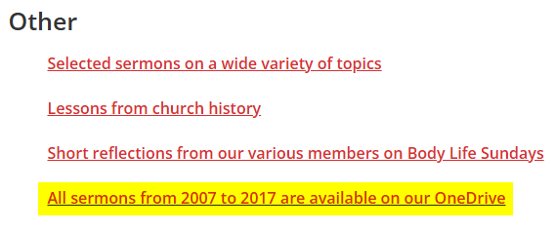
Did God command genocide?
https://trinity-evangelical-church.org/sermons-main/
https://trinity-evangelical-church.org/sermons-main/sermons_2021
https://trinity-evangelical-church.org/sermons-main/sermons_2023

Slide 25
Theological Things to Think about
God’s People, in God’s Place, under God’s Rule and blessing.
God keeps his promises.
There are promises yet to be realized.
JOSHUA

Slide 26
God’s People in God’s Place
Gen 12:7 “To your offspring I will give this land.”
Gen 13:15 “All the land that you see I will give to you and to your offspring forever.”
Gen 15:18 “To your offspring I give this land.”
Gen 17:8 “I will give to you and to your offspring after you the land of your sojournings, all the land of Canaan, for an everlasting possession.”
Gen 26:3-4, Gen 28:4, Gen 28:13, Gen 35:12, Gen 48:4, Ex 3:8, Ex 6:8, Ex 32:13
JOSHUA

Slide 27
Theological Things to Think about
God’s People, in God’s Place, under God’s Rule and blessing.
God keeps his promises.
There are promises yet to be realized.
JOSHUA

Slide 28
God’s People in God’s Place
Rev 21:2-3 I saw the holy city, new Jerusalem, coming down out of heaven from God…and I heard a loud voice from the throne saying, “Behold, the dwelling place of God is with man. He will dwell with them, and they will be his people, and God himself will be with them as their God.”
Heb 11:10 “He was looking forward to the city with foundations, whose architect and builder is God.”
Heb 11:13 “All these people were still living by faith when they died. They did not receive the things promised; they only saw them and welcomed them from a distance.”
Heb 11:16 “Instead, they were longing for a better country--a heavenly one. Therefore God is not ashamed to be called their God, for he has prepared a city for them.”
JOSHUA

Slide 29
You know with all your heart and soul that not one of all the good promises the LORD your God gave you has failed. Every promise has been fulfilled; not one has failed.
(Joshua 23:14)
JOSHUA

