Slide 1
Judges

Slide 4
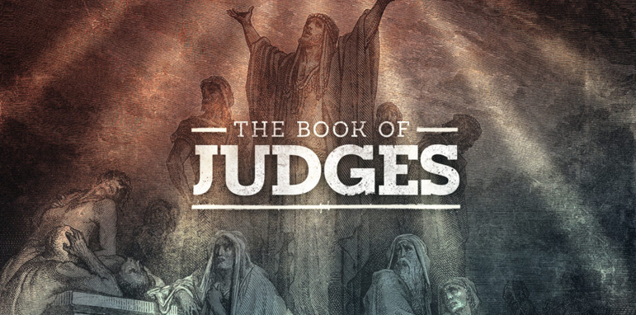

Slide 6
Compromise
& Tragedy

Slide 9
Judges

Slide 10
Judges
Context:
Immediately following Joshua 23-24

Slide 11
Judges
1:1 After the death of Joshua, the Israelites asked the Lord, “Who of us is to go up first to fight against the Canaanites?”
2:6 After Joshua had dismissed the Israelites, they went to take possession of the land, each to their own inheritance.

Slide 12
Judges
1:1-2:5
2:6-Ch.16
Ch.17-21
F
J
T
Judges
Two Terrible Stories
Framing the Book

Slide 13
Judges
1:1-2:5
2:6-Ch.16
Ch.17-21
Judges
Two Terrible Stories
Framing the Book

Slide 14
Judges 1
²¹ The Benjamites, however, did not drive out the Jebusites…
²⁷ Manasseh did not drive out the people… for the Canaanites were determined to live in that land. ²⁸ When Israel became strong, they pressed the Canaanites into forced labor but never drove them out completely.
²⁹ Nor did Ephraim drive out the Canaanites…(they) continued to live among them. ³⁰ Neither did Zebulun… ³¹ Nor did Asher… ³³ Neither did Naphtali…
³⁴ The Amorites confined the Danites to the hill country, not allowing them to come down into the plain.

Slide 15
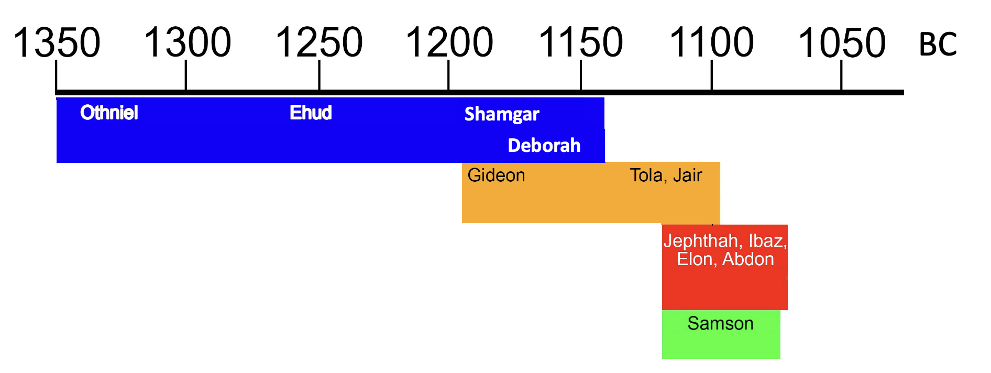
Judges

Slide 16
Judges
1:1-2:5
2:6-Ch.16
Ch.17-21
Othniel
Ehud
Shamgar
Deborah
Gideon
Tola
Jair
Levite & His Concubine
Micah’s Idols
Framing the Book
Jephthah
Ibaz
Elon
Abdon
Samson

Slide 17
Judges

