Slide 3
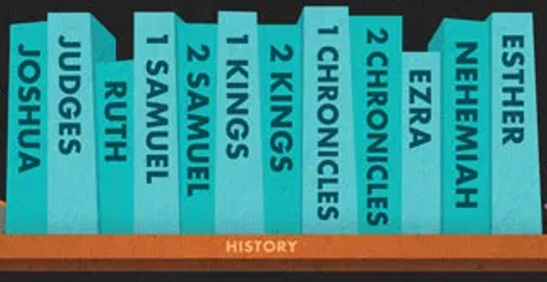
Purposeful stories retelling historical events

Slide 4
Biblical narratives consist of:
• A scene
• A plot
• A plot resolution
• Characters
• Dialogue
• The narrator

Slide 5
The 3 levels of an OT narrative
• 3rd – The grand story of redemption history
• 2nd – The story of God’s covenant people
• 1st – The story of the event itself

Slide 6
Cautions and advice
1. Don’t look for hidden meanings.
2. Don’t look for “The moral of the story.”
3. Be careful with supposed ”examples to imitate.”
4. Narratives are not intended to explain doctrine.
5. Don’t expect to find all the answers.

