Slide 1
1 Samuel

Slide 2
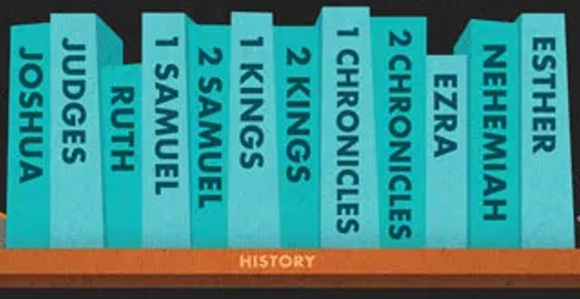
Review:
Biblical Narrative: Purposeful stories retelling historical events

Slide 3
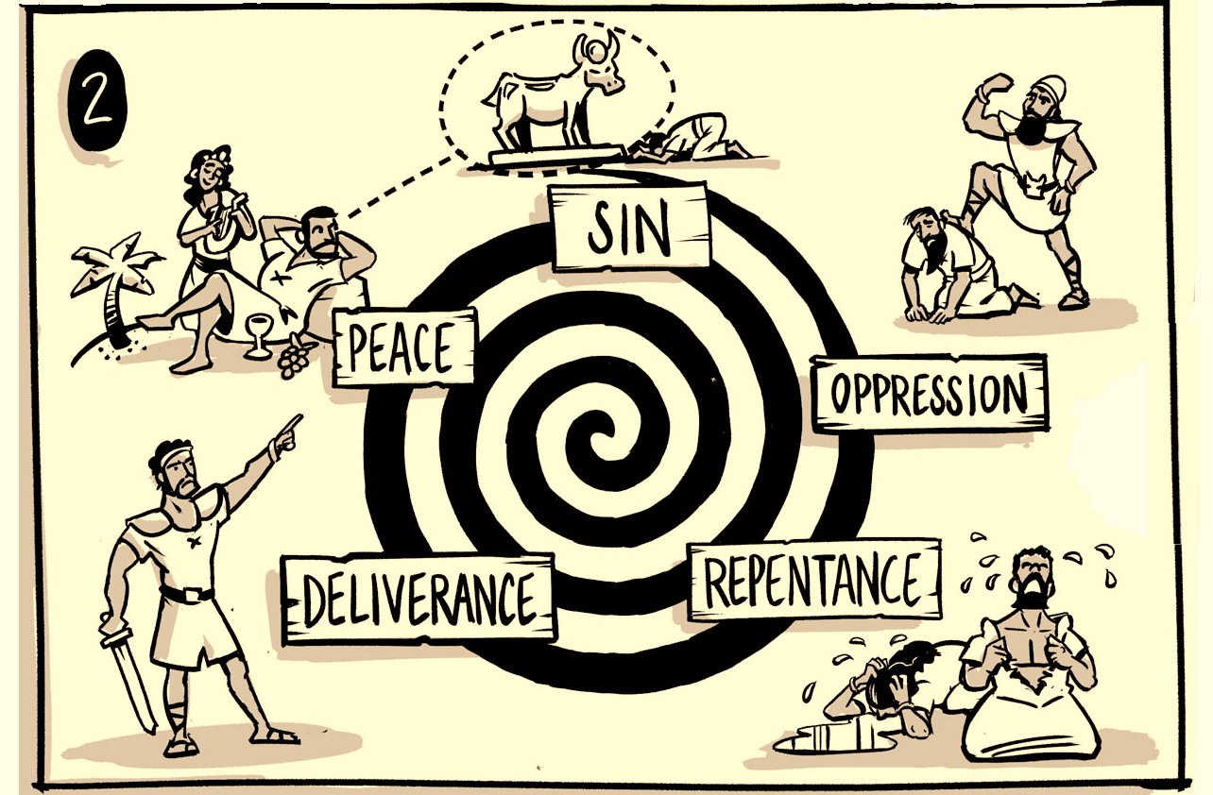
Review: The Book of Judges

Slide 4
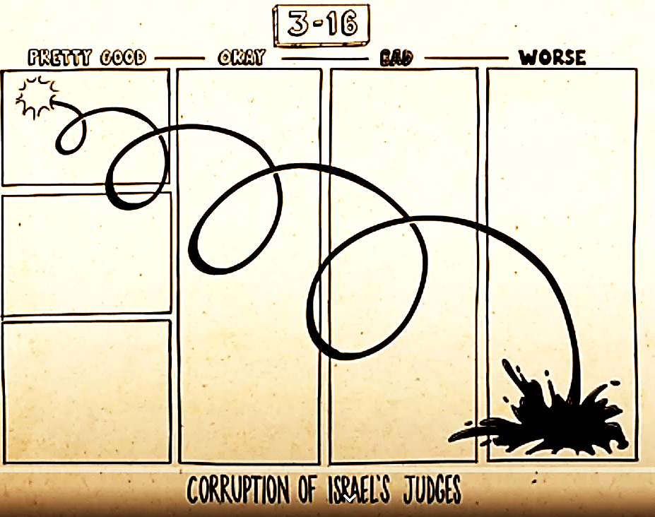
Review: The Book of Judges

Slide 5
Presentation Outline for 1 Samuel
Background to 1 Samuel: Who, What, When, Where, and Why?
Vignettes
This is History, Not Mythology!
Applications

Slide 6
Background to 1 Samuel: Who is the Author?
Samuel did write. The Jewish Talmud attributes the book to him.
1 Samuel 10:25 “Then Samuel told the people the ordinances of the kingdom, and wrote them in the book and placed it before the LORD.”
1 Chron 29:29 “Now the acts of King David, from first to last, are written in the Chronicles of Samuel the seer, and in the Chronicles of Nathan the prophet, and in the Chronicles of Gad the seer”
Are these the same as the book of Samuel? We don’t know.
The book is anonymous
1Samuel |  |  |  |  |  |  |  |  |  |  |  |  |  |  |  |  |  |  |  |  |  |  |  |  |  |  |  |  |  |  | 2 Samuel
1 | 2 | 3 | 4 | 5 | 6 | 7 | 8 | 9 | 10 | 11 | 12 | 13 | 14 | 15 | 16 | 17 | 18 | 19 | 20 | 21 | 22 | 23 | 24 | 25 | 26 | 27 | 28 | 29 | 30 | 31 | 1 | 2 | 3 | 4 | 5 | 6 | 7 | 8 | 9 | 10 | 11 | 12 | 13 | 14 | 15 | 16 | 17 | 18 | 19 | 20 | 21 | 22 | 23 | 24
1 Samuel 25:1a “Then Samuel died”

Slide 7
Background to 1 Samuel: Who are the People?
God
Samuel – the last judge
Saul - king
David – shepherd, poet/psalmist/musician, king
Hannah (Samuel’s mother)
Eli (priest,) Hophni and Phinehas (sons)
Jonathan

Slide 8
Psalm | Incident in David’s Life in 1 Samuel | References
34 | David delivered from danger by feigning madness in the presence of King Achish of Gath | 1 Sam. 21:12–22:1
52 | Doeg the Edomite tells Saul that David went to the house of Ahimelech | 1 Sam. 22:9–19
54 | The Ziphites tell Saul that David is hiding among them | 1 Sam. 23:19
56 | The Philistines seize David in Gath | 1 Sam. 21:10–11
57 | David flees from Saul into a cave | 1 Sam. 22:1 or 24:3
59 | Saul sends men to watch David’s house in order to kill him | 1 Sam. 19:11
63 | David in the desert of Judah | 2 Samuel 15–17? 1 Sam. 23:14–15?
142 | David flees from Saul into a cave | Same as Psalm 57

Slide 9
Incident in David’s Life in 1 Samuel
1 Samuel 23:19-21 Then Ziphites came up to Saul at Gibeah, saying, “Is David not hiding with us in the strongholds at Horesh, on the hill of Hachilah, which is on the south of Jeshimon? 20 Now then, O king, come down according to all the desire of your soul to do so; and our part shall be to surrender him into the king’s hand.” 21 Saul said, “May you be blessed of the LORD, for you have had compassion on me.
The Ziphites were Judahites, but they apparently were not happy to have David and his men in the area. Psalm 54 was in response to this occasion. (ESV Study Bible)

Slide 10
Psalms 54
Prayer for Defense against Enemies. For the choir director; on stringed instruments. A maskil of David, when the Ziphites came and said to Saul, “is not David hiding himself among us?”
​¹ Save me, O God, by Your name,
And vindicate me by Your power.
² Hear my prayer, O God; Give ear to the words of my mouth.
³ For strangers have risen against me And violent men have sought my life; They have not set God before them. Selah.

Slide 11
Psalms 54
⁴ Behold, God is my helper; The Lord is the sustainer of my soul.
⁵ He will recompense the evil to my foes; Destroy them in Your faithfulness.
⁶ Willingly I will sacrifice to You; I will give thanks to Your name, O LORD, for it is good.
⁷ For He has delivered me from all trouble, And my eye has looked with satisfaction upon my enemies.

Slide 12
Background to 1 Samuel: What?
Three Levels of Narrative:
The Grand Story of Redemption – The ultimate King will rule his people
The Story of God’s Covenant People – The establishment of a kingship in Israel
The Event Themselves – more to come…

Slide 13
Background to 1 Samuel: What?
The Events Themselves “The first third of 1 Samuel pits the decline of Eli and his sons against the rise of Samuel, so that readers should picture these chapters in the form of an X (Eli's decline occurring simultaneously with Samuel's ascent). The remainder of the book is likewise an extended X in which the decline of Saul is played against the rise of David. In this phase of the story, the stories of Saul and David are intertwined, as readers are kept up to date on the tragic decline of Saul and the life of the king-in-waiting as a fugitive.” (ESV Study Bible)

Slide 14
Background to 1 Samuel: When?
1 Samuel
…
?
6. Exile
1. Beginnings
2. Patriarchs
Intertestamental Period
3. Sojourn/ Conquest/
Settlement
5. Divided Monarchy
4. United Monarchy
7. Return from Exile/
Post-exilic Judaism

Slide 15
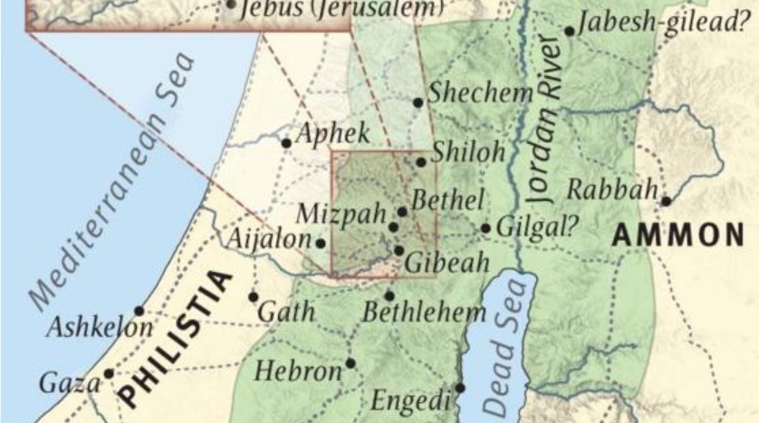
Background to 1 Samuel: Where?
Eli’s home and temple
Samuel’s home
Saul’s headquarters
David’s home

Slide 16
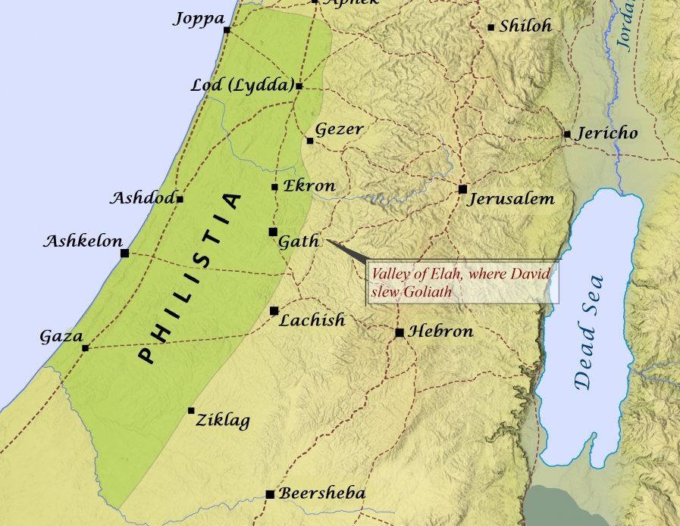
Background to 1 Samuel: Where? Five Cities of the Philistines and their Five Lords
Noah → Ham → → Philistines (Genesis 10)

Slide 17
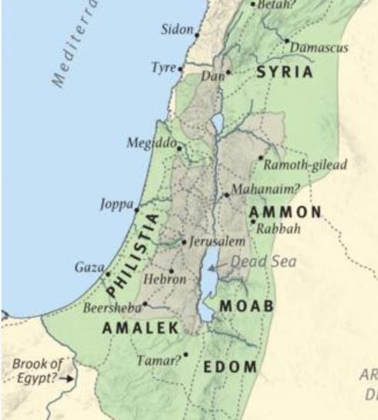
Background to 1 Samuel: Where are the Enemies?
Lot and his younger daughter → Ben-ammi (Genesis 19)
Lot and his older daughter → Moab (Genesis 19) (Ruth)
Noah → Ham → → Philistines (Genesis 10)
Isaac → Esau/Edom/”Red” (Genesis 25)
Isaac → Esau/Edom → Eliphaz (Genesis 36)

Slide 18
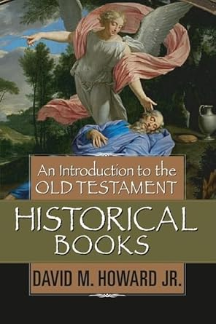
Background to 1 Samuel: Why?
“The books of Samuel deal with the establishment of kingship in Israel and its theological significance. The books begin with Israel still under the decentralized system of the judges period and end with the Israelite monarchy firmly in place. They begin with the last of the judges (Samuel) and end with the first – and the greatest – king in the line of Judah (David.)”

Slide 19
Background to 1 Samuel: What? The Events Themselves

Slide 20
Vignette 1: Eli, Hannah, and their Children
Eli
Priest at Shiloh – 1 Samuel 1:9 “… Now Eli the priest …”
Old and Overweight - 1 Samuel 4:18 “… for he was old and heavy.”
Father to Hophni and Phinehas - 1 Samuel 1:3 “the two sons of Eli, Hophni and Phinehas

Slide 21
Vignette 1: Eli, Hannah, and their Children
Hophni and Phinehas
1 Samuel 2:12 “Now the sons of Eli were worthless men; they did not know the LORD”
1 Samuel 2:22-25 “Now Eli was very old; and he heard all that his sons were doing to all Israel, and how they lay with the women who served at the doorway of the tent of meeting. 23 He said to them, “Why do you do such things, the evil things that I hear from all these people? 24 No, my sons; for the report is not good which I hear the LORD’S people circulating. 25 If one man sins against another, God will mediate for him; but if a man sins against the LORD, who can intercede for him?” But they would not listen to the voice of their father, for the LORD desired to put them to death.

Slide 22
Vignette 1: Eli, Hannah, and their Children
Hannah’s Story
1 Samuel 1:1-2 Now there was a certain man from Ramathaim-zophim from the hill country of Ephraim, and his name was Elkanah … ² He had two wives: the name of one was Hannah and the name of the other Peninnah; and Peninnah had children, but Hannah had no children.
1 Samuel 1:3-7 Now this man would go up from his city yearly to worship and to sacrifice to the LORD of hosts in Shiloh. … ⁴ When the day came that Elkanah sacrificed, he would give portions to Peninnah his wife and to all her sons and her daughters; ⁵ but to Hannah he would give a double portion, for he loved Hannah, but the LORD had closed her womb. ⁶ Her rival, however, would provoke her bitterly to irritate her, because the LORD had closed her womb. ⁷ It happened year after year, as often as she went up to the house of the LORD, she would provoke her; so she wept and would not eat.

Slide 23
Vignette 1: Eli, Hannah, and their Children
1 Samuel 1:10-11 She, greatly distressed, prayed to the LORD and wept bitterly. ¹¹ She made a vow and said, “O LORD of hosts, if You will indeed look on the affliction of Your maidservant and remember me, and not forget Your maidservant, but will give Your maidservant a son, then I will give him to the LORD all the days of his life, and a razor shall never come on his head.” (Nazarite vow – See Numbers 6)

Slide 24
Vignette 1: Eli, Hannah, and their Children
1 Samuel 1:12-15 Now it came about, as she continued praying before the LORD, that Eli was watching her mouth. ¹³ As for Hannah, she was speaking in her heart, only her lips were moving, but her voice was not heard. So Eli thought she was drunk. ¹⁴ Then Eli said to her, “How long will you make yourself drunk? Put away your wine from you.” ¹⁵ But Hannah replied, “No, my lord, I am a woman oppressed in spirit; I have drunk neither wine nor strong drink, but I have poured out my soul before the LORD.”

Slide 25
Vignette 1: Eli, Hannah, and their Children
1 Samuel 1:19-22 Then they arose early in the morning and worshiped before the LORD, and returned again to their house in Ramah. And Elkanah had relations with Hannah his wife, and the LORD remembered her. ²⁰ It came about in due time, after Hannah had conceived, that she gave birth to a son; and she named him Samuel, saying, “Because I have asked him of the LORD.”
²¹ Then the man Elkanah went up with all his household to offer to the LORD the yearly sacrifice and pay his vow. ²² But Hannah did not go up, for she said to her husband, “I will not go up until the child is weaned; then I will bring him, that he may appear before the LORD and stay there forever.”

Slide 26
Vignette 1: Eli, Hannah, and their Children
1 Samuel 2:26 Now the boy Samuel was growing in stature and in favor both with the LORD and with men.
1 Samuel 3:1-4 Now the boy Samuel was ministering to the LORD before Eli. And word from the LORD was rare in those days, visions were infrequent. ² It happened at that time as Eli was lying down in his place (now his eyesight had begun to grow dim and he could not see well), ³ and the lamp of God had not yet gone out, and Samuel was lying down in the temple of the LORD where the ark of God was, ⁴ that the LORD called Samuel; and he said, “Here I am.”

Slide 27
Vignette 1: Eli, Hannah, and their Children
1 Samuel 3:10-14 Then the LORD came and stood and called as at other times, “Samuel! Samuel!” And Samuel said, “Speak, for Your servant is listening.” ¹¹ The LORD said to Samuel, “Behold, I am about to do a thing in Israel at which both ears of everyone who hears it will tingle. ¹² In that day I will carry out against Eli all that I have spoken concerning his house, from beginning to end. ¹³ For I have told him that I am about to judge his house forever for the iniquity which he knew, because his sons brought a curse on themselves and he did not rebuke them. ¹⁴ Therefore I have sworn to the house of Eli that the iniquity of Eli’s house shall not be atoned for by sacrifice or offering forever.”

Slide 28
Vignette 1: Hannah
1 Samuel 3:15-18 So Samuel lay down until morning. Then he opened the doors of the house of the LORD. But Samuel was afraid to tell the vision to Eli. ¹⁶ Then Eli called Samuel and said, “Samuel, my son.” And he said, “Here I am.” ¹⁷ He said, “What is the word that He spoke to you? Please do not hide it from me. May God do so to you, and more also, if you hide anything from me of all the words that He spoke to you.” ¹⁸ So Samuel told him everything and hid nothing from him. And he said, “It is the LORD; let Him do what seems good to Him.”

Slide 29
Vignette 2: The People Ask for a King
1 Samuel 8: 1,3-5,7
¹ And it came about when Samuel was old that he appointed his sons judges over Israel. … ³ His sons, however, did not walk in his ways, but turned aside after dishonest gain and took bribes and perverted justice. ⁴ Then all the elders of Israel gathered together and came to Samuel at Ramah; ⁵ and they said to him, “Behold, you have grown old, and your sons do not walk in your ways. Now appoint a king for us to judge us like all the nations.”
⁷ The LORD said to Samuel, “Listen to the voice of the people in regard to all that they say to you, for they have not rejected you, but they have rejected Me from being king over them.

Slide 30
Vignette 2: The People Ask for a King
The people have rejected God’s leadership, but it accomplishes God’s will for a kingdom to be established.
God’s Sovereignty and Man’s Responsibility
Acts 2:22-23 “Men of Israel, listen to these words: Jesus the Nazarene, a man attested to you by God with miracles and wonders and signs which God performed through Him in your midst, just as you yourselves know— ²³ this Man, delivered over by the predetermined plan and foreknowledge of God, you nailed to a cross by the hands of godless men and put Him to death.

Slide 31
The Grand Story of Redemption – The Ultimate King will Rule His People
Psalms 2:6-8
“But as for Me, I have installed My King Upon Zion, My holy mountain.”
⁷ “I will surely tell of the decree of the LORD: He said to Me, ‘You are My Son,Today I have begotten You.
⁸ ‘Ask of Me, and I will surely give the nations as Your inheritance, And the very ends of the earth as Your possession.
Psalms 5:1-2 (David)
Give ear to my words, O LORD, Consider my groaning.
² Heed the sound of my cry for help, my King and my God, For to You I pray.

Slide 32
The Grand Story of Redemption – The Ultimate King will Rule His People
Matthew 2:1-2​ Now after Jesus was born in Bethlehem of Judea in the days of Herod the king, magi from the east arrived in Jerusalem, saying, ² “Where is He who has been born King of the Jews? For we saw His star in the east and have come to worship Him.”
Revelation 19:15-16 From His mouth comes a sharp sword, so that with it He may strike down the nations, and He will rule them with a rod of iron; and He treads the wine press of the fierce wrath of God, the Almighty. ¹⁶ And on His robe and on His thigh He has a name written, “KING OF KINGS, AND LORD OF LORDS.”

Slide 33
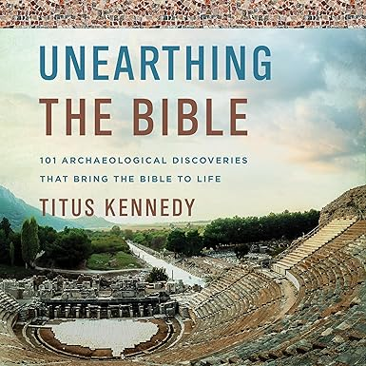
Vignette 3: David and Goliath
1 Samuel 17:4 Then a champion came out from the armies of the Philistines named Goliath, from Gath, whose height was six cubits and a span.
“… the Dead Sea Scrolls and the Septuagint, more than 1,000 years older than the Masoretic* text, state that the height of Goliath a four cubits and a span (about six feet nine.) This shorter height was still considerably taller than the average man at the time (approximately five feet five)…”
* The Masoretic text is the authoritative Hebrew and Aramaic text of the 24 books of the Hebrew Bible. Oldest copy 11th century AD

Slide 34
Vignette 3: David and Goliath
muh-NAH-muh-kee
1 Samuel 17:4 Then a champion came out from the armies of the Philistines named Goliath, from Gath, whose height was six cubits and a span.
A champion in biblical, ancient Near Eastern, and Homeric literature is a man who steps out to fight between the two battle lines. (ESV Study Bible)
“Single Combat” or monomachy (muh-NAH-muh-kee)

Slide 35
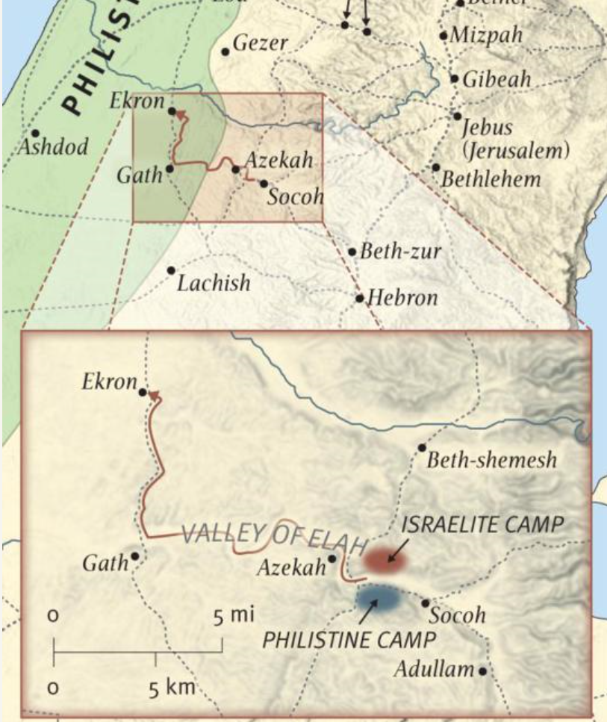
Vignette 3: David and Goliath

Slide 36
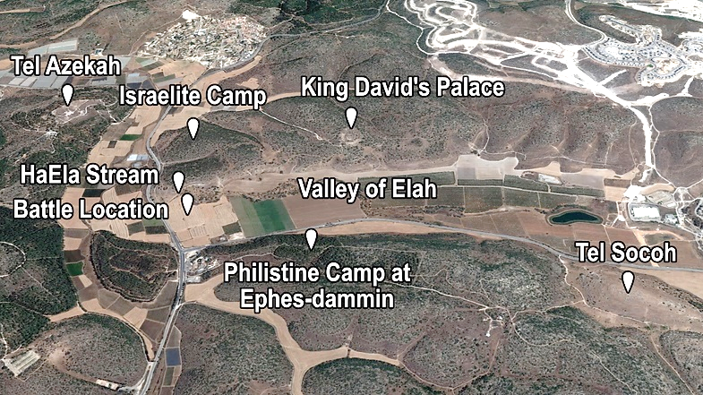

Slide 38
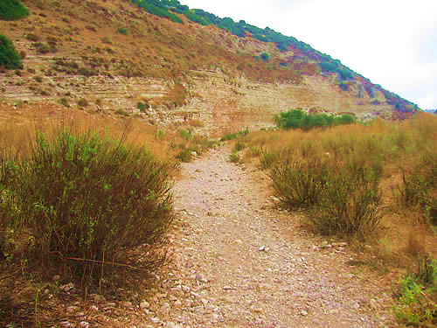

Slide 39
Sling

Slide 40
This is History, Not Mythology!
If you were making it up, would you invent a whole list of cities whose locations could be verified?
If you were making it up, would you invent a whole genealogy of names that could be verified?
Lord of the Rings

Slide 41
This is History, Not Mythology!
1 Samuel 13:19-21 “Now no blacksmith could be found in all the land of Israel, for the Philistines said, “Otherwise the Hebrews will make swords or spears.” ²⁰ So all Israel went down to the Philistines, each to sharpen his plowshare, his mattock, his axe, and his hoe. ²¹ The charge was two-thirds of a shekel (PYM ) for the plowshares, the mattocks, the forks, and the axes, and to fix the hoes.

Slide 42
This is History, Not Mythology!
“For centuries, Bible translators had no idea what they word PYM meant since it appeared no where else in the Old Testament and no ancient lexicons had translated it’s meaning. However, archaeological excavations at Gezer in the early 1900’s uncovered a stone weight inscribed in ancient Hebrew script with the word PYM and the ancient mystery was solved.”

Slide 43
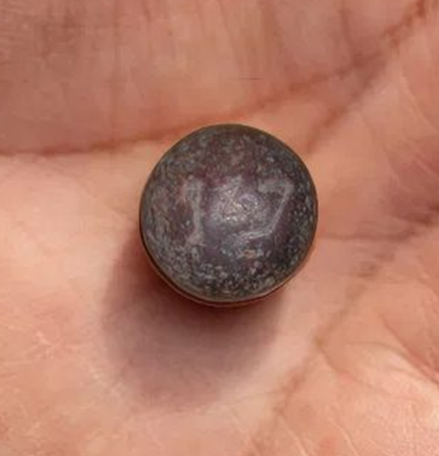
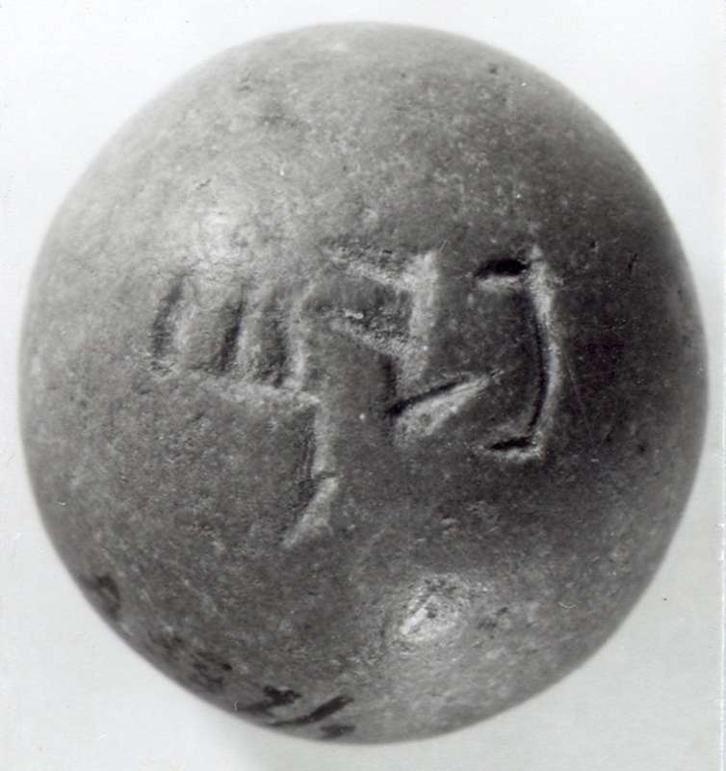
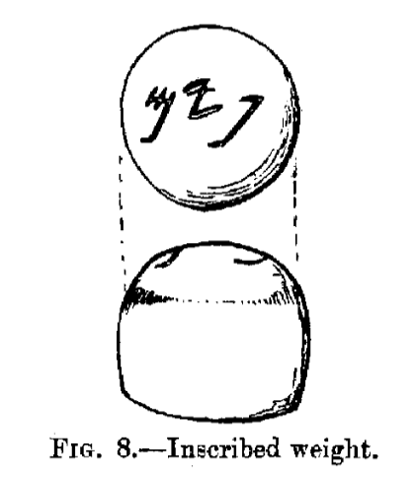
This is History, Not Mythology!
PYM

Slide 44
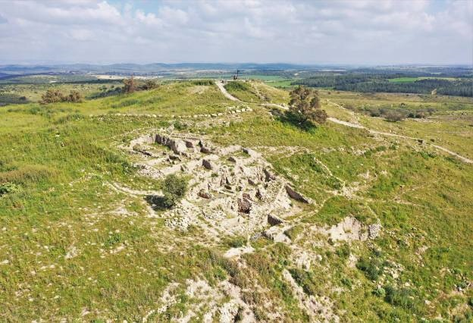
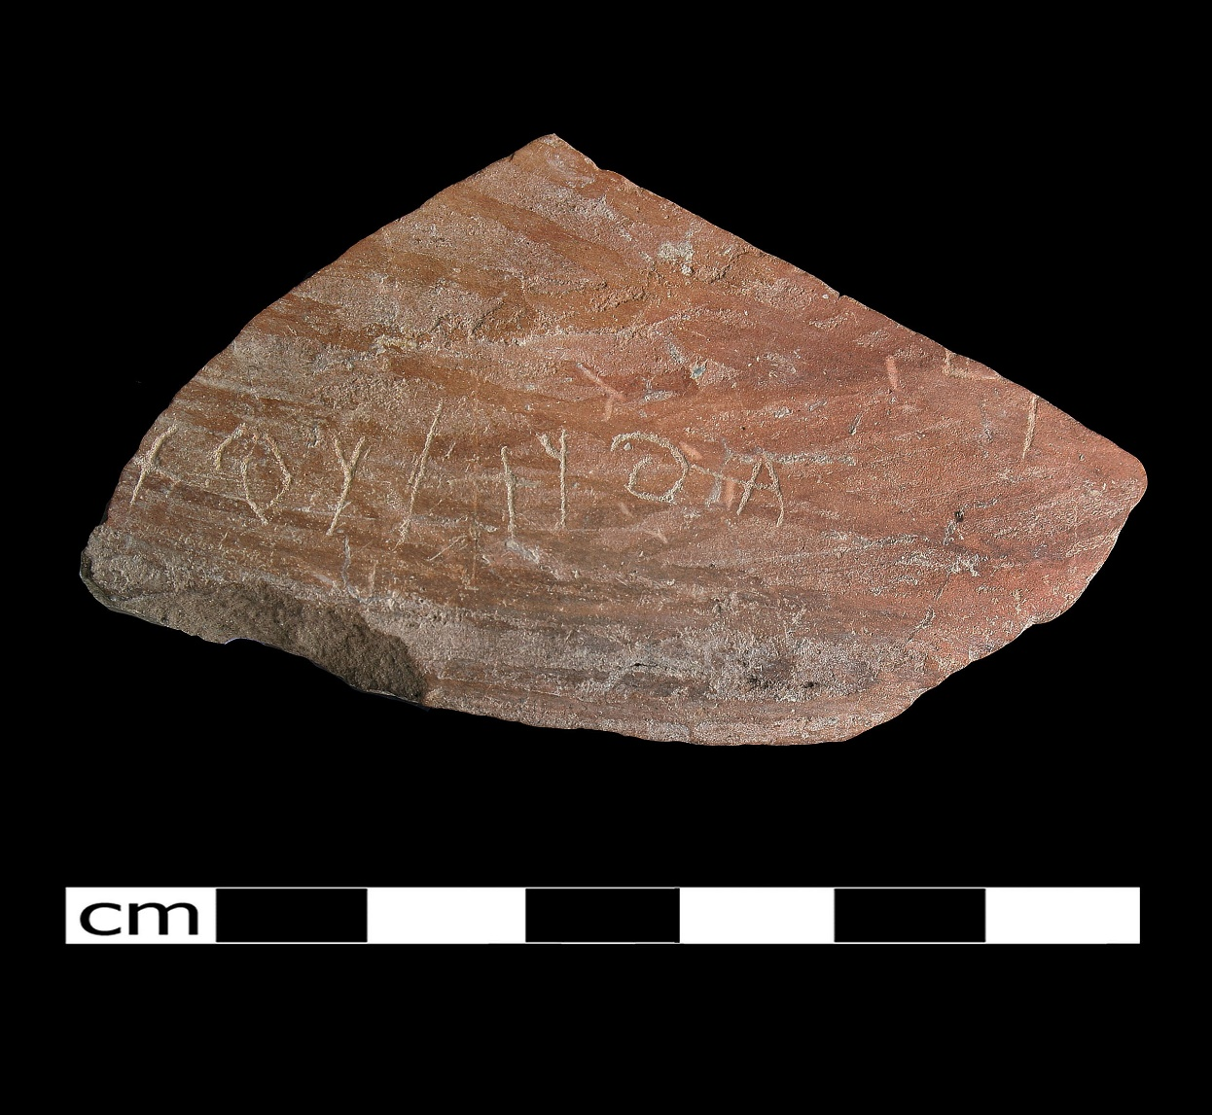
This is History, Not Mythology!
1 Samuel 17:4a Then a champion came out from the armies of the Philistines named Goliath, from Gath,
Gath Ostracon – 10th or 9th century BC

Slide 45
This is History, Not Mythology!
“Analysis indicates that the inscription represents two names or a name and a word. The first name appears to be a form of the name Goliath, although scholars differ on the exact interpretation of the letters and the translation of the text.”

Slide 46
This is History, Not Mythology!
“However, the inscription comes from the city of Goliath and his descendants not long after the wars between David and the giants of Gath and it records a Philistine or Aegean name ‘Goliath’ (or one etymologically equivalent,) demonstrating that Philistines did live in Gath and that the name ‘Goliath’ was used in that city during the time of the United Monarchy of Israel…”

Slide 47
Application 1: Read the Bible
Wendell Brane in a note to the teachers of this series, “Part of our task is to whet their appetite to read these OT books themselves, and better appreciate what they read based on what you share about the book.”
Read slowly.
Read with bible study items such as a commentary and atlas or other books.

Slide 48
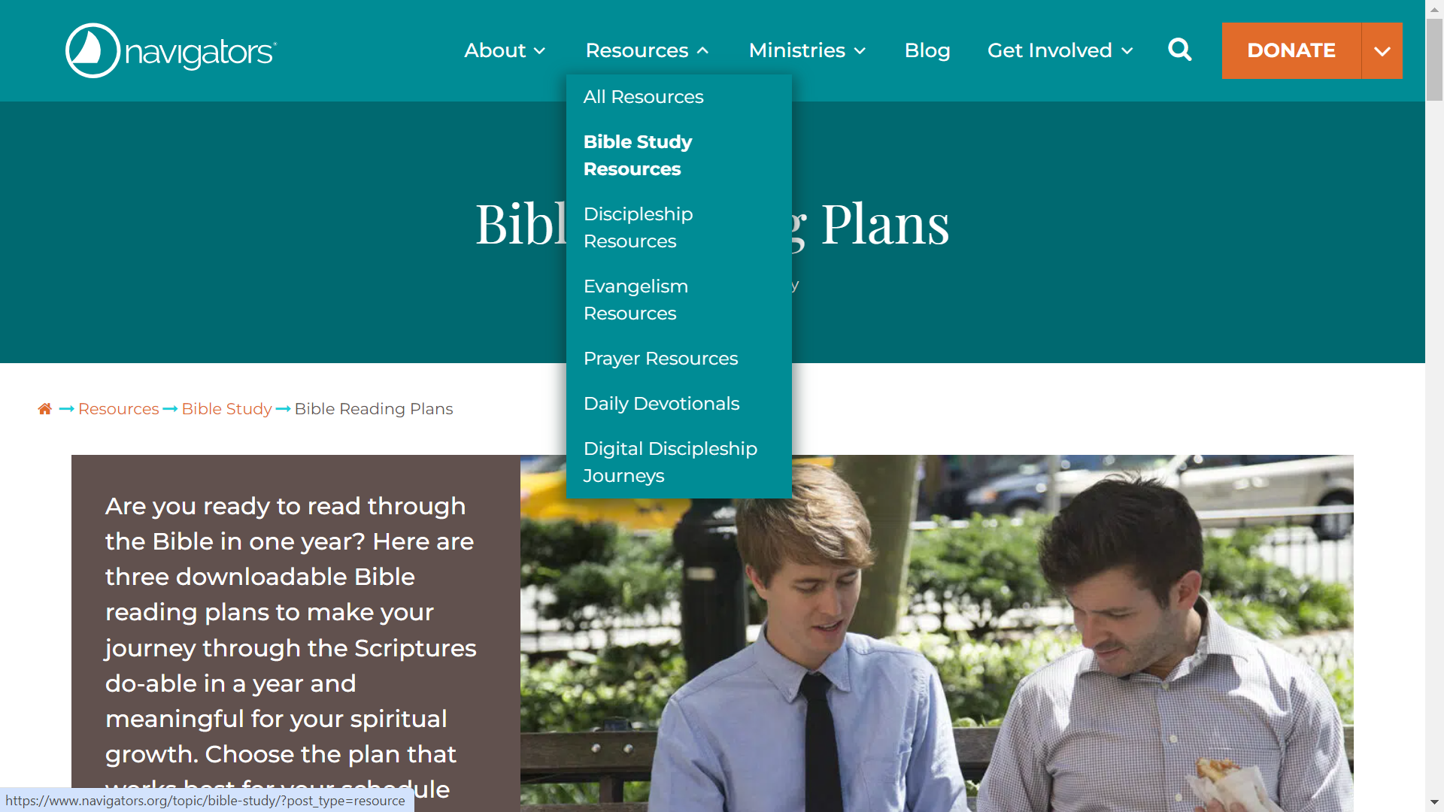
They have three plans

Slide 49
It doesn’t matter how long it takes you to complete it!

Slide 50
Holy Cow! That just happened?
John: Reading 1 Samuel

Slide 51
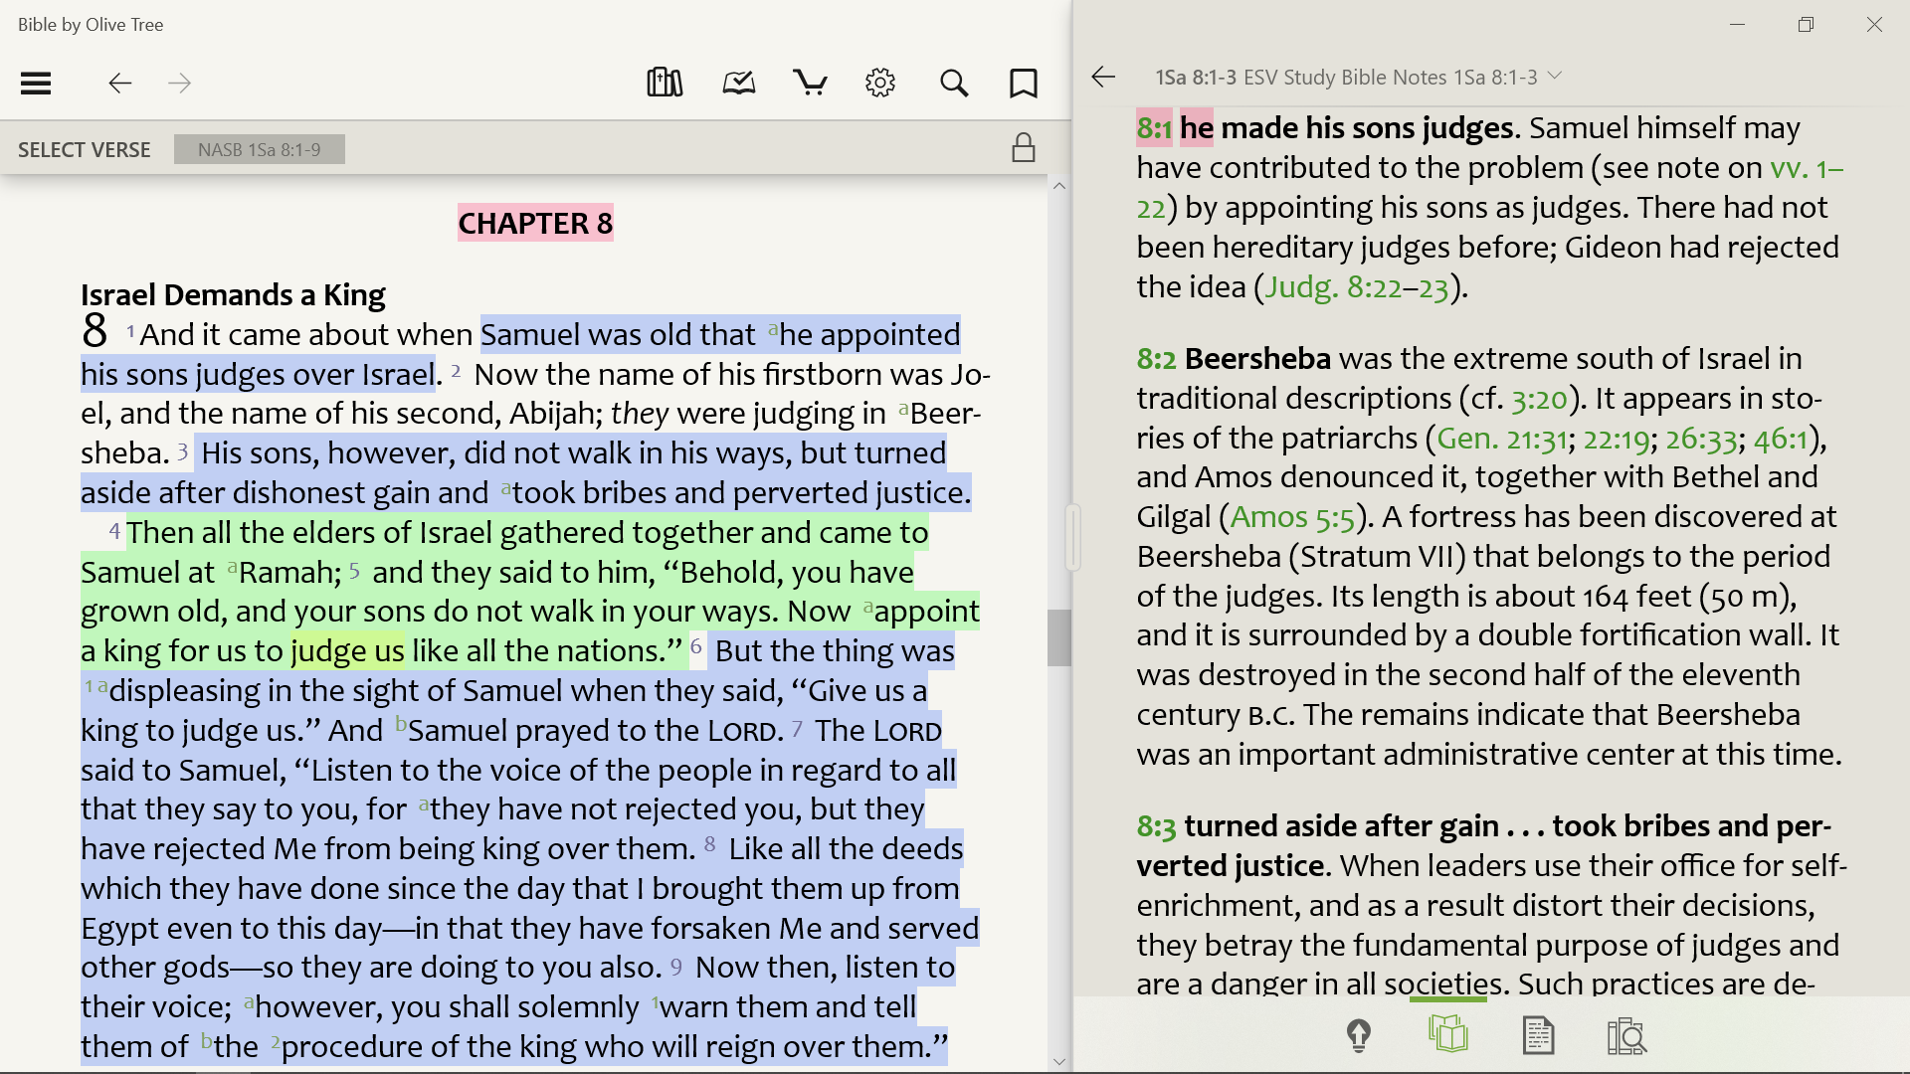
Bible by Olive Tree

Slide 52
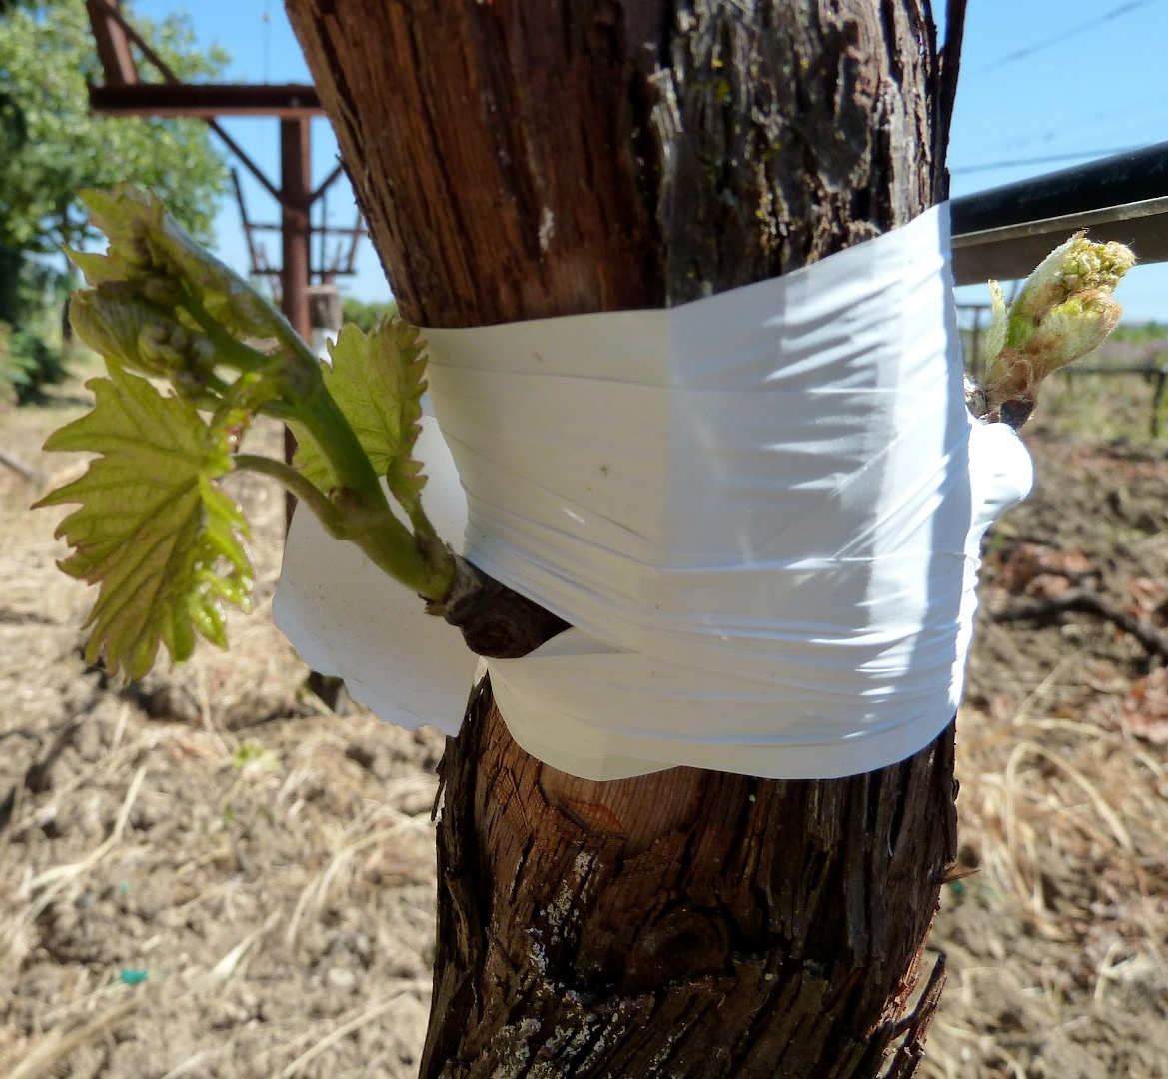
Application 2: This is Our History
Romans 11:17 But if some of the branches (Jews) were broken off, and you (Gentiles,) being a wild olive, were grafted in among them and became partaker with them of the rich root of the olive tree,

