Slide 1
Gen 11:1-9
Now the whole world had one language and a common speech. 2 As men moved eastward, they found a plain in Shinar and settled there.
3 They said to each other, "Come, let's make bricks and bake them thoroughly." They used brick instead of stone, and tar for mortar. 4 Then they said, "Come, let us build ourselves a city, with a tower that reaches to the heavens, so that we may make a name for ourselves and not be scattered over the face of the whole earth."

Slide 2
5 But the LORD came down to see the city and the tower that the men were building. 6 The LORD said, "If as one people speaking the same language they have begun to do this, then nothing they plan to do will be impossible for them. 7 Come, let us go down and confuse their language so they will not understand each other."
8 So the LORD scattered them from there over all the earth, and they stopped building the city. 9 That is why it was called Babel--because there the LORD confused the language of the whole world. From there the LORD scattered them over the face of the whole earth.

Slide 3
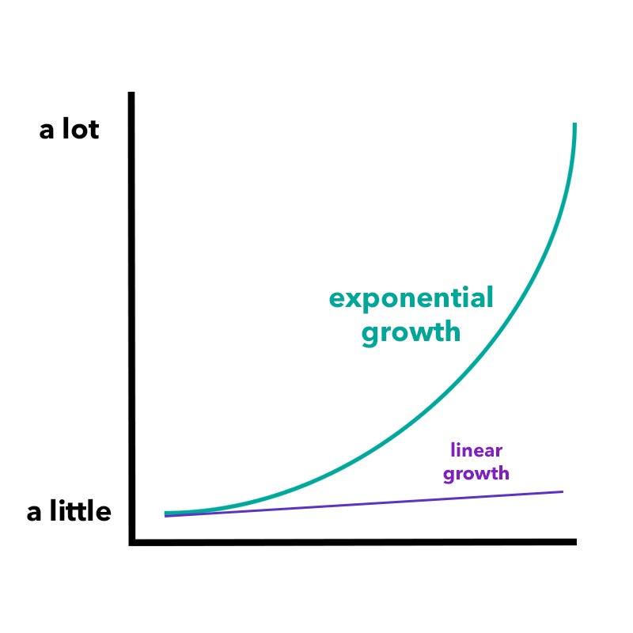

Slide 4
Artificial Intelligence
AI is the ability of a computer or robot to perform tasks commonly associated with intelligent beings, such as learning, reasoning, problem solving, and using language.

Slide 5
“There are many heated debates in Washington, many of them important, but no issues keep me awake at night like those surrounding technology and artificial intelligence. The implications artificial intelligence will have for our future are vast… It is critical that the church be proactive in understanding AI. It’s also critical that the church insist AI be used in ways consistent with the truth that all people possess dignity and worth, created as they are in the image of God.”
~Russell Moore

Slide 6
AI has the potential to positively impact various aspects of human life and society, leading to numerous improvements. Here are several ways in which AI can contribute to making lives better.

Slide 7
Healthcare Advancements:
Diagnosis and Treatment: AI can assist in medical diagnostics, offering faster and more accurate analysis of medical images and data.
Drug Discovery: AI can accelerate the drug discovery process by predicting potential drug candidates and analyzing their effectiveness.

Slide 8
2. Improved Accessibility:
• Assistive Technologies: AI can be utilized to develop assistive technologies that help individuals with disabilities, enhancing accessibility and inclusivity.

Slide 9
3. Education Enhancement:
• Personalized Learning: AI can tailor educational content to individual needs, providing personalized learning experiences for students.
• Intelligent Tutoring Systems: AI-powered tutoring systems can offer additional support to students, adapting to their pace and learning styles.

Slide 10
4. Automation and Efficiency:
• Streamlined Processes: AI automation can optimize various tasks, reducing human error and increasing efficiency in industries such as manufacturing, logistics, and administration.
• Routine Jobs: Mundane and repetitive tasks can be automated, allowing humans to focus on more creative and complex aspects of their work.

Slide 11
6. Improved Customer Experiences:
• Personalized Recommendations: AI algorithms can analyze user preferences and behavior to provide personalized recommendations in areas like entertainment, shopping, and content consumption.
• Natural Language Processing: AI-driven chatbots and virtual assistants enhance customer service by understanding and responding to natural language queries.

Slide 12
7. Enhanced Safety and Security:
• Predictive Policing: AI can help predict and prevent crimes by analyzing patterns and trends in large datasets.
• Cybersecurity: AI-powered tools can enhance cybersecurity by identifying and mitigating potential threats in real-time.

Slide 13
7. Enhanced Safety and Security:
• Predictive Policing: AI can help predict and prevent crimes by analyzing patterns and trends in large datasets.
• Cybersecurity: AI-powered tools can enhance cybersecurity by identifying and mitigating potential threats in real-time.

Slide 14
8. Research and Development:
• Scientific Discovery: AI can accelerate research by processing vast amounts of data and identifying patterns, contributing to advancements in various scientific fields.

Slide 15
9. Social Services:
• Poverty Alleviation: AI can assist in addressing societal issues, such as poverty, by optimizing resource allocation and aiding in policy decision-making.

Slide 16
10. Innovations in Entertainment:
• Content Creation: AI technologies can contribute to creative fields, generating art, music, and other content, leading to new forms of entertainment.

Slide 17
Biblical Principles Guiding How We
Think About and Use AI
We were designed to work

Slide 18
2 Thess 3:6-15
In the name of the Lord Jesus Christ, we command you, brothers, to keep away from every brother who is idle and does not live according to the teaching you received from us. 7 For you yourselves know how you ought to follow our example. We were not idle when we were with you, 8 nor did we eat anyone's food without paying for it. On the contrary, we worked night and day, laboring and toiling so that we would not be a burden to any of you. 9 We did this, not because we do not have the right to such help, but in order to make ourselves a model for you to follow. 10 For even when we were with you, we gave you this rule: "If a man will not work, he shall not eat."

Slide 19
11 We hear that some among you are idle. They are not busy; they are busybodies. 12 Such people we command and urge in the Lord Jesus Christ to settle down and earn the bread they eat. 13 And as for you, brothers, never tire of doing what is right.
14 If anyone does not obey our instruction in this letter, take special note of him. Do not associate with him, in order that he may feel ashamed. 15 Yet do not regard him as an enemy, but warn him as a brother.

Slide 20
Generative AI
Generative artificial intelligence is artificial intelligence capable of generating text, images or other data using generative models, often in response to prompts.

Slide 22
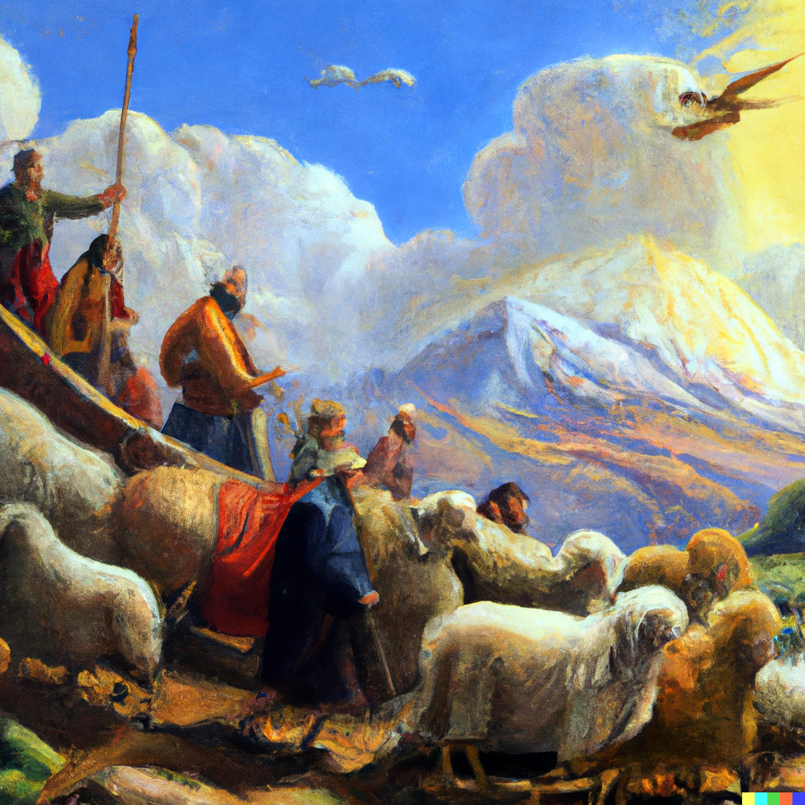
Command: Create an oil painting of Noah and his family and the animals coming off the Ark on Mt. Ararat on a sunny day.
Time: Approx. 5 seconds

Slide 23
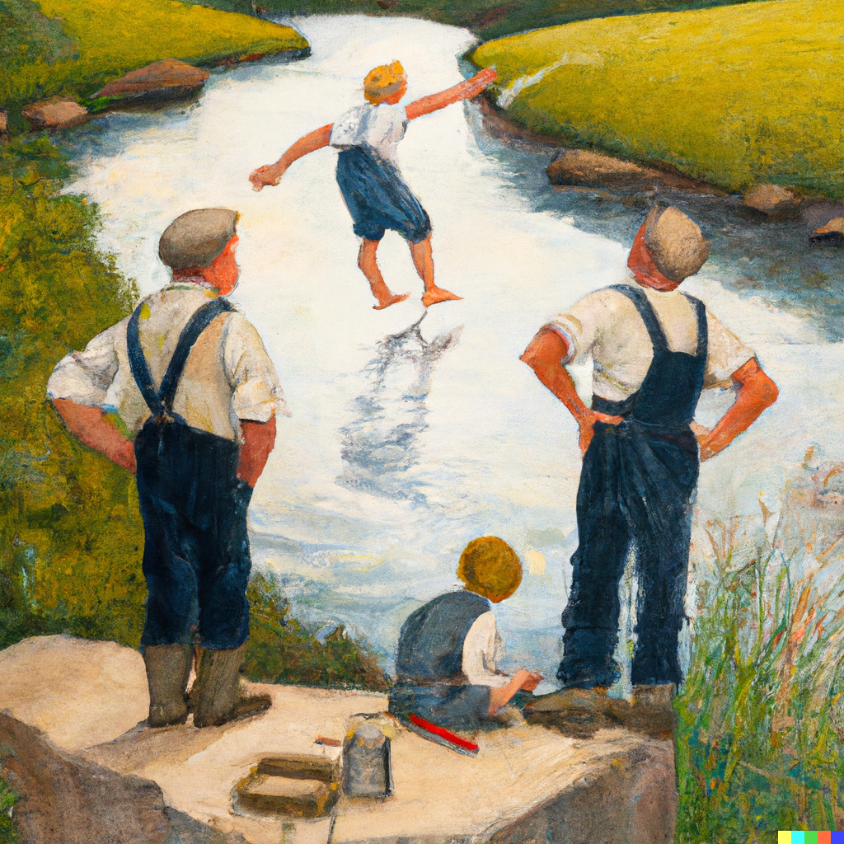
Command: Create a painting similar to a Norman Rockwell work with boys playing in the river with a frustrated father in overalls watching.
Time: Approx. 7 seconds

Slide 27
Biblical Principles Guiding How We
Think About and Use AI
We were designed to work
We were designed to be creative

Slide 28
Command:
Write me a 30-minute sermon on what Christians should think about AI and how they should use it in a biblical way.
ChatGPT:
Title: "Navigating the Future: A Christian Perspective on AI"
Introduction (5 minutes): Good morning/afternoon, brothers and sisters in Christ. Today, we embark on a journey of exploration and reflection as we delve into the realm of artificial intelligence, seeking to understand what it means for us as Christians. As we navigate this rapidly evolving technological landscape, let us anchor ourselves in the timeless wisdom of God's Word…

Slide 29
Biblical Principles Guiding How We
Think About and Use AI
We were designed to work
We were designed to be creative
We were designed to think

Slide 30
Biblical Principles Guiding How We
Think About and Use AI
We were designed to work
We were designed to be creative
We were designed to think
We were designed to have dominion, to be in charge and to steward God’s creation

Slide 31
Biblical Principles Guiding How We
Think About and Use AI
We were designed to work
We were designed to be creative
We were designed to think
We were designed to have dominion, to be in charge and to steward God’s creation
We were designed for this world

Slide 34
Biblical Principles Guiding How We
Think About and Use AI
We were designed to work
We were designed to be creative
We were designed to think
We were designed to have dominion, to be in charge and to steward God’s creation
We were designed for this world
We were designed for relationships

Slide 35
Biblical Principles Guiding How We
Think About and Use AI
We were designed to work
We were designed to be creative
We were designed to think
We were designed to have dominion, to be in charge and to steward God’s creation
We were designed for this world
We were designed for relationships
We were designed as responsible moral agents

Slide 38
“Does Homosexual Activity Shorten Life?”
(Study published in the National Library of Medicine, NIH)
______________________________________________________
“Four lines of evidence were consistent with previous findings suggesting that homosexual activity may be associated with a lifespan shortened by 20 to 30 years.”

Slide 41
Biblical Principles Guiding How We
Think About and Use AI
We were designed to work
We were designed to be creative
We were designed to think
We were designed to have dominion, to be in charge and to steward God’s creation
We were designed for this world
We were designed for relationships
We were designed as responsible moral agents
We were designed to know our place, to recognize our dependence on God, and to place our hope and trust in Him

