Slide 1
2 Samuel

Slide 3
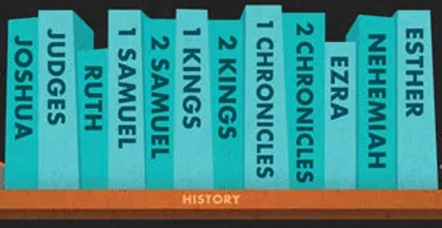

Slide 5
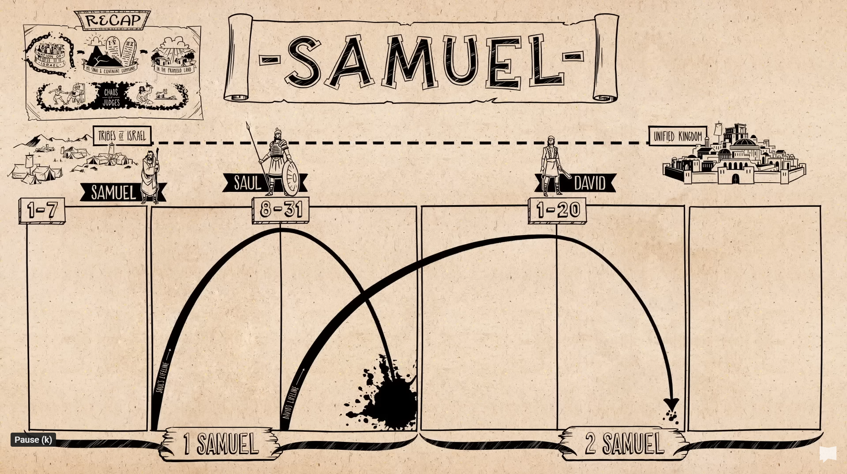
Title
Text

Slide 6
Title
Text

Slide 7
David’s lament over Jonathan
I Samuel 1:25-26 – “How the mighty have fallen in battle! Jonathan lies slain on your heights. I grieve for you, Jonathan my brother; you were very dear to me. Your love for me was wonderful, more wonderful than that of women.”

Slide 8
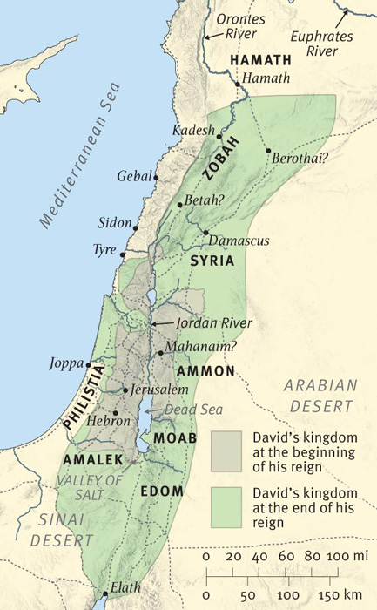
David’s kingdom at the start vs. end of his reign

Slide 9
God’s promise to David
1 Samuel 11-16: “‘The Lord declares to you that the Lord himself will establish a house for you: ¹² When your days are over and you rest with your ancestors, I will raise up your offspring to succeed you, your own flesh and blood, and I will establish his kingdom. ¹³ He is the one who will build a house for my Name, and I will establish the throne of his kingdom forever.

Slide 10
God’s promise to David
¹⁴ I will be his father, and he will be my son. When he does wrong, I will punish him with a rod wielded by men, with floggings inflicted by human hands. ¹⁵ But my love will never be taken away from him, as I took it away from Saul, whom I removed from before you. ¹⁶ Your house and your kingdom will endure forever before me; your throne will be established forever.’”

Slide 11
2 Samuel 21-24 Structure
- Saul’s failure to honor the Gibeonite treaty - David’s reliance upon others in battle - David’s poems of thanksgiving - David’s reliance upon others in battle - David’s failure regarding the census

Slide 12
