Slide 1
Kings

Slide 2
The Covenant Pattern in Kings: Five Critical Turning Points
Introduction

Slide 3
Theme: 1 Kings 9:1-9
When Solomon had finished building the temple of the LORD and the royal palace, and had achieved all he had desired to do, the LORD appeared to him a second time, as he had appeared to him at Gibeon. The LORD said to him: “I have heard the prayer and plea you have made before me; I have consecrated this temple, which you have built, by putting my Name there forever. My eyes and my heart will always be there.
“As for you, if you walk before me faithfully with integrity of heart and uprightness, as David your father did, and do all I command and observe my decrees and laws, I will establish your royal throne over Israel forever, as I promised David your father when I said, ‘You shall never fail to have a successor on the throne of Israel.’

Slide 4
Theme: 1 Kings 9:1-9
But if you or your descendants turn away from me and do not observe the commands and decrees I have given you and go off to serve other gods and worship them, then I will cut off Israel from the land I have given them and will reject this temple I have consecrated for my Name. Israel will then become a byword and an object of ridicule among all peoples. This temple will become a heap of rubble. All who pass by will be appalled and will scoff and say, ‘Why has the LORD done such a thing to this land and to this temple?’ People will answer, ‘Because they have forsaken the LORD their God, who brought their ancestors out of Egypt, and have embraced other gods, worshiping and serving them—that is why the LORD brought all this disaster on them.’ ”

Slide 5
1. Solomon – Wisdom Misused
The Reign of Solomon (Chapters 1-11)
David’s Final Days and Solomon’s Rise to Power (1:1 – 2:46)
Solomon’s Wisdom and Wealth (3:1 – 4:34)
The Building of the Temple and Palace (5:1 – 8:66)
Solomon’s Achievements and Decline (9:1 – 11:43)

Slide 6
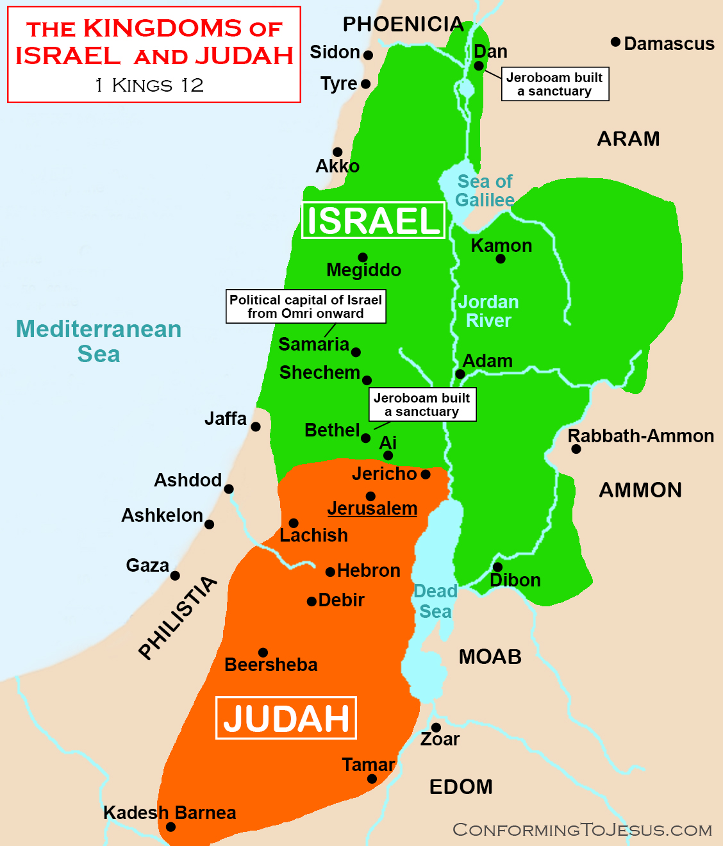
1. Solomon – Wisdom Misused
The Golden Age
First Signs of Trouble
The High Cost of Compromise
A Kingdom Divided

Slide 7
2. Elijah/Elisha Confront Omri Dynasty
Enter the Prophets
Confronting Baal
Fire from Heaven
Oil for the poor
A Faithful Remnant

Slide 8
3. Menahem Becomes Assyria’s Vassal
The Price of Protection
Silver for Security
Trust Misplaced
Independence Lost

Slide 9
4. Ahaz Becomes Assyria’s Vassal
A Kingdom Under Pressure
The Fatal Choice
Temple Desecrated
Point of No Return

Slide 10
5. Hezekiah shows Judah’s Treasures to Babylonians
Reform and Recovery
The Babylonian Visitors
A Future Revealed
Pride Before the Fall

Slide 11
The Pattern Fulfilled
From Solomon to Exile
Warning → Choice → Consequence
The Cost of Covenant Breaking
Lessons for Leadership

Slide 12
Contemporary Relevance
Trust and Power
Faithfulness Under Pressure
The Price of Compromise
Leadership's Legacy

Slide 13
Kings

