Slide 3
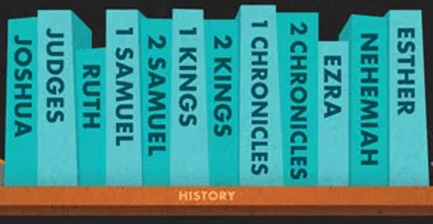
Purposeful stories retelling historical events

Slide 4
Why does the Bible have 2 separate accounts of the same period?

Slide 5
Purpose

Slide 6
Context
• Who was Chronicles written for?
• Who wrote it?
• How are the Chronicles structured?

Slide 7
Theology

Slide 8
1 Chronicles 21:1-4
¹Satan rose up against Israel and caused David to take a census of the people of Israel.
² So David said to Joab and the commanders of the army, “Take a census of all the people of Israel—from Beersheba in the south to Dan in the north—and bring me a report so I may know how many there are.”
³ But Joab replied, “May the Lord increase the number of his people a hundred times over! But why, my lord the king, do you want to do this? Are they not all your servants? Why must you cause Israel to sin?”
⁴ But the king insisted that they take the census, so Joab traveled throughout all Israel to count the people.

Slide 9
1 Chronicles 21:1 Satan rose up against Israel and caused David to take a census of the people of Israel.
2 Samuel 24:1 Once again, the anger of the Lord burned against Israel, and he caused David to harm them by taking a census.

Slide 10
New English Translation
1 Chronicles 21:1 An adversary opposed Israel, inciting David to count how many warriors Israel had.
2 Samuel 24:1 The Lord’s anger again raged against Israel, and he incited David against them, saying, “Go count Israel and Judah.”

Slide 11
2 Chronicles 7:14 If my people, who are called by my name, will humble themselves and pray and seek my face and turn from their wicked ways, then I will hear from heaven, and I will forgive their sin and will heal their land.

