Slide 1
1 and 2 Kings

Slide 2
Objective of this Series
Familiarize ourselves with Old Testament History My Task:
Provide an overview of 1 and 2 Kings
Know what they are about
Know how to read and what to look for
Get you motivated/interested to read

Slide 3
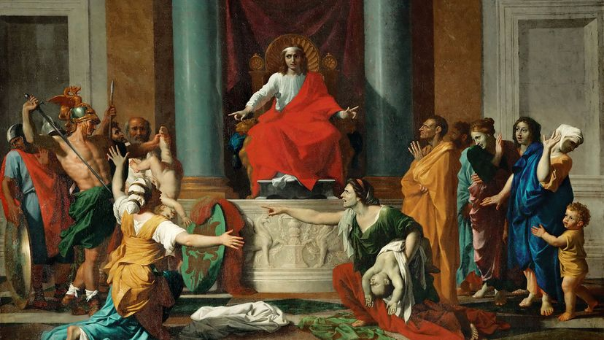
Solomon’s Wise Ruling

Slide 4
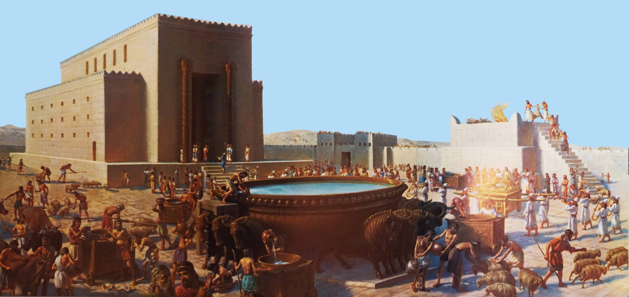
Solomon Builds the Temple

Slide 5
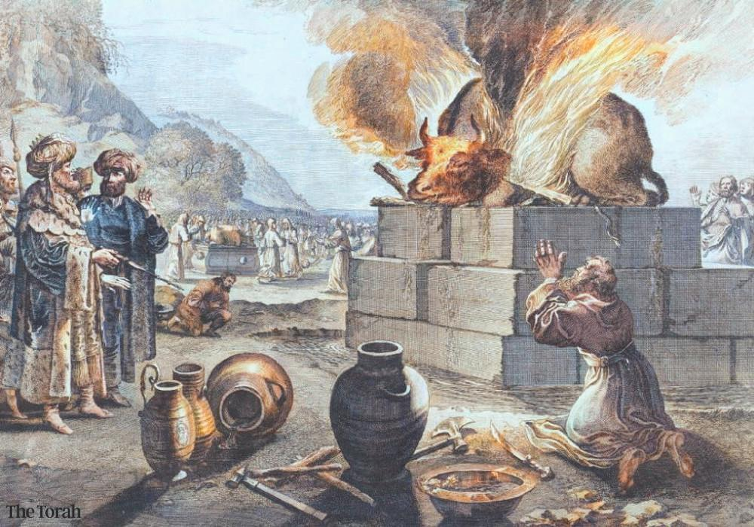
Elijah vs. the Prophets of Baal

Slide 6
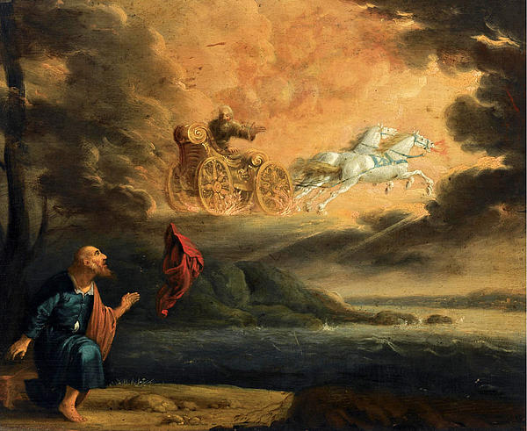
Elijah Taken Up Into Heaven

Slide 7
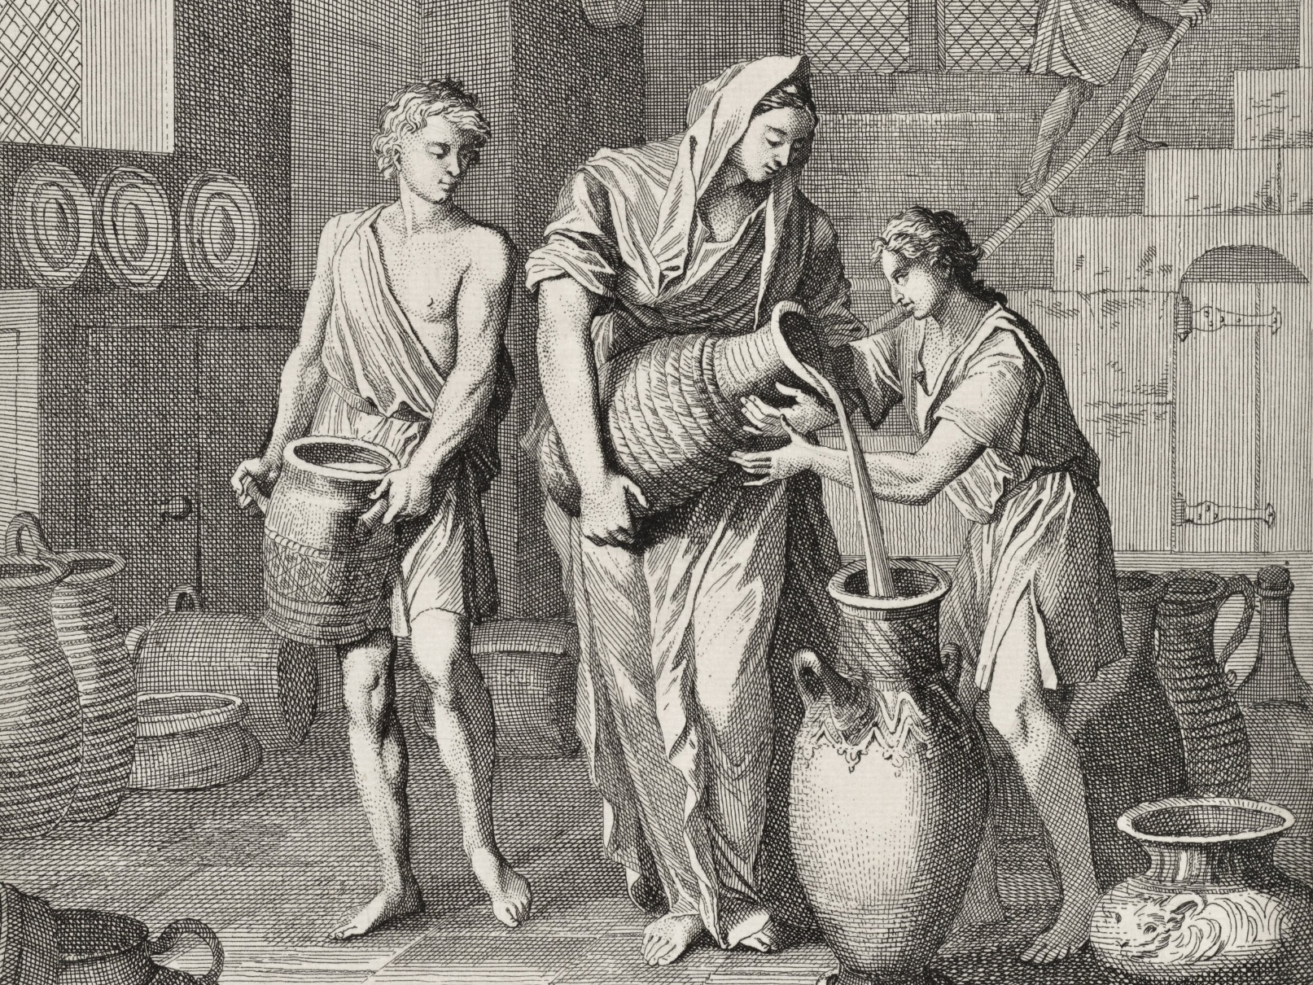
Elisha and the Widow’s Oil

Slide 8
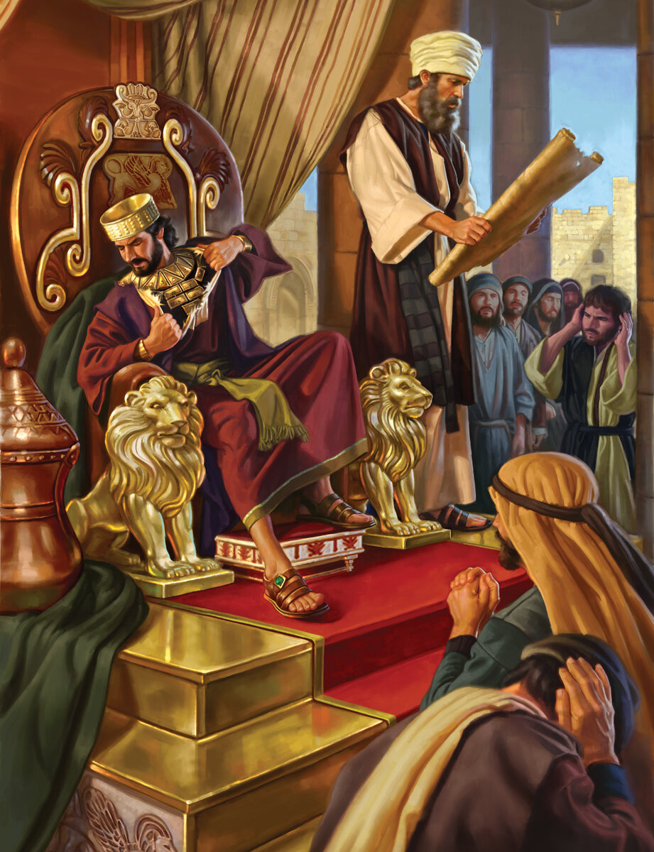
King Josiah Finds the Book of the Law

Slide 10
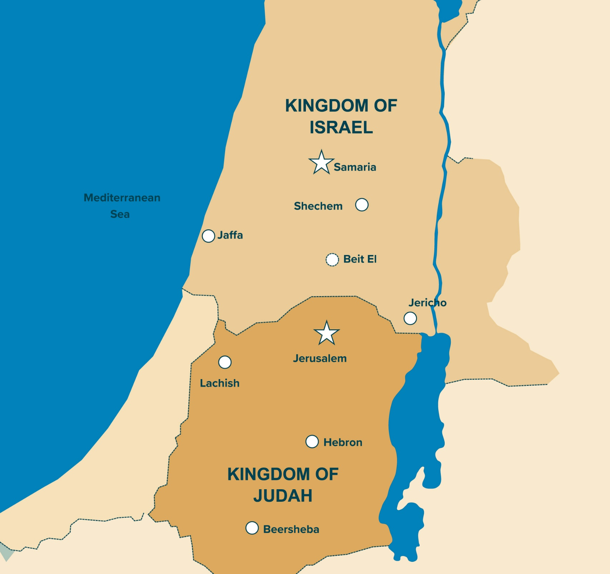

Slide 11
Overview of 1 and 2 Kings
Title, Author, Sources and Dates
Purpose
Chronology
Themes & Theology
Outline
Takeaways

Slide 12
Title of the Books
Greek Septuagint:
1 and 2 Samuel = “First and Second Reigns”
1 and 2 Kings = “Third and Fourth Reigns”
Latin Vulgate:
1 and 2 Samuel = “First and Second Kings”
1 and 2 Kings = “Third and Fourth Kings”

Slide 13
The Tanakh (Hebrew Bible)
TA TORAH (LAW) |  | NA NEVI’IM (PROPHETS) |  | KH KETUVIM (WRITINGS)
Genesis |  | Joshua |  | Psalms
Exodus | Former Prophets | Judges |  | Job
Leviticus |  | 1 & 2 Samuel | Pre-Exilic Writings | Proverbs
Numbers |  | 1 & 2 Kings |  | Ruth
Deuteronomy |  | Isaiah |  | Song of Songs
 | Latter Prophets | Jeremiah |  | Ecclesiastes
 |  | Ezekiel |  | Lamentations
 |  | The Twelve | Post-Exilic Writings | Esther
 |  |  |  | Daniel
 |  |  |  | Ezra-Nehemiah
 |  |  |  | 1 & 2 Chronicles

Slide 14
Named Sources
Book of the Annals of Solomon “As for the other events of Solomon’s reign—all he did and the wisdom he displayed—are they not written in the book of the annals of Solomon?” 1 Kings 11:41 (NIV)
Book of the Annals (or Daily Deeds) of the Kings of Israel
“As for the other events of [king’s name]’s reign, and all he did, are they not written in the book of the annals of the kings of Israel?”
Book of the Annals (or Daily Deeds) of the Kings of Judah
“As for the other events of [king’s name]’s reign, and all he did, are they not written in the book of the annals of the kings of Judah?”

Slide 15
Deuteronomic History
The theory that Joshua, Judges, Samuel and Kings were written/compiled as one long history.
Deuteronomy 17:18-20
18 When he takes the throne of his kingdom, he is to write for himself on a scroll a copy of this law, taken from that of the Levitical priests. 19 It is to be with him, and he is to read it all the days of his life so that he may learn to revere the Lord his God and follow carefully all the words of this law and these decrees 20 and not consider himself better than his fellow Israelites and turn from the law to the right or to the left. Then he and his descendants will reign a long time over his kingdom in Israel.

Slide 16
Timeline – Major Dates
971, 931 B.C.
722 B.C.
586 B.C.
Reign of Solomon, Israel Divided
Fall of Israel
Fall of Judah

Slide 17
Chronology - Patterns
Accession Notice (Israel): In the Xth year of PN [personal name], king of Judah, PN son of PN began to reign over all of Israel at Tirzah/Samaria and reigned for X years. He did what was evil in the Lord’s eyes.
Accession Notice (Judah): PN son of PN [his father, the king] began to reign over Judah in the Xth year of PN king of Israel. PN was X years old when he began to reign, and he reigned X years in Jerusalem. His mother’s name was PN daughter of PN. And PN did what was good/evil in the Lord’s eyes.

Slide 18
Chronology - Patterns
Death Notice (Israel): Now the rest of the deeds of PN, and all that he did, are they not written in the Book of the Annals of the Kings of Israel? And PN slept with his fathers and was buried at Tirzah/Samaria, and PN (his son) reigned in his place.
Death Notice (Judah): Now the rest of the deeds of PN, and all that he did, are they not written in the Book of the Annals of the Kings of Judah? PN slept with his fathers and was buried with his fathers in the city of David his father; and PN his son reigned in his place.

Slide 27
Chronology - Problems
Factors that help explain:
Coregencies – periods during which two kings ruled with overlapping dates.
When did a king begin counting the years of his reign?
Judah and Israel began their calendar years at different times.

Slide 28
Themes & Theology
God’s Faithfulness to the Davidic Covenant
Covenant Unfaithfulness and Consequences
The Role of Prophecy

Slide 29
Outline
1 Kings
The Reign of Solomon (Chapters 1-11)
The Division of the Kingdom (Chapters 12-16)
The Ministry of Elijah (Chapters 17-22)
2 Kings
The Ministries of Elijah and Elisha (Chapters 1-13)
The Decline of Israel and Judah (Chapters 11-17)
The Last Days of Judah (Chapters 18-25)

Slide 30
1 Kings
The Reign of Solomon (Chapters 1-11)
David’s Final Days and Solomon’s Rise to Power (1:1 – 2:46)
Solomon’s Wisdom and Wealth (3:1 – 4:34)
The Building of the Temple and Palace (5:1 – 8:66)
Solomon’s Achievements and Decline (9:1 – 11:43)

Slide 31
1 Kings
The Division of the Kingdom (Chapters 12-16)
Rehoboam and Jeroboam (12:1 – 14:20)
The Kings of Judah and Israel (14:21 – 16:34)
The Ministry of Elijah (Chapters 17-22)
Elijah’s Confrontations with Ahab (17:1 – 19:21)
Ahab’s Wars and Further Wickedness (20:1 – 21:29)
Ahab’s Death and Jehoshaphat’s Reign (22:1 – 53)

Slide 32
2 Kings
The Ministries of Elijah and Elisha (Chapters 1-13)
Elijah’s Final Acts and Elisha’s Inheritance (1:1 – 2:25)
Elisha’s Miracles and Prophetic Work (3:1 – 8:15)
Judgment on Israel’s House (8:16 – 10:36)

Slide 33
2 Kings
The Decline of Israel and Judah (Chapters 11-17)
The Reign of Joash and Repairs to the Temple (11:1 – 12:21)
The Decline and Fall of the Northern Kingdom (13:1 – 17:41)
The Last Days of Judah (Chapters 18-25)
Hezekiah’s Reforms and Deliverance (18:1 – 20:21)
Manasseh and the Downward Spiral of Judah (21:1 – 23:30)
The Fall of Jerusalem (24:1 – 25:30)

Slide 34
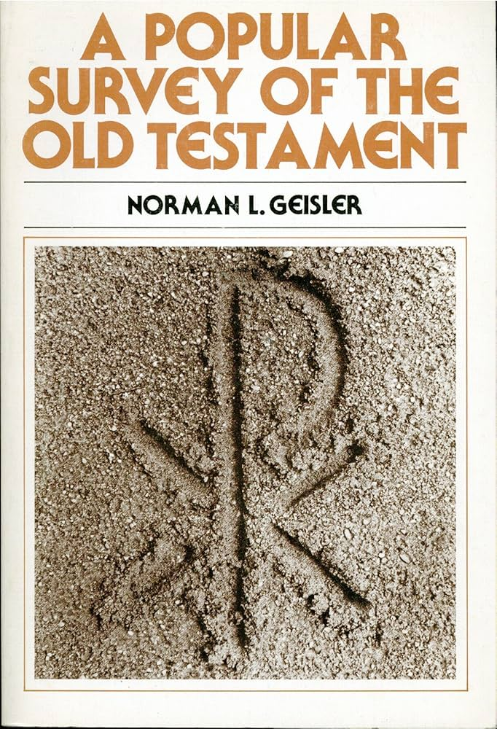
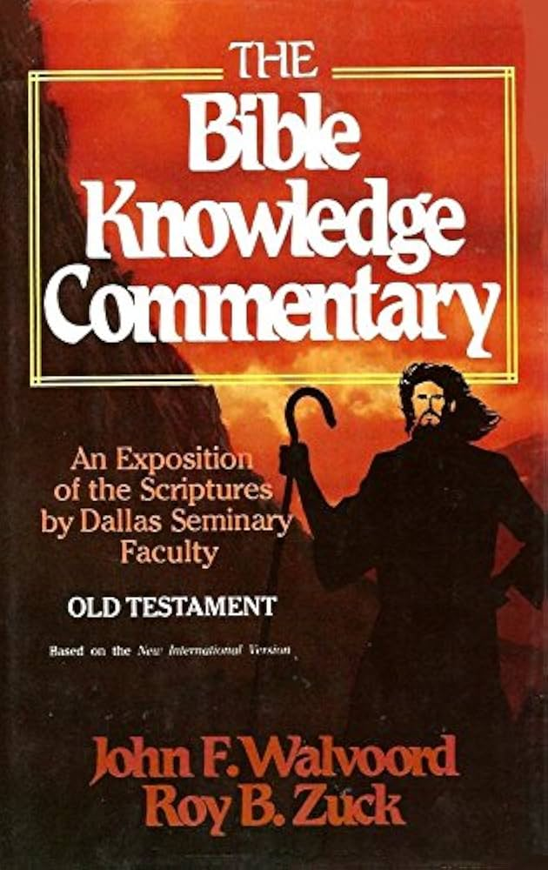
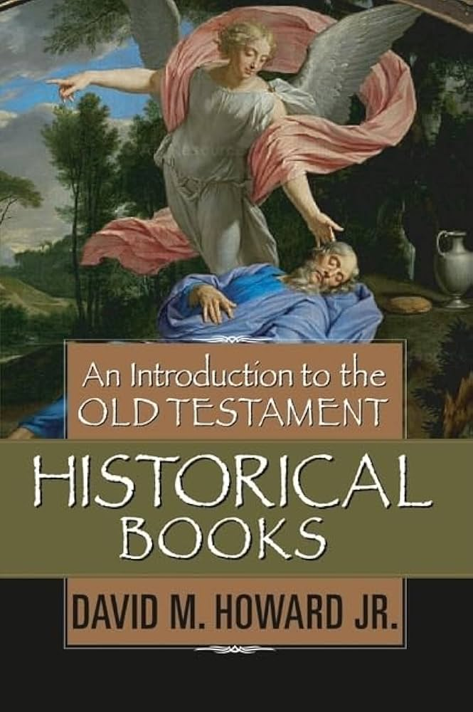
Resources Used
An Introduction to the Old Testament Historical Books
- David M. Howard Jr.
A Popular Survey of the Old Testament
- Norman L. Geisler
The Bible Knowledge Commentary – Old Testament
- Walvoord and Zuck, Thomas Constable
How to Read the Bible Book by Book
- Fee and Stuart
NIV Biblical Theology Study Bible – Introduction to 1 Kings
- D.A. Carson
The Bible Project
Bible Gateway
The Gospel Coalition – Introduction to 1 & 2 Kings
The Gospel Coalition – Knowing the Bible: 1 & 2 Kings
ESV Global Study Bible – Introduction to 1 & 2 Kings

Slide 35
