Slide 1
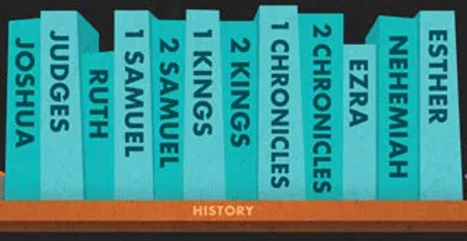
Purposeful stories retelling historical events

Slide 2
Supplement

Slide 3
Tanakh
Dead Sea Scrolls
Septuagint
Masoretic Text

Slide 4
Tanakh
Dead Sea Scrolls
Septuagint
Masoretic Text

Slide 5
TANAKH
T = Torah (Law)
N = Nevi’im (Prophets)
KH = Ketuvim (Writings)

Slide 6
Tanakh
Dead Sea Scrolls (DDS)
Septuagint
Masoretic Text

Slide 7
Tanakh
Dead Sea Scrolls (DDS) – Qumran Community
Septuagint
Masoretic Text

Slide 8
Tanakh
Dead Sea Scrolls
Septuagint (LXX)
Masoretic Text

Slide 9
Tanakh
Dead Sea Scrolls
Septuagint
Masoretic Text (MT)

Slide 10
Every client, every contract, every job
We're with you

Slide 12
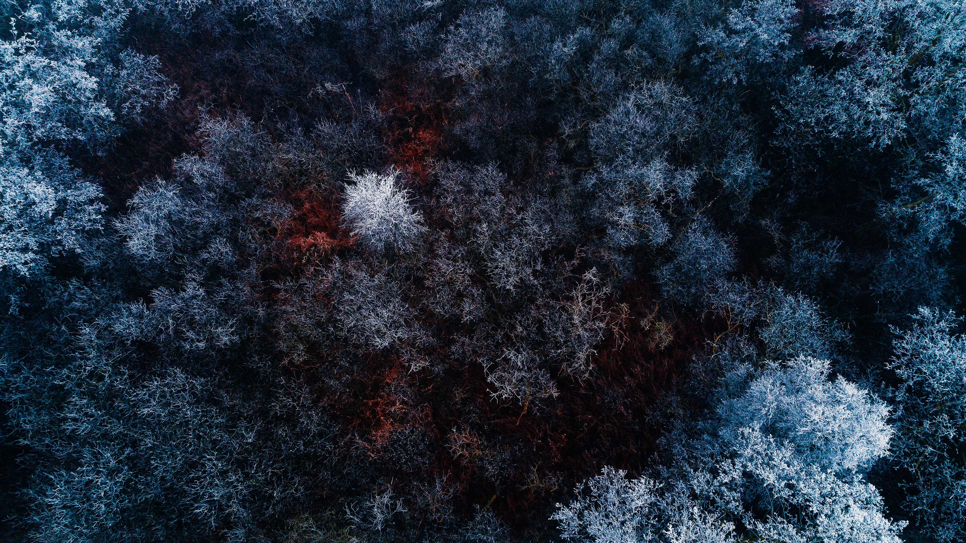
Hark the Herald Angels Sing

Slide 13
Hark! The herald angels sing
“Glory to the newborn King
Peace on earth, and mercy mild
God and sinners reconciled!”

Slide 14
Joyful, all ye nations rise
Join the triumph of the skies
With th’angelic host proclaim
“Christ is born in Bethlehem!”
With th’angelic host proclaim
“Christ is born in Bethlehem!”

Slide 15
Christ, by highest heav’n adored
Christ the everlasting Lord
Late in time, behold Him come
Offspring of a virgin’s womb

Slide 16
Veiled in flesh the Godhead see
Hail th’ incarnate Deity
Pleased as man with men to dwell
Jesus our Emmanuel
Pleased as man with men to dwell
Jesus our Emmanuel

Slide 17
Hail the heavenly Prince of Peace!
Hail the Sun of Righteousness!
Light and life to all He brings
Ris’n with healing in His wings

Slide 18
Mild He lays His glory by
Born that man no more may die
Born to raise the sons of earth
Born to give them second birth
Born to raise the sons of earth
Born to give them second birth

Slide 19
Come, Desire of Nations, come
Fix in us Thy humble home
Rise, the woman’s conquering Seed
Bruise in us the serpent’s head

Slide 20
Adam’s likeness, now efface
Stamp Thine image in its place
Second Adam from above
Reinstate us in Thy love
Second Adam from above
Reinstate us in Thy love

